Slide 1
Fermions in
Two Dimensions:
From Few to Many

Slide 2
Fermions in
Two Dimensions:
From Many to Few

Slide 3
Fermions in
Two Dimensions:
From Many to Few to Many to Few to Many to Few…

Slide 4
Fermions in
Two Dimensions:
From Many to Few to Many to Few to Many to Few…

Slide 5
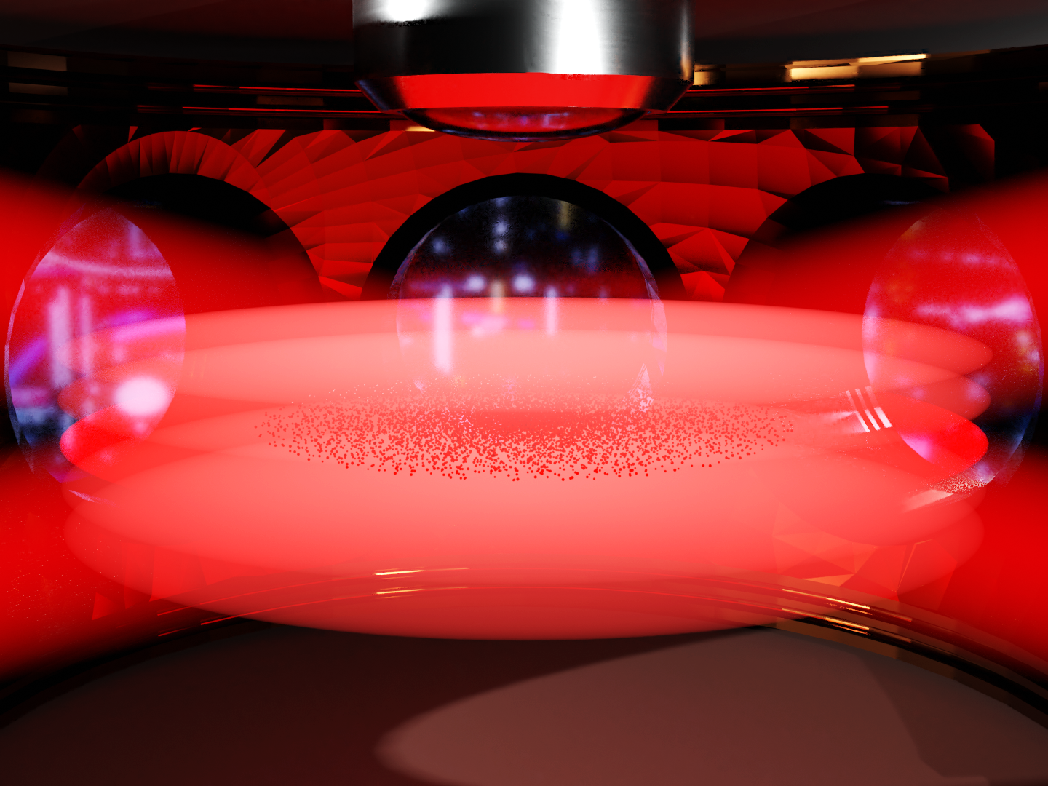
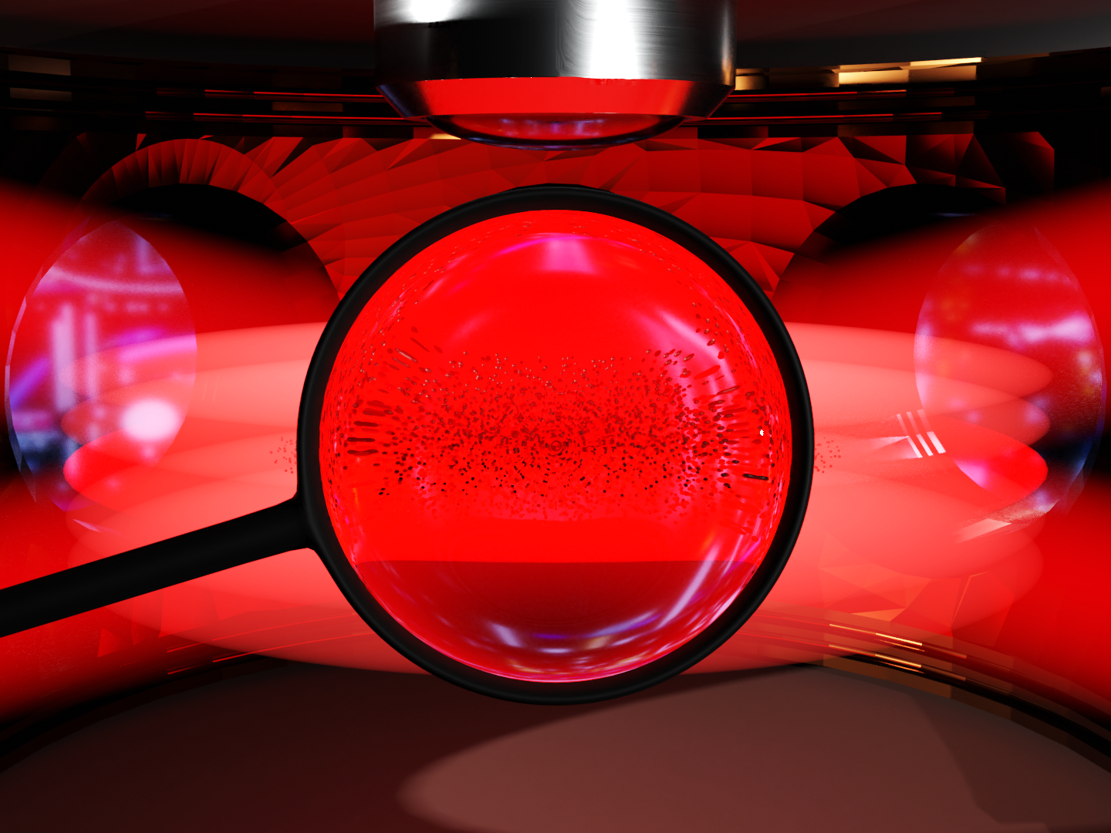
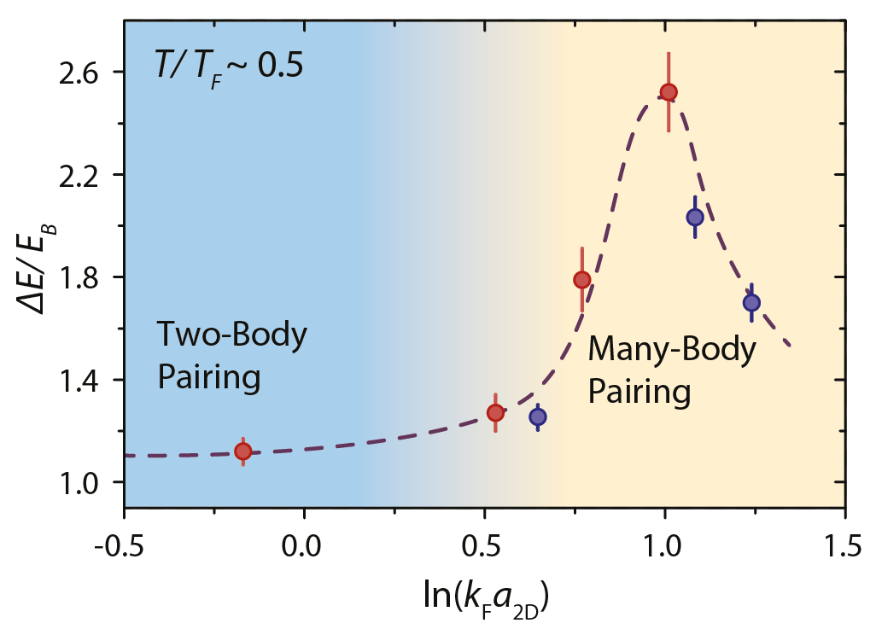
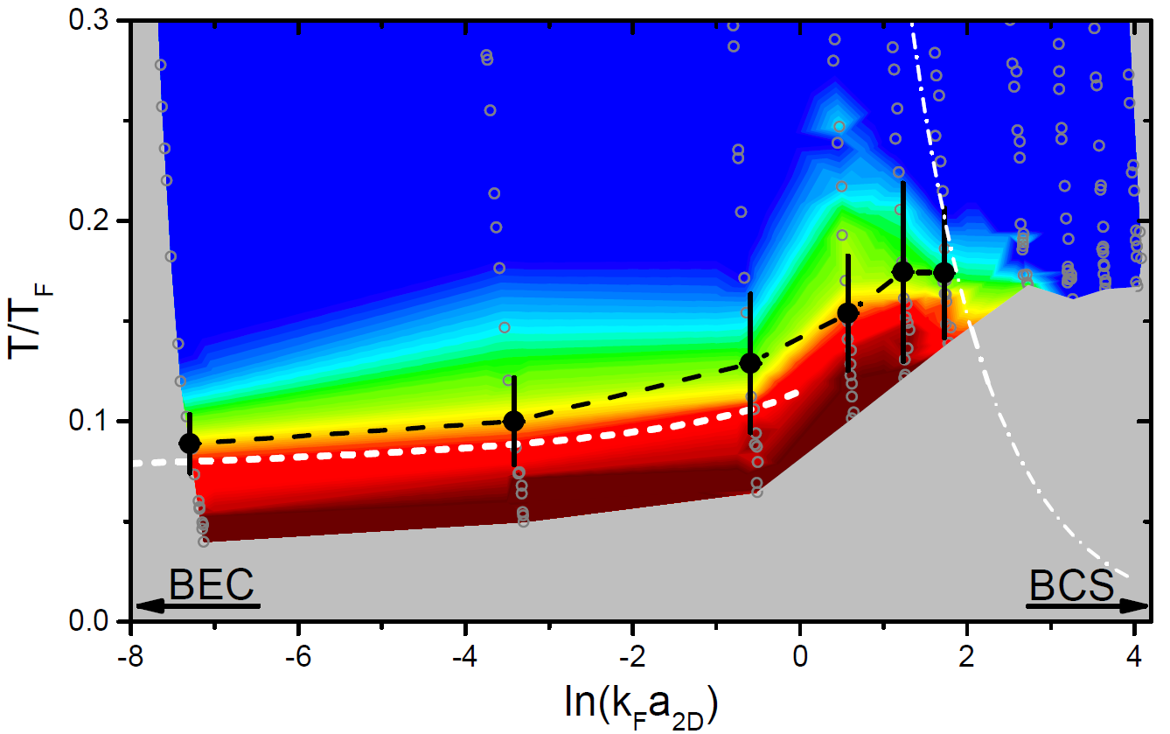
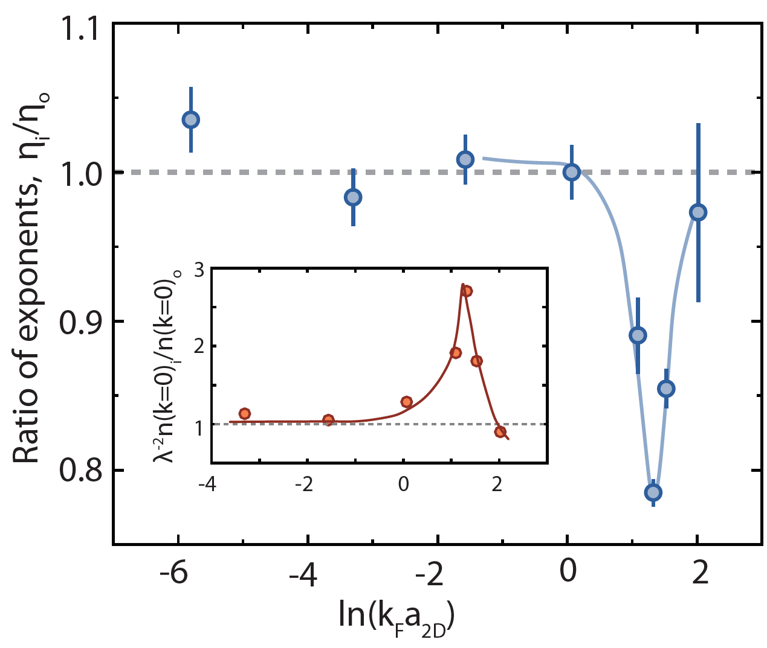
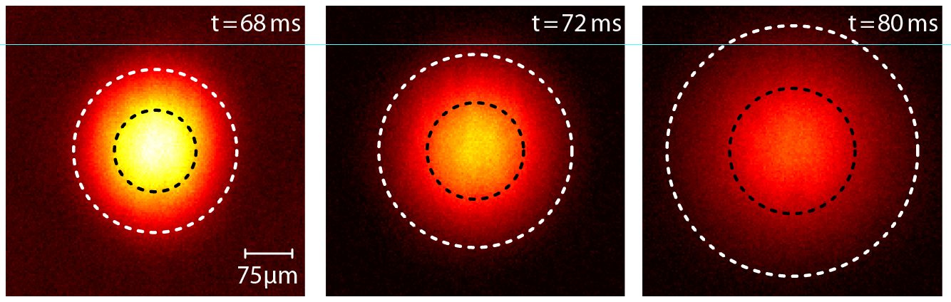
Fermions in Two Dimensions
M.G. Ries et al., PRL 114, 230401 (2015)
P.A. Murthy et al., Science 359, 6374 (2018)
MH et al., PRL 121, 120401 (2018)
P.A. Murthy et al., Science 365, 6450 (2019)

Slide 6
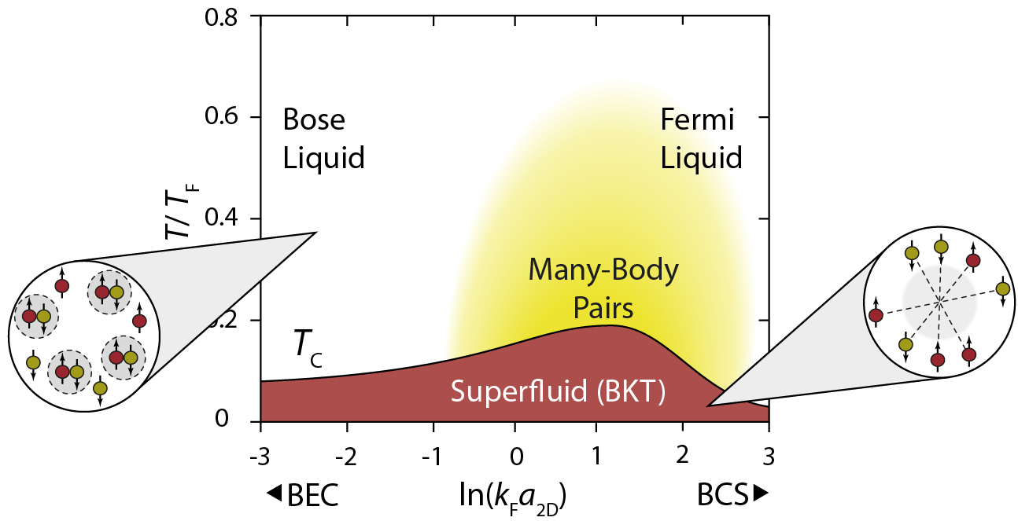
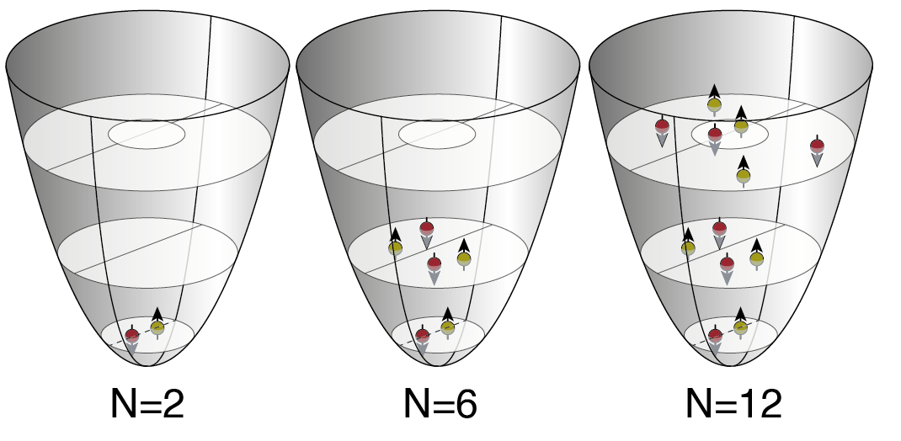
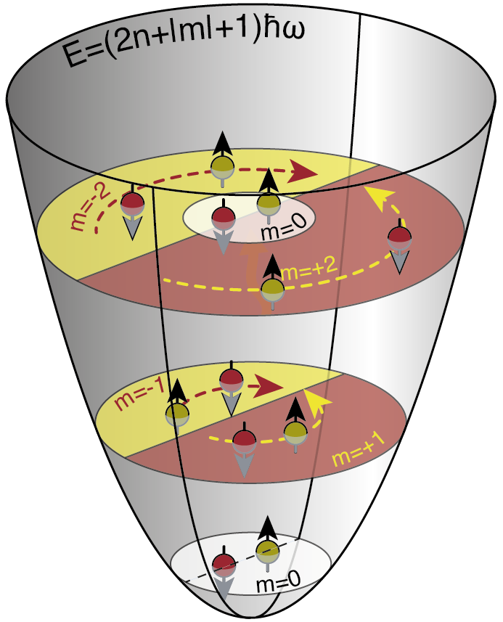
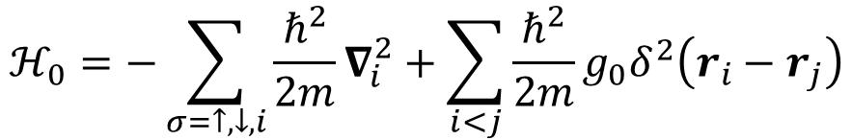

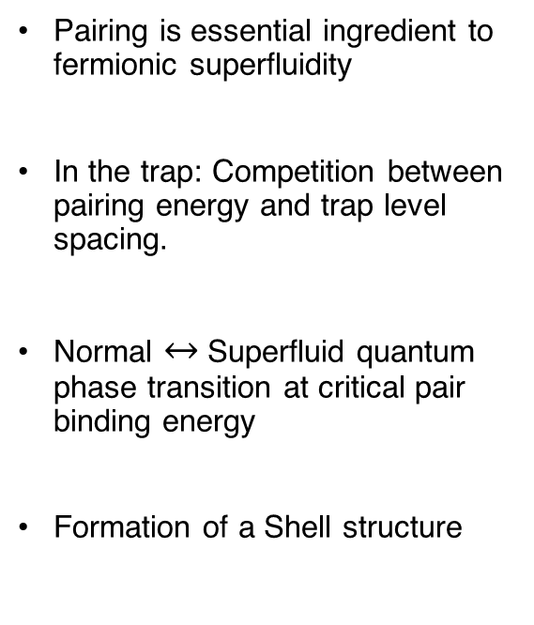
Mesoscopic Systems
$$ℋ_{0}=−\sum_{σ=↑,↓,i}{\frac{ℏ^{2}}{2m}∇_{i}^{2}+{\sum_{i<j}{\frac{ℏ^{2}}{2m}}g}_{0}δ^{2}\left(r_{i}−r_{j}\right)}$$
$$+ V_{ext}$$
Pairing is essential ingredient to fermionic superfluidity
In the trap: Competition between pairing energy and trap level spacing.
Normal $↔$ Superfluid quantum phase transition at critical pair binding energy
Formation of a Shell structure
What are the few-body precursors of the phase transition?

Slide 7
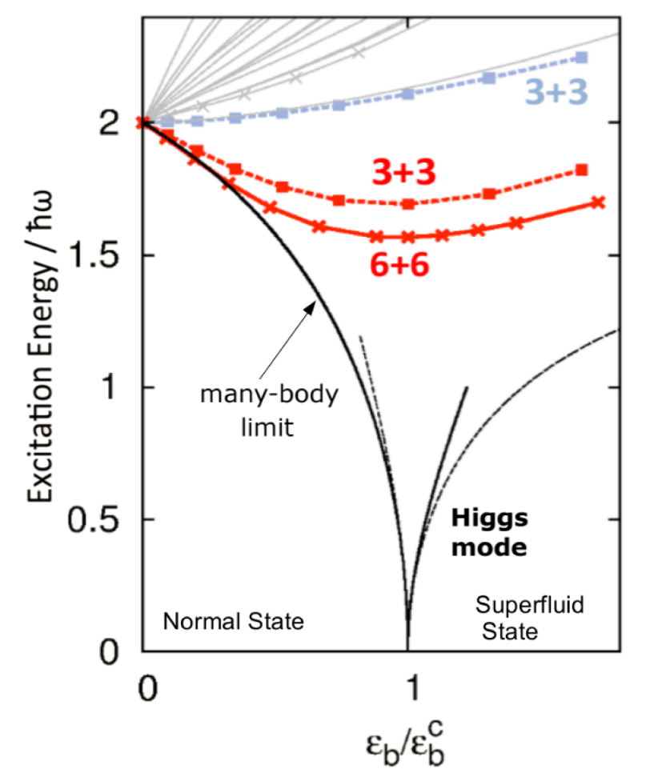
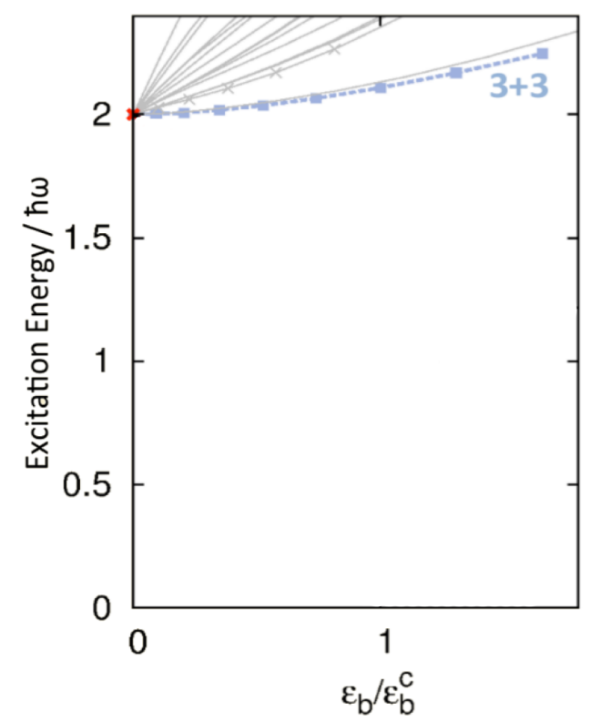
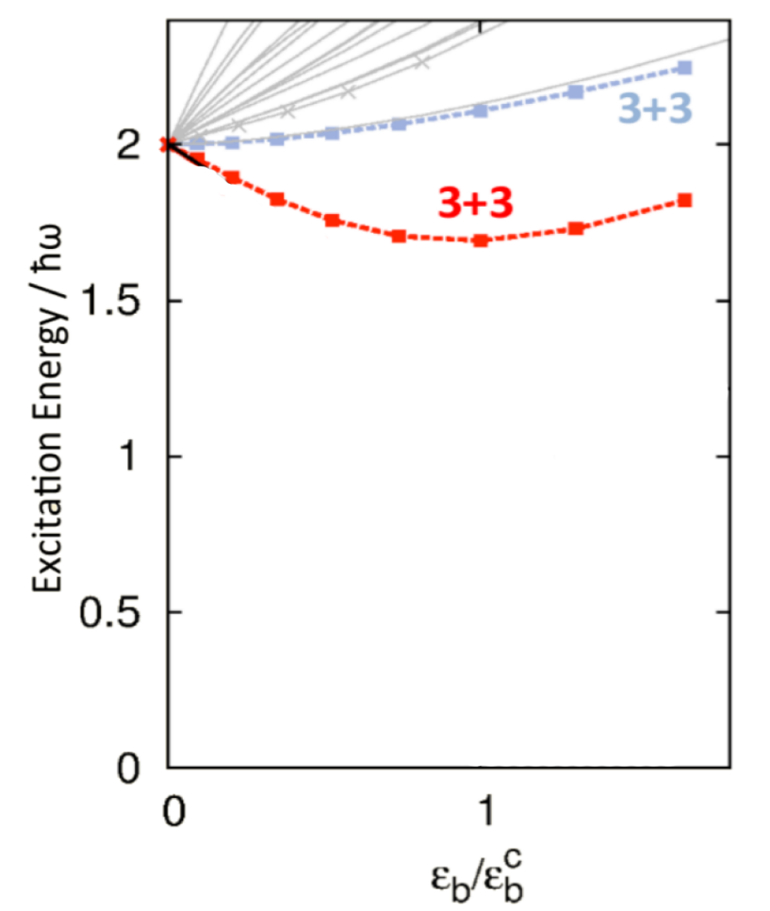
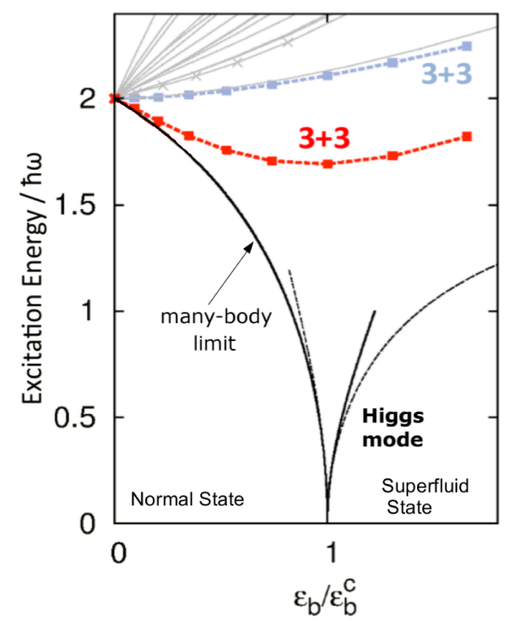
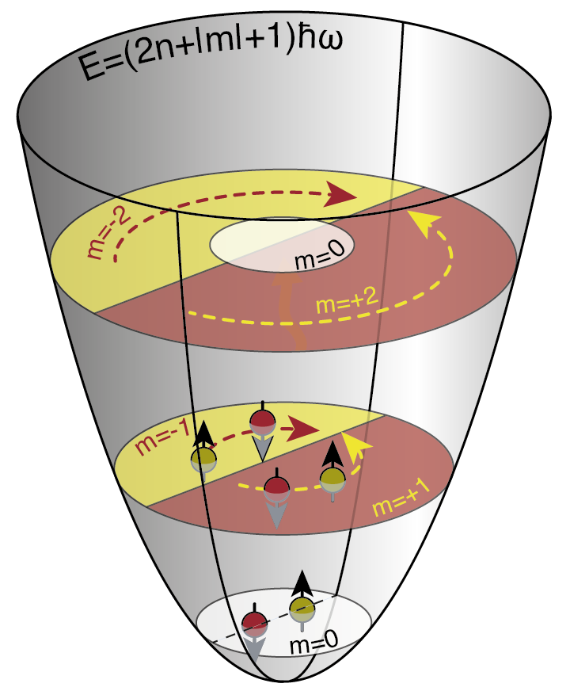
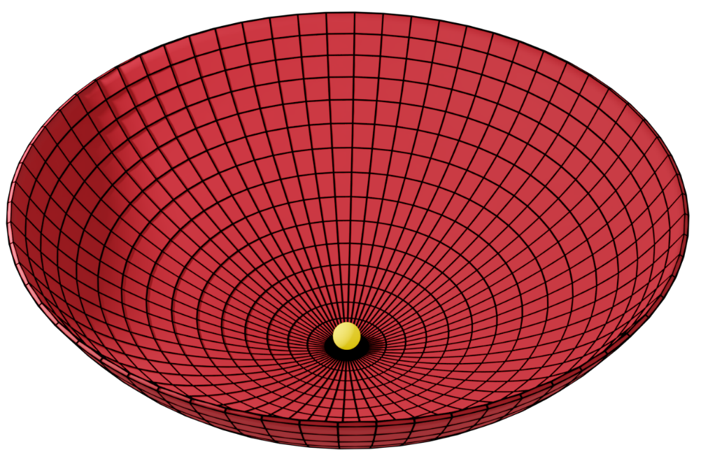
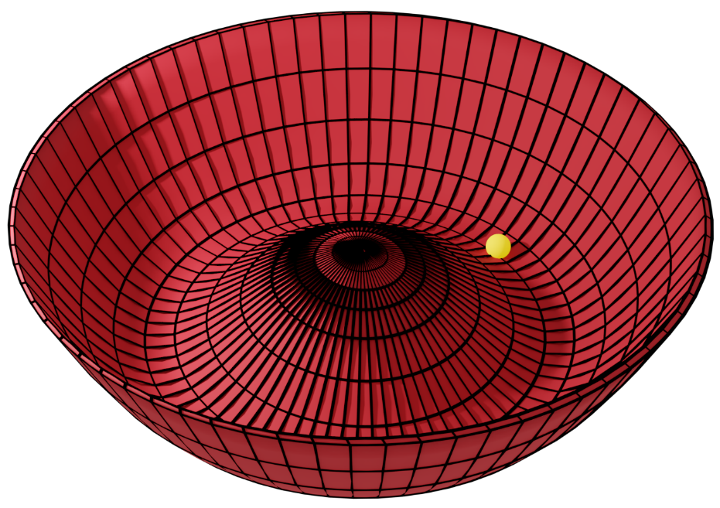


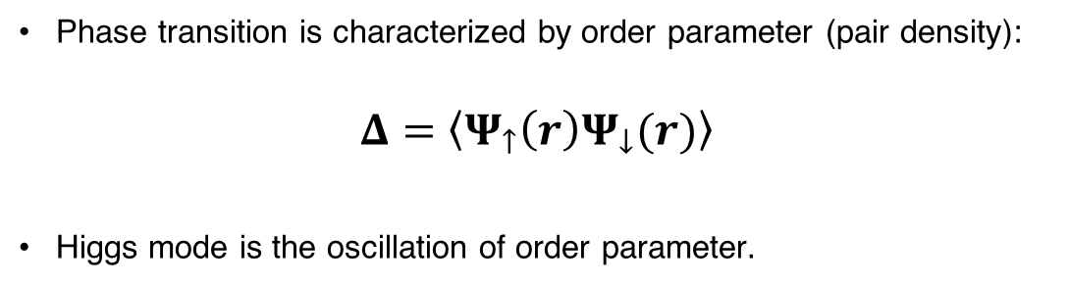
Higgs Mode Precursor
Phase transition is characterized by order parameter (pair density):
$$Δ=\left\langle Ψ_{↑}\left(r\right)Ψ_{↓}(r)\right\rangle$$
Higgs mode is the oscillation of order parameter.
J. Bjerlin et al., PRL 116, 155302 (2016):
Normal Fluid $(Δ=0$)
Superfluid $(Δ≠0$)

Slide 8
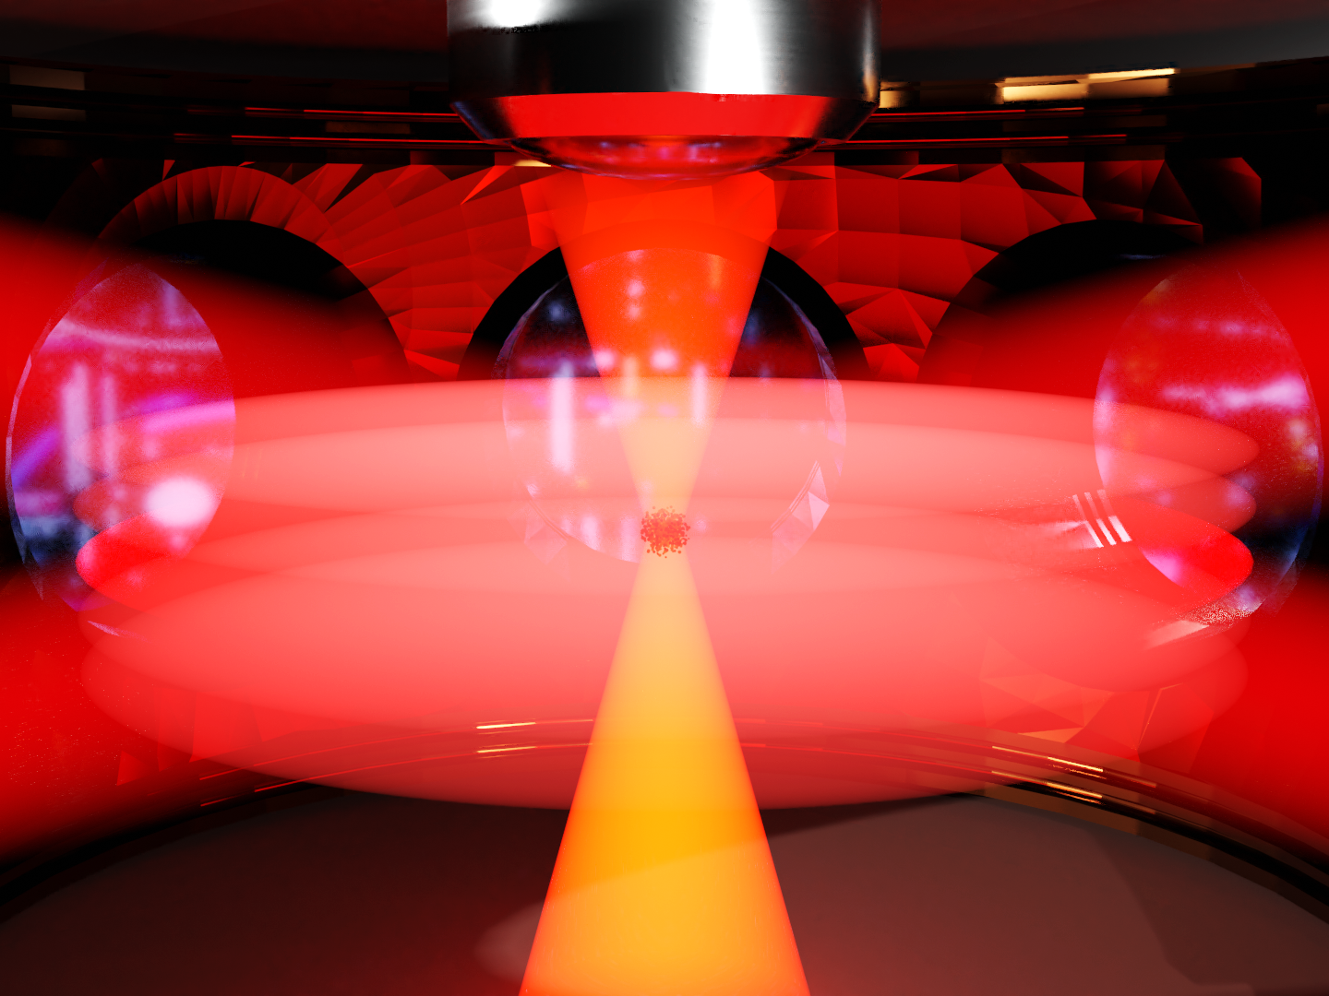
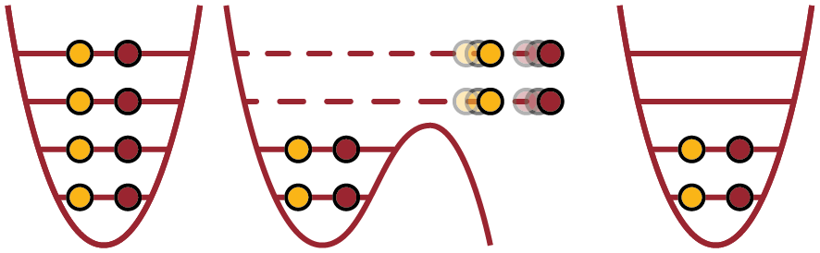
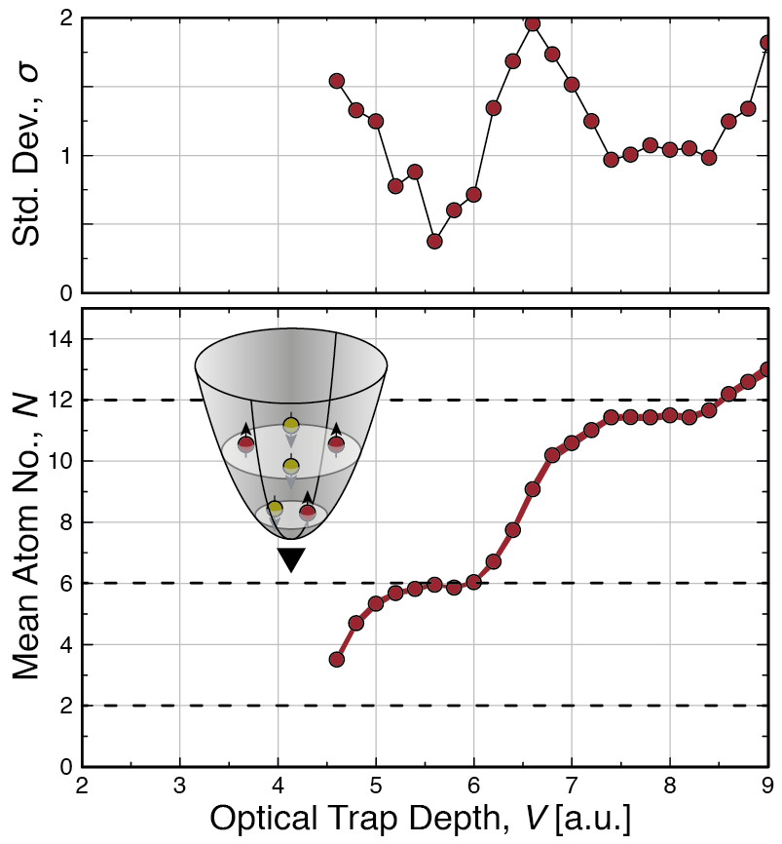
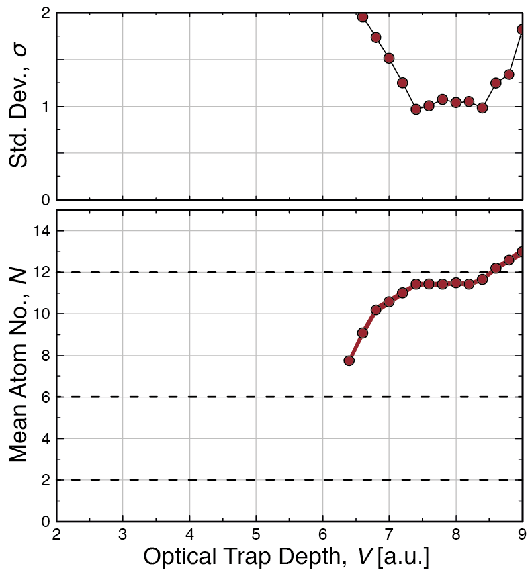
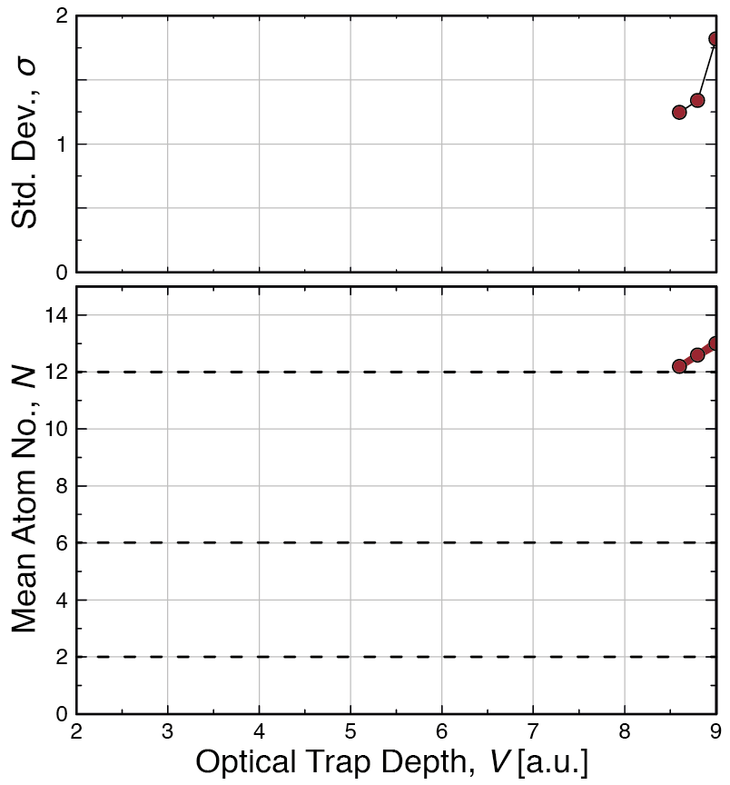
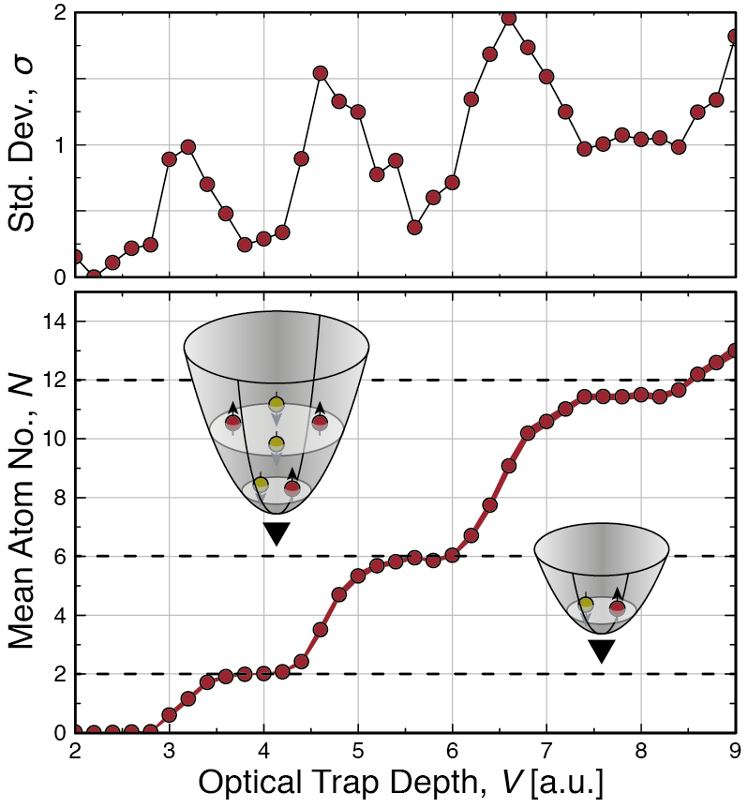
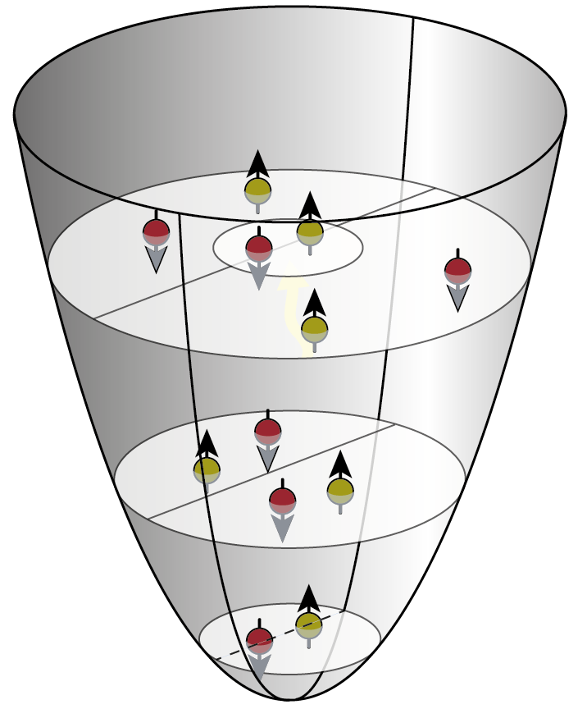
Combined Potential
J. Bjerlin et al., PRL 116, 155302 (2016):
?
F. Serwane et al. Science 15, 6027 (2011)

Slide 9
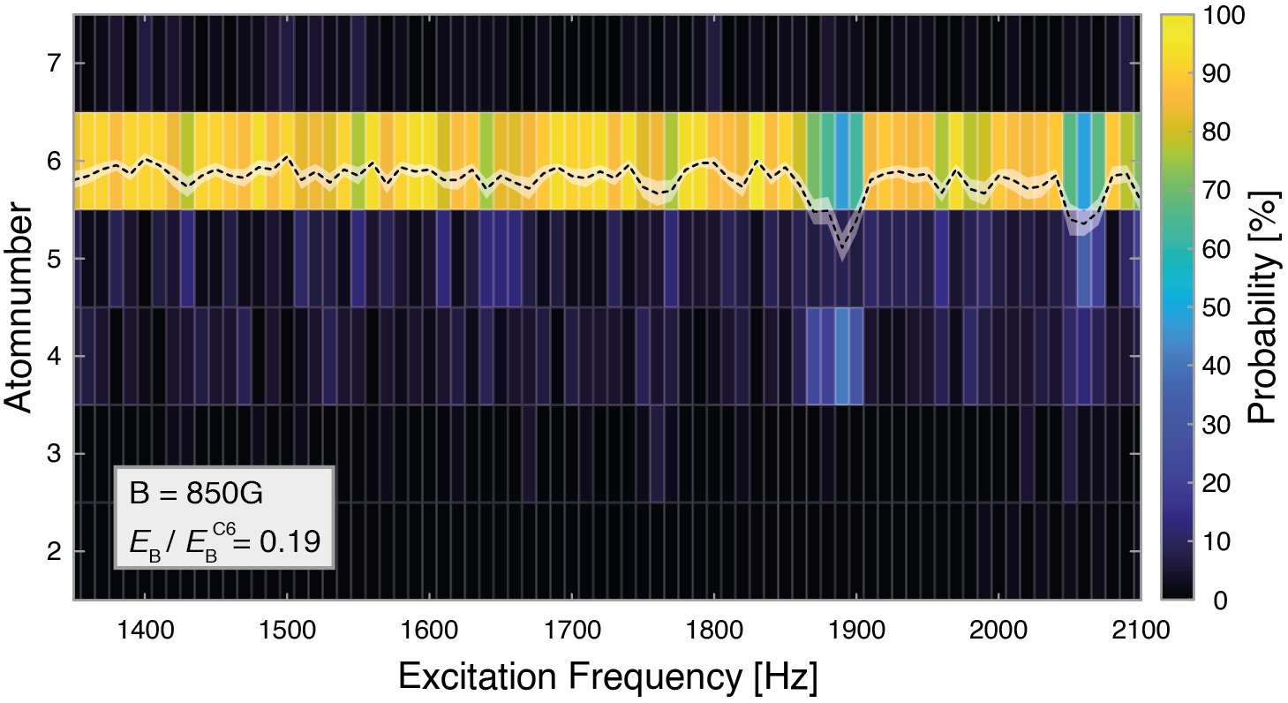
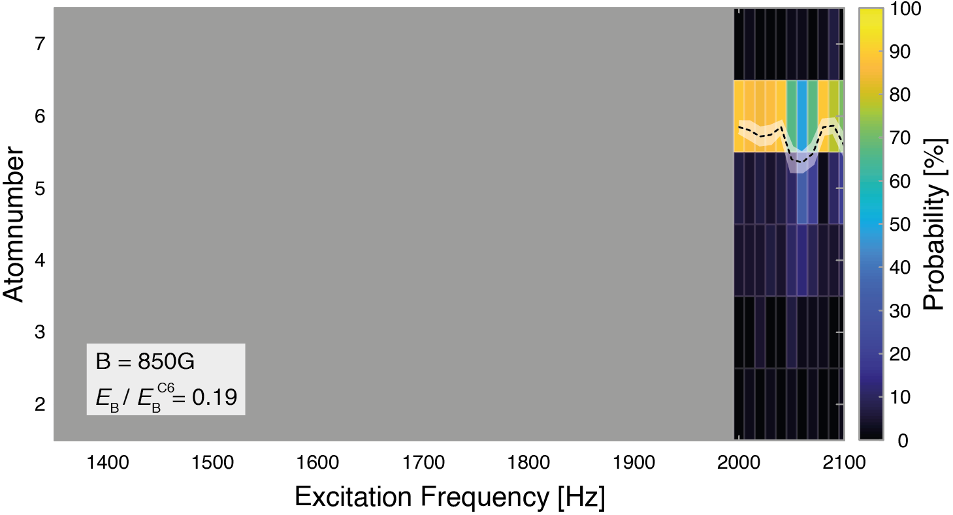
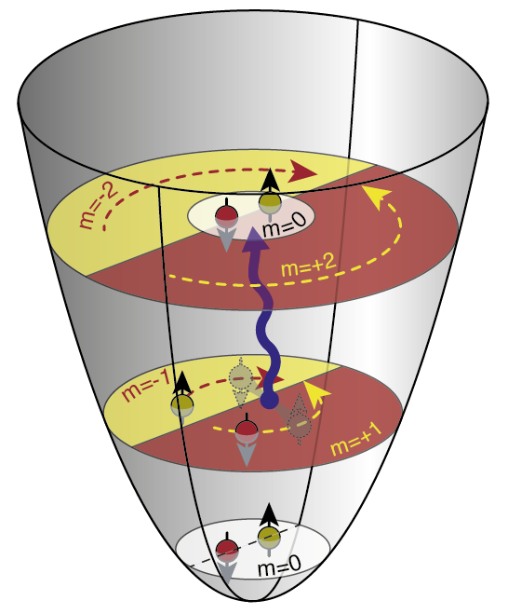
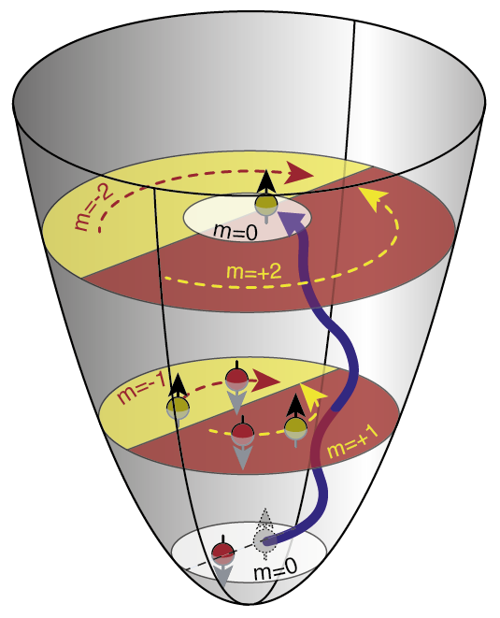

Excitation Spectrum
$$2ω_{R}$$

Slide 10
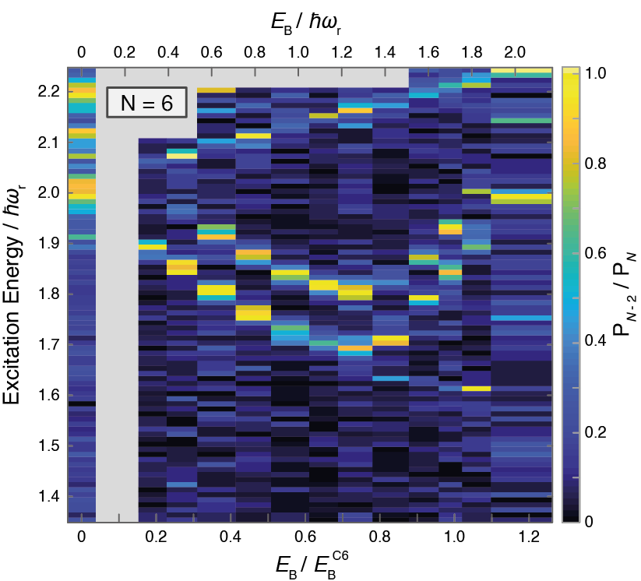
Interaction Dependence
Interactions are tuned by Feshbach resonance
Higher modes show mean-field shift with increasing attraction.
Lowest mode is non-monotonous!

Slide 11
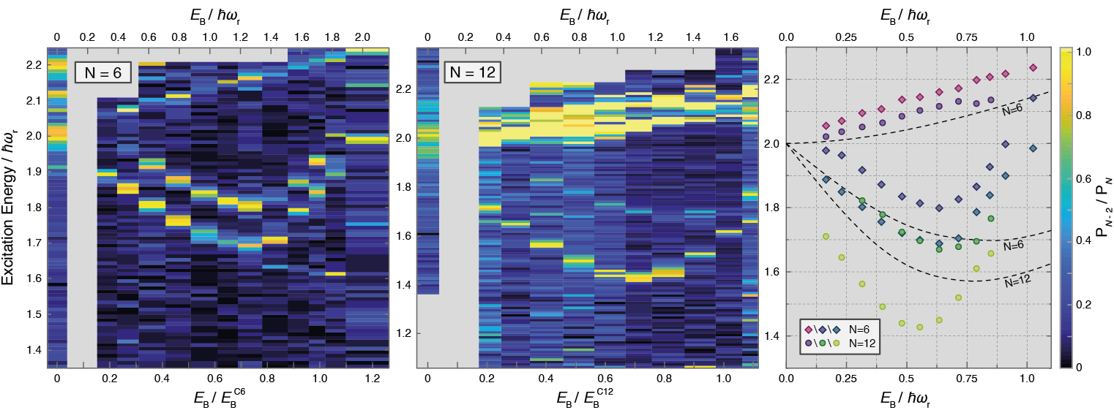

From Few to Many …
Preliminary!
Lowest mode deepens with increasing particle number.
Minimum shifts towards smaller binding energies for larger particle numbers.
Lowest mode is few-body Higgs precursor!

Slide 12
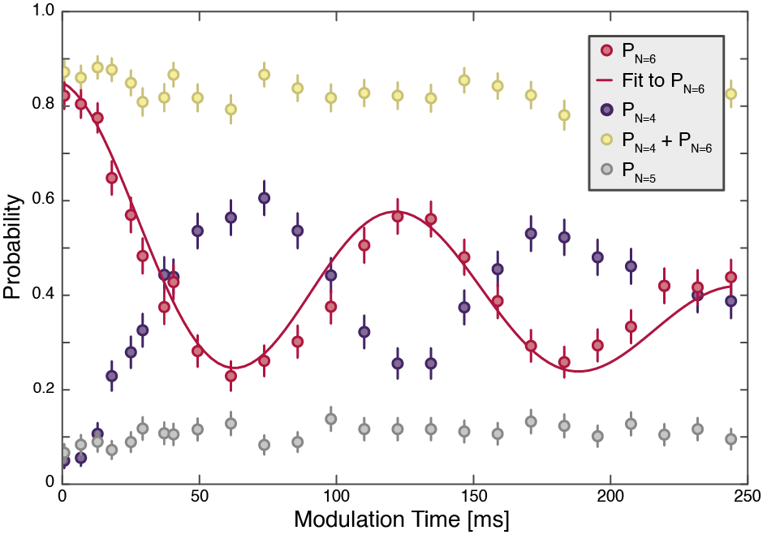
Coherent Drive
Modulate binding energy at Higgs frequency.
Observe coherent oscillations between probability for N=4 and N=6.
Oscillations decay very slowly on the order of 250ms.
Can prepare system in coherent superposition of highly non-trivial many-body states!

Slide 13
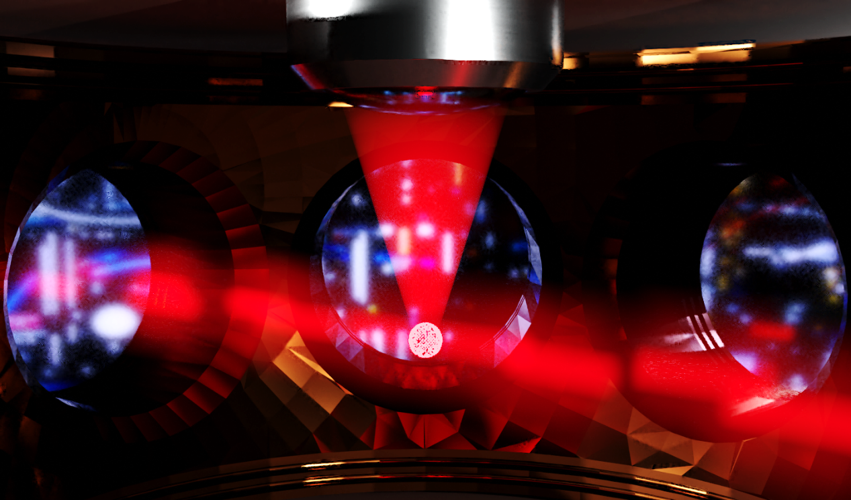
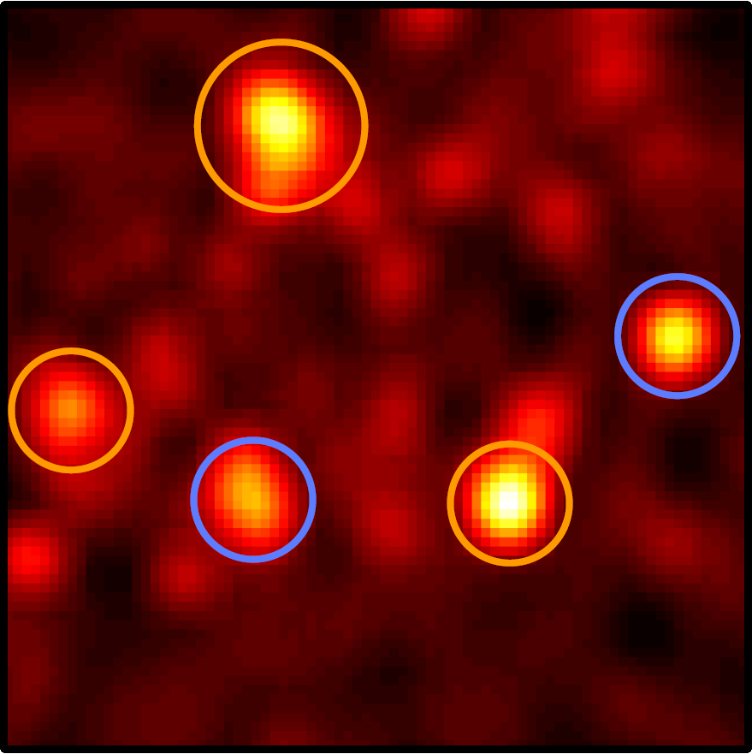
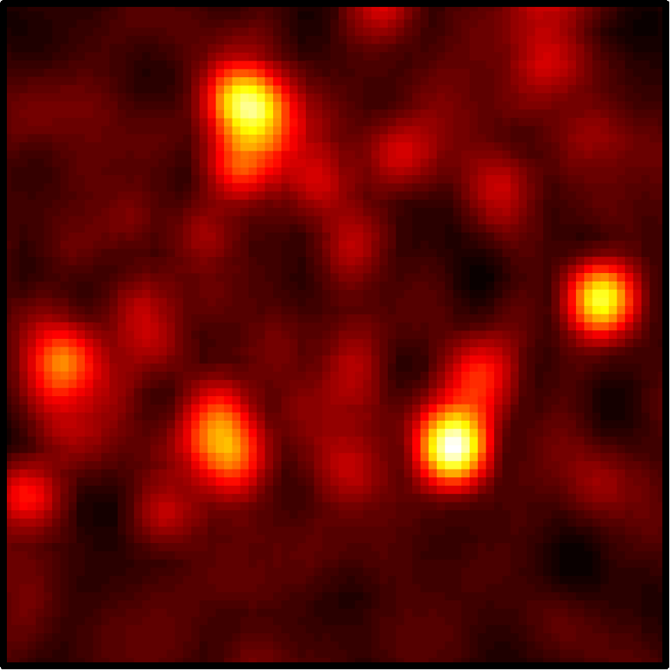
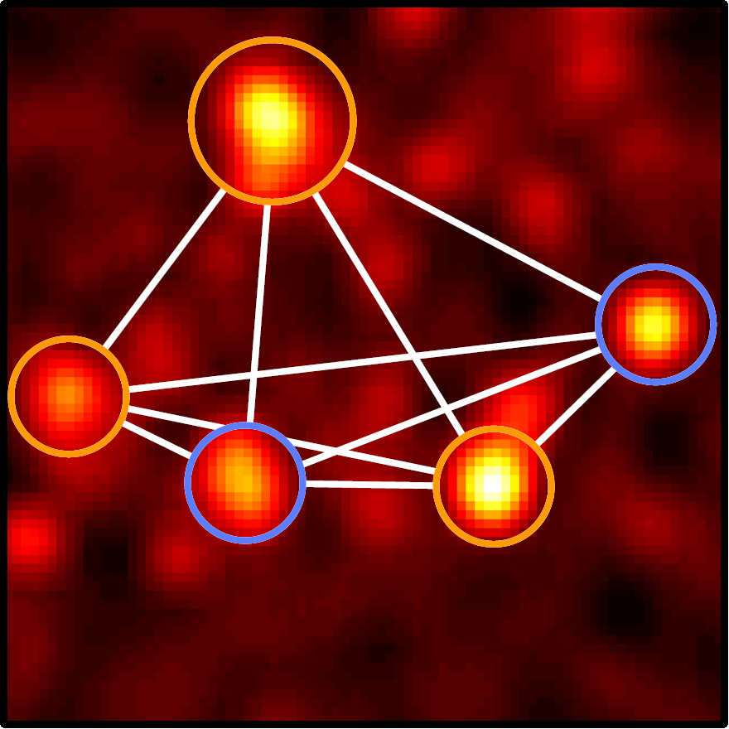
Momentum Correlations
M.G. Ries et al., PRL 114, 230401 (2015)
P.A. Murthy et al., Science 359, 6374 (2018)
Measurement of complete 2D momentum distribution after TOF:
Single Particle Resolved
Spin Resolved
Instantaneous switch to non-interacting system with microwave pulse
MH et al., PRL 121, 120401 (2018)
P.A. Murthy et al., Science 365, 6450 (2019)

Slide 14

Fermions in two dimension: many
Quantum scale anomaly and spatial coherence in a 2D Fermi superfluid
Nicolò Defenu
Institute for theoretical physics
Heidelberg University
QSEC
25/09/2019

Slide 15
Classical vs Quantum System
Classical System
Motion Equations
Single Trajectory
Quantum System
Schrödinger Equation
Infinite degrees of freedom

Slide 16
Quantum anomaly
Quantization of the classical Hamiltonian
Qualitative Effects
Classical symmetries may be spontaneously broken at the quantum level
Non-integrable dynamics
Superfluid Transitions in 2d
Quantum Anomaly

Slide 17
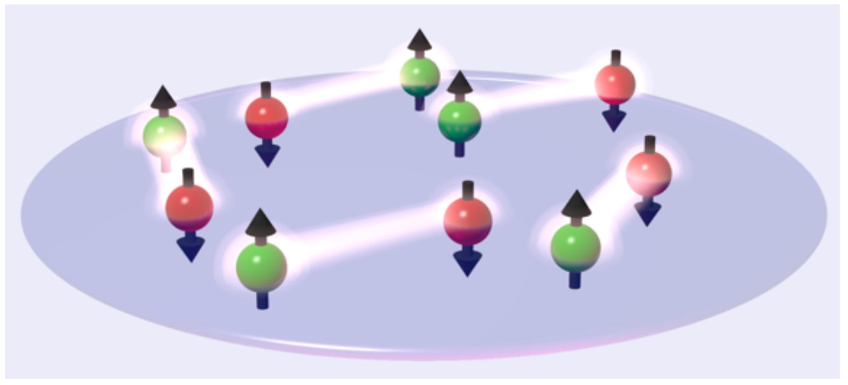
Ultracold quantum gases
2D Fermi gases
Essential ingredients
2-component Fermi gas (labeled ⬆ and ⬇)
s-wave contact interaction
two-dimensional geometry

Slide 18
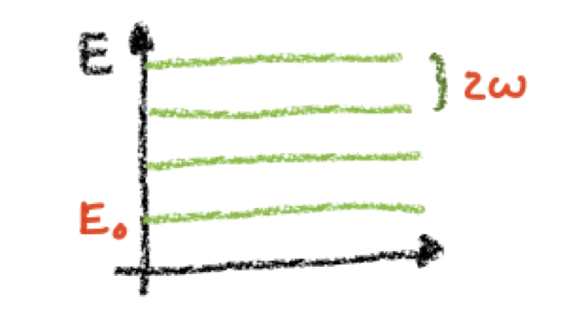
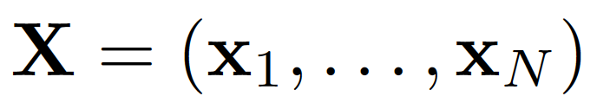
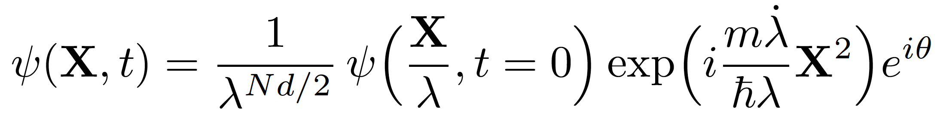
Dynamical scaling symmetry
Applies to the many-body system at the classical level
N-body system
A single parameter describes the dynamics
Period of the breathing mode exactly known
Integrable dynamics
,
L. P. Pitaevskii et al. Phys. Rev. A, 55, R 835 (1997)
F. Werner and Y. Castin, Phys. Rev. A 74, 053604 (2006)

Slide 19
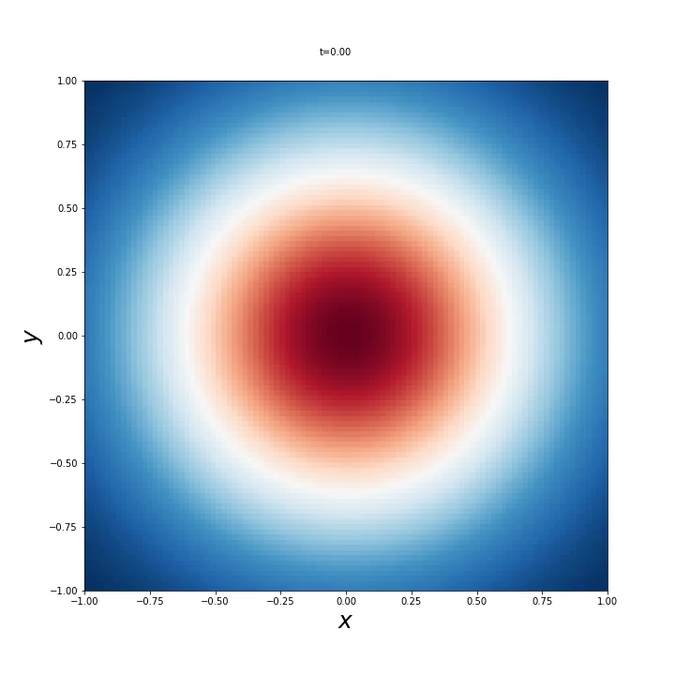
Self-similarity

Slide 20
Quantum Anomaly
Quantum fluctuations break the SO(2,1) dynamical scaling symmetry
An additional length scale is introduced in the problem by Quantum Fluctuations
The additional length-scale corresponds to the size of the bound state
Scale invariance broken by 2D bound state
W. Zwerger: Varenna lecture notes Strongly Interacting Fermi Gases (2014)

Slide 21
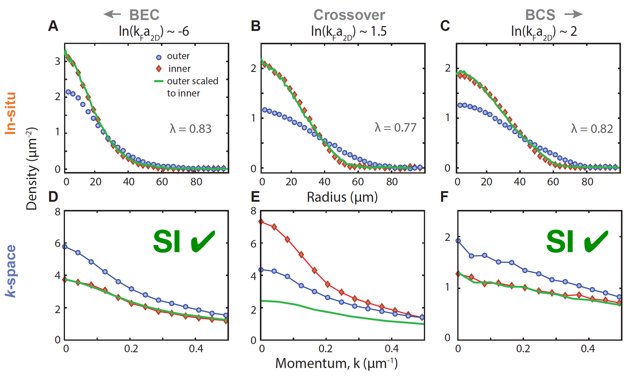
In-situ and momentum space
Tuning interactions
BEC side (weakly interacting dimers)
Compare density profile at inner and outer TP
Perfect scaling
BEC side (weakly interacting dimers)
Compare density profile at inner and outer TP
Perfect scaling
P. A. Murthy, N. Defenu et al., Science 19, 268 (2019)

Slide 22
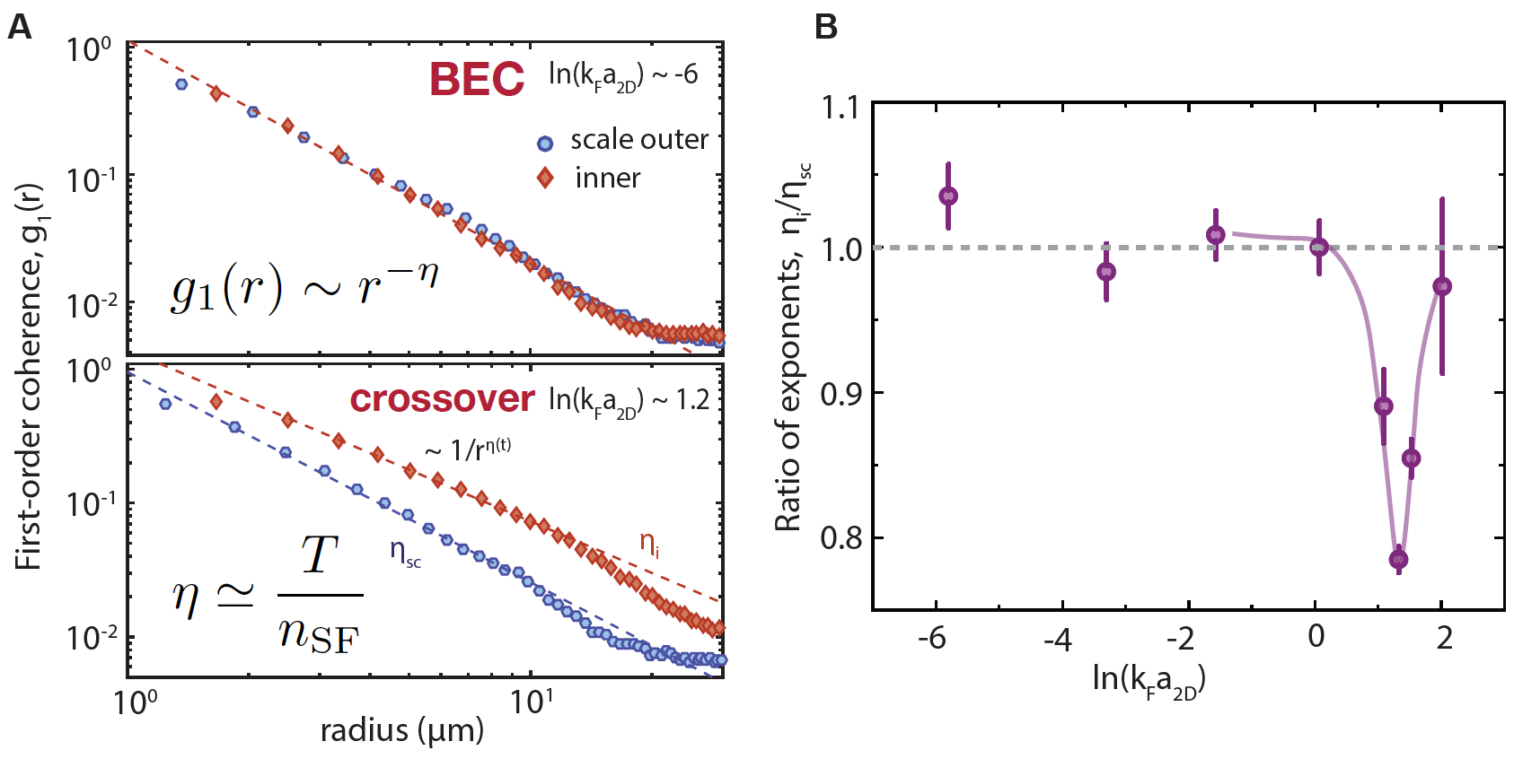
Scale invariance and coherence
First-order coherence function
Momentum distribution encodes coherence properties
Power-law decay (BKT type superfluid in 2D)
Check scale invariance in exponent

Slide 23
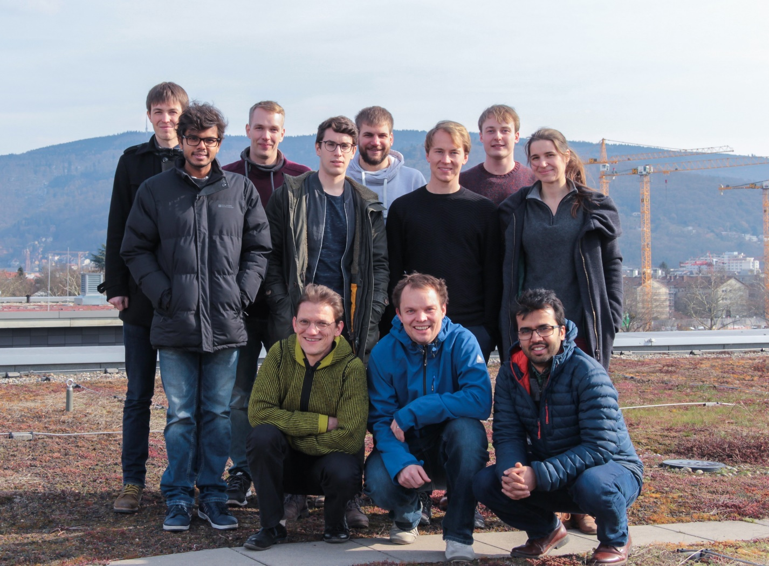






The Team
PI:
Selim Jochim
Postdocs:
Philipp Preiß
Gerhard Zürn
Fermions in 2D:
Luca Bayha
Keerthan Subramanian
Puneet Murthy -> Zurich
Few-Fermion Systems:
Jan-Hendrik Becher
Ralf Klemt
Ram-Janik Petzold
Theory:
Tilman Enss

Slide 24
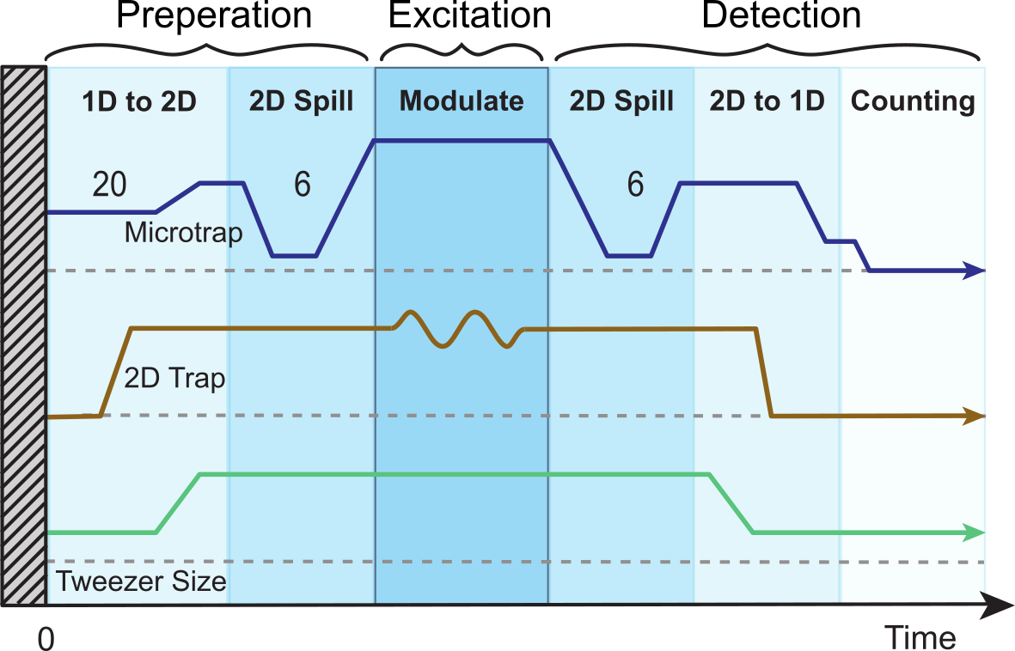
Experimental Sequence

Slide 25
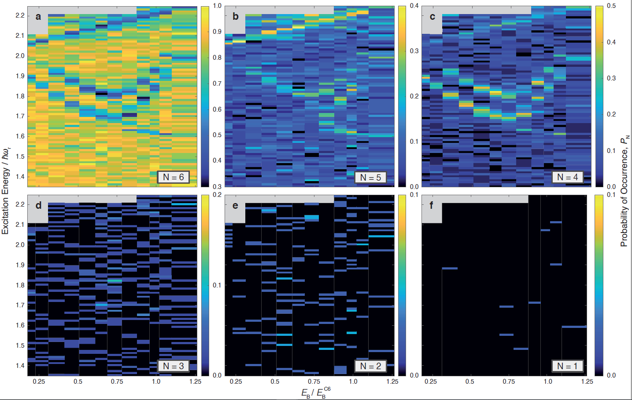
N=6 Dataset

Slide 26
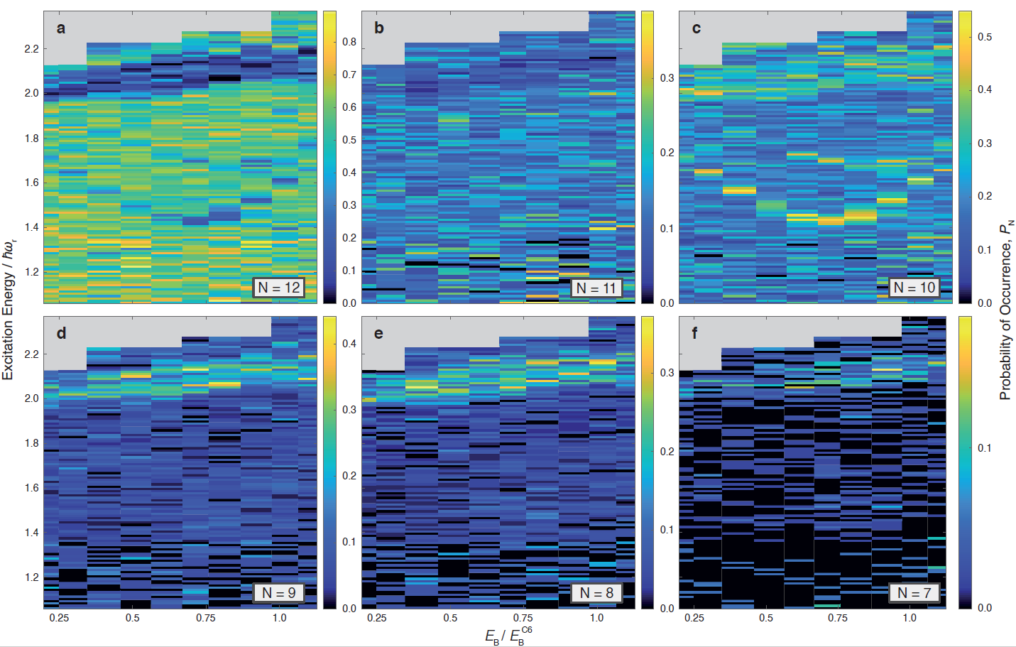
N=12 Dataset

