Slide 1

Using time-time correlations to detect entanglement and spreading of quantum information
Martin Gärttner
Kirchhoff-Institut für Physik, Heidelberg
QSEC 2019
Heidelberg
September 26, 2019

Slide 2
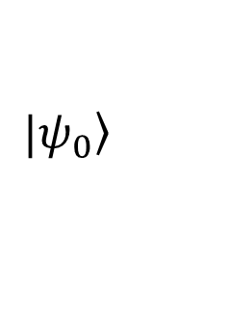

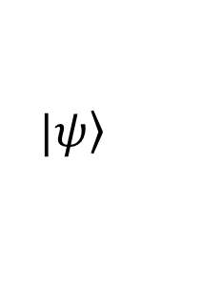

(Analog) Quantum simulation
$$|\left.ψ_{0}\right\rangle$$
$$e^{−iHt}$$
$$|\left.ψ\right\rangle$$
evolve
measure
$$\left\langle ψ | A | ψ\right\rangle$$
Goal: Characterize the prepared states as a function of t and the parameters of H.
Problem:
Often only global measurements possible
Full state tomography not feasible for large N

Slide 3


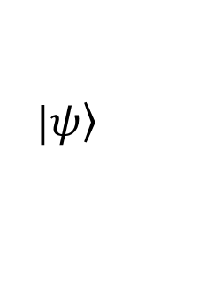



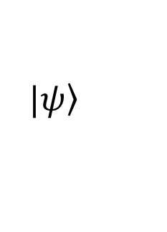
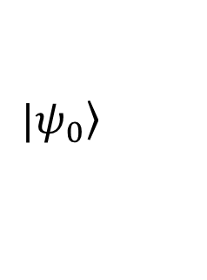

Quantum simulation extended
$$|\left.ψ_{0}\right\rangle$$
$$e^{−iHt}$$
$$|\left.ψ\right\rangle$$
$$e^{iAφ}$$
$$|\left.ψ_{φ}\right\rangle$$
$$e^{iHt}$$
$$|\left.ψ_{f}\right\rangle$$
easy to prepare
separable
interesting
entangled?
useful?
perturb
time
reversal
measure
$$\left\langle ψ_{f} | B | ψ_{f}\right\rangle$$
→ Measure time-time correlations, out-of-time-order correlations
→ extract more information about
→ only global observables needed
$$|\left.ψ\right\rangle$$

Slide 4
OTOCs quantify operator growth

Slide 5




Operator growth
$$C\left(t\right)=\left\langle {\left|\left[\hat{W}(t),\hat{V}\right]\right|}^{2}\right\rangle \sim \left\langle {\hat{W}(t)}^{†}{\hat{V}}^{†}\hat{W}(t)\hat{V}\right\rangle −\left\langle \hat{W}(t) {\hat{W}(t)}^{†}{\hat{V}}^{†}\hat{V}\right\rangle$$
$$\hat{H}=\sum{{\hat{σ}}_{i}^{z}{\hat{σ}}_{i+1}^{z}}$$
$$\hat{V}={\hat{σ}}_{j}^{x}$$
Example:
$$\hat{W}={\hat{σ}}_{i}^{x}$$
$$\hat{W}\left(t\right)={{e^{−i\hat{H}t}\hat{σ}}_{i}^{x}e}^{i\hat{H}t}=(1−i\hat{H}t−…){\hat{σ}}_{i}^{x}(1+i\hat{H}t+…)$$
$$={\hat{σ}}_{i}^{x}+it\left({\hat{σ}}_{i}^{y}{\hat{σ}}_{i+1}^{z}−…\right)+…$$
site i
site j
t=0
t>0
operators grow in in time, quantified by commutator “scrambling”

Slide 6
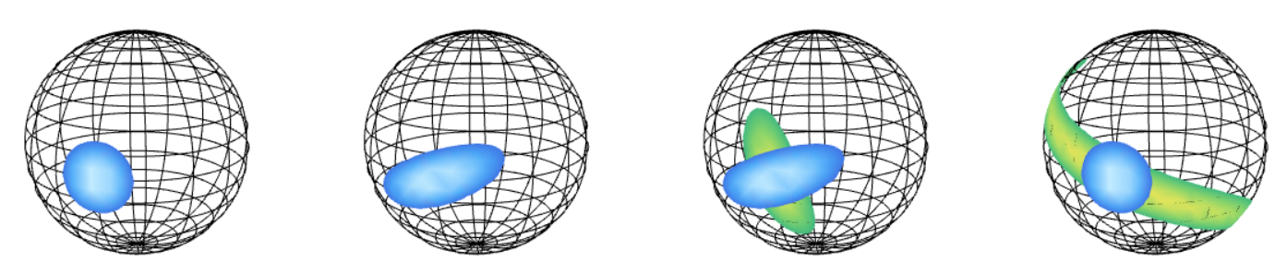





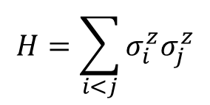


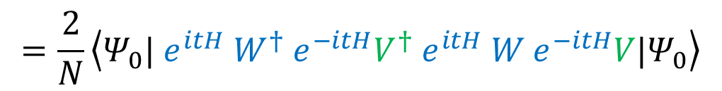

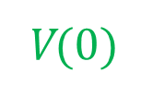
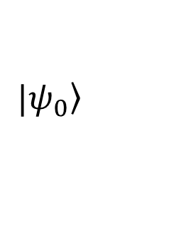

OTOC measurement in spin systems
$$|\left.ψ_{0}\right\rangle$$
$$e^{−iHt}$$
$$e^{−iS_{x}φ}$$
$$e^{iHt}$$
$$\left\langle S_{x}\right\rangle$$
prepare
evolve
rotate
evolve back
measure
time
$$H=\sum_{i<j}{σ_{i}^{z}σ_{j}^{z}}$$
$$φ$$
$$\left\langle S_{x}\right\rangle =\left\langle {Ψ_{0}| e}^{itH} e^{iφS_{x}}{ e}^{−itH}S_{x}{ e}^{itH}{ e}^{−iφS_{x}}{ e}^{−itH}|Ψ_{0}\right\rangle$$
$$=\frac{2}{N}\left\langle {Ψ_{0}| e}^{itH} W^{†}{ e}^{−itH}V^{†}{ e}^{itH} W{ e}^{−itH}V|Ψ_{0}\right\rangle$$
$$W^{†}(t)$$
$$V^{†}(0)$$
$$W(t)$$
V$(0)$

Slide 7


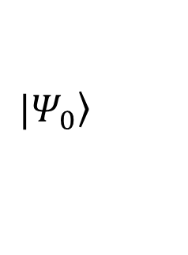
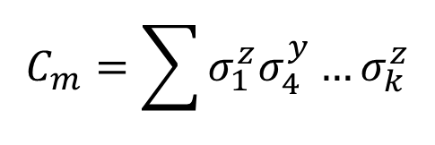
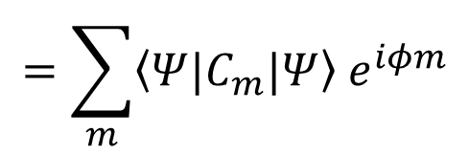
Collective operator spreading
$$\left\langle S_{x}\right\rangle =\left\langle {Ψ_{0}| e}^{itH} e^{iφS_{x}}{ e}^{−itH}S_{x}{ e}^{itH}{ e}^{−iφS_{x}}{ e}^{−itH}|Ψ_{0}\right\rangle$$
$$=\sum_{m}{\left\langle Ψ|C_{m}|Ψ\right\rangle { e}^{iφm}}$$
$$C_{m}=\sum{σ_{1}^{z}σ_{4}^{y}…σ_{k}^{z}}$$
At least m terms
$$|\left.Ψ_{0}\right\rangle$$
$$σ_{i}^{z}σ_{j}^{z}=σ_{i}^{+}σ_{j}^{+}+σ_{i}^{+}σ_{j}^{−}$$
$${+σ}_{i}^{−}σ_{j}^{+}+σ_{i}^{−}σ_{j}^{−}$$

Slide 8
Penning trap quantum simulator

Slide 9
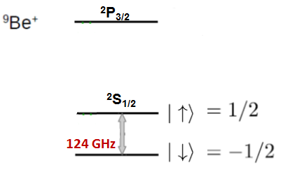


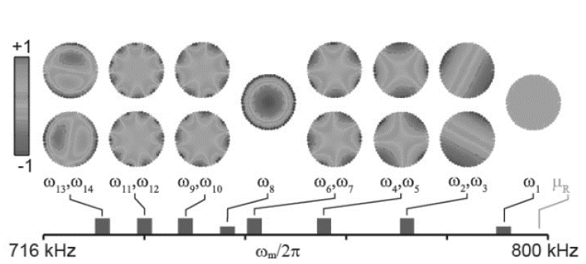
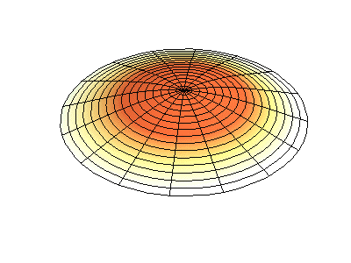
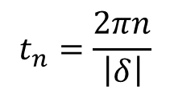
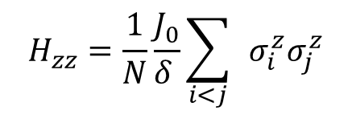
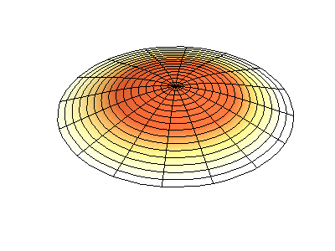

Penning trap experiment
With Justin Bohnet
Group of John Bollinger
(NIST Boulder)
ODF
Britton et al. Nature 2012
Bohnet et al. Science 2015
Two hyperfine states
used as spin ½ system
$$H_{zz}=\frac{1}{N}\frac{J_{0}}{δ_{ }^{ }}\sum_{i<j}{ }σ_{i}^{z}σ_{j}^{z}$$
CM
$$t_{n}=\frac{2πn}{\left|δ\right|}$$
at
$$δ$$

Slide 10
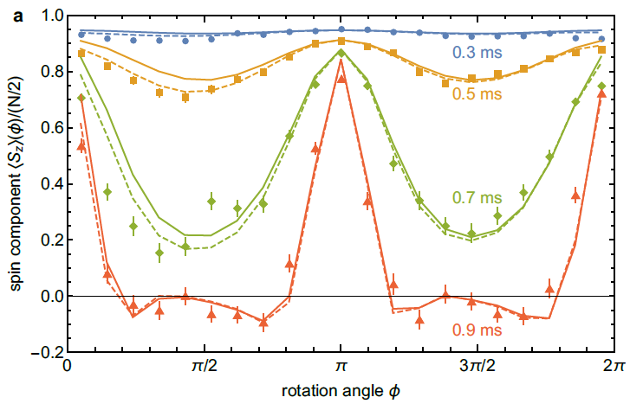



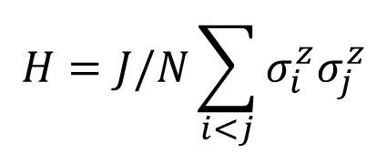

Experimental results
$$φ$$
$$H=J/N\sum_{i<j}{σ_{i}^{z}σ_{j}^{z}}$$
$$J≲5kHz$$
$$N=111$$
$$Γ=93Hz$$
[MG, J. G. Bohnet et al. Nat. Phys. 13 781 (2017)]

Slide 11
Fourier transform of magnetization
[MG, J. G. Bohnet et al. Nat. Phys. 13 781 (2017)]
Observe operator spreading
Only global spin measurement

Slide 12
OTOCs quantify coherence

Slide 13



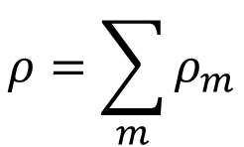














Multiple quantum coherences
Example: N=3
$$↑↑↑$$
$$↓↑↑$$
$$↑↓↑$$
$$↑↑↓$$
$$↓↓↑$$
$$↓↑↓$$
$$↓↓↑$$
$$↓↓↓$$
$$ρ=\sum_{m}{ρ_{m}}$$
$$↑↑↑$$
0
m=-1
m=-2
-3
$$↓↑↑$$
$$↑↓↑$$
1
m=0
m=-1
-2
$$↑↑↓$$
$$I_{m}=Tr[ρ_{m}ρ_{m}^{†}]$$
$$↓↓↑$$
$$↓↑↓$$
2
m=1
m=0
-1
$$↓↓↑$$
$$↓↓↓$$
3
m=2
m=1
0
[NMR: Pines group 1980s]

Slide 14

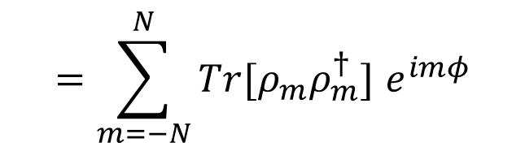








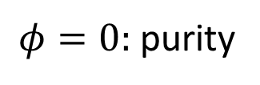
Multiple quantum coherences
$$e^{−iHt}$$
$$e^{−iS_{x}φ}$$
$$e^{iHt}$$
$$\left\langle ρ_{0}\right\rangle$$
prepare
evolve
rotate
evolve back
measure
$$ρ_{0}$$
$$ρ$$
$$ρ_{f}$$
time
$$\left\langle ρ_{0}\right\rangle =Tr\left[ρ_{0}ρ_{f}\right]=Tr[ρ_{0}{ e}^{itH}e^{−iφS_{x}}{ e}^{−itH}ρ_{0}{ e}^{itH}{ e}^{iφS_{x}}{ e}^{−itH}]$$
$$=Tr[{ e}^{−itH}ρ_{0}{ e}^{itH}e^{−iφS_{x}}{ e}^{−itH}ρ_{0}{ e}^{itH}{ e}^{iφS_{x}}]$$
$$=Tr[ρ e^{−iφS_{x}}ρ{ e}^{iφS_{x}}]$$
$φ=0:$ purity
$$=\sum_{m=−N}^{N}{Tr[ρ_{m}ρ_{m}^{†}] e^{imφ}}$$
$$I_{m}$$

Slide 15
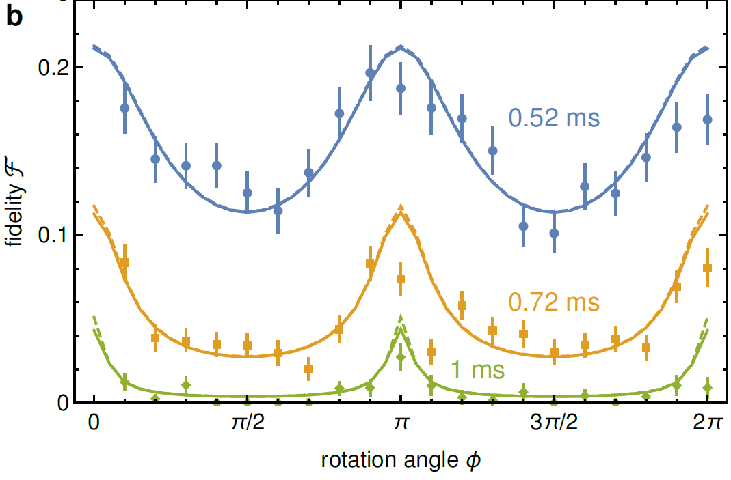
MQC – experimental results
N=48
Lines: Simulation including decoherence
[MG, J. G. Bohnet et al. Nat. Phys. 13 781 (2017)]

Slide 16
OTOCs detect entanglement

Slide 17
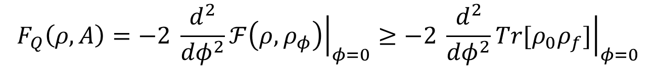
OTOCs as lower bound on QFI
$$F_{Q}\left(ρ,A\right)=−2 \frac{d^{2}}{{dφ}^{2}}{\left.ℱ\left(ρ,ρ_{φ}\right)\right|}_{φ=0}≥−2 \frac{d^{2}}{{dφ}^{2}}{\left.Tr[ρ_{0}ρ_{f}]\right|}_{φ=0}$$
→ OTOC witnesses
multi-particle
entanglement.
[MG, P. Hauke, A. M. Rey,
Phys. Rev. Lett. 120, 040402 (2018)]

Slide 18
OTOCs detect chaos

Slide 19

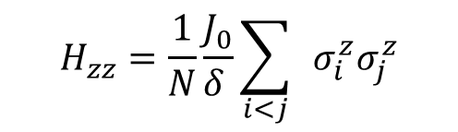
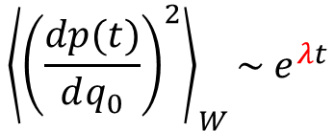
OTOCs for quantum chaos
Quantum – classical correspondence
Truncated
Wigner
$${\left\langle {\left(\frac{dp(t)}{dq_{0}}\right)}^{2}\right\rangle }_{W}\sim e^{λt}$$
$$C(t)=−\left\langle {\left[V(t),W\right]}^{2}\right\rangle$$
Lyapunov exponent
Ion experiment:
$$H=\frac{J}{N}S_{z}^{2}$$
Two bosonic modes
class. integrable
no chaos
Minimal model showing chaos?
Three-mode system with integrability breaking?

Slide 20
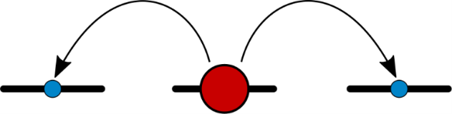






Three-mode system
$$H=g{\vec{S}}^{2}+qQ_{zz}+rS_{x}$$
$$F=1$$
$$g=q=1$$

Slide 21



Three-mode chaos
$$H=g{\vec{S}}^{2}+qQ_{zz}+rS_{x}$$
$$F=1$$
1
$$ρ_{0}$$
M. Rautenberg
and MG,
arXiv:1907.04094
0
$$Θ_{s}$$
$$Θ_{s}$$

Slide 22
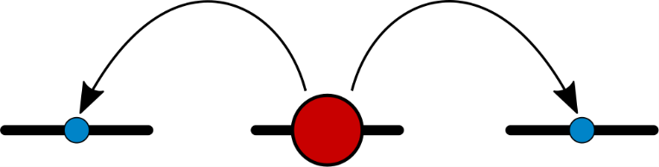
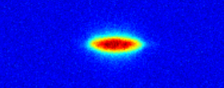




Time reversal in spinor BECs
$$g>0$$
$$F=2$$
Rb BEC
$$g<0$$
$$F=1$$
Spin-changing collisions:
M. Rautenberg
and MG,
arXiv:1907.04094
$$H=g\left(a_{−1}^{†}a_{1}^{†}a_{0}a_{0}+a_{0}^{†}a_{0}^{†}a_{−1}a_{1}+…\right)$$

Slide 23
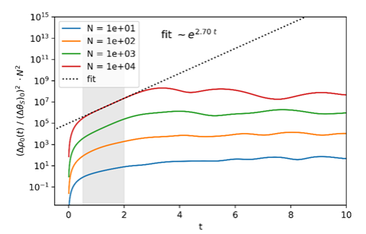
Exponential OTOC growth
Using truncated Wigner simulations
Exact diagonalization only up to N=100
P R E L I M I N A R Y

Slide 24








OTOCs in (Rydberg) spin systems
Hamiltonian engineering
x $N$
$$S_{z}$$
$$π/2$$
$${−S}_{z}$$
$$π/2$$
$$H_{xx}$$
$$H_{xx}$$
time
$$τ$$
$$τ$$
$${{ e}^{i(π/2)S_{z}} e}^{−iτσ_{i}^{x}σ_{j}^{x}}{ e}^{−i(π/2)S_{z}}{ e}^{−iτσ_{i}^{x}σ_{j}^{x}}=e^{−iτσ_{i}^{y}σ_{j}^{y}}{ e}^{−iτσ_{i}^{x}σ_{j}^{x}}$$
$$≈{ e}^{−iτ{(σ}_{i}^{x}σ_{j}^{x}+σ_{i}^{y}σ_{j}^{y})}$$
Time reversal: pulse sequence 1 → H
pulse sequence 2 → -H

Slide 25


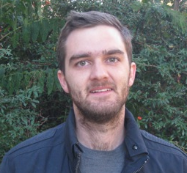
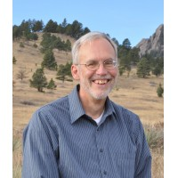
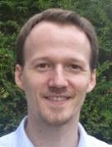
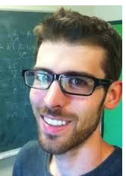
Acknowledgements
A. M. Rey
M. Wall
A. Safavi-Naini
R. Lewis-Swan
J. Bollinger
J. Bohnet
K. Gilmore
P. Hauke

Slide 26

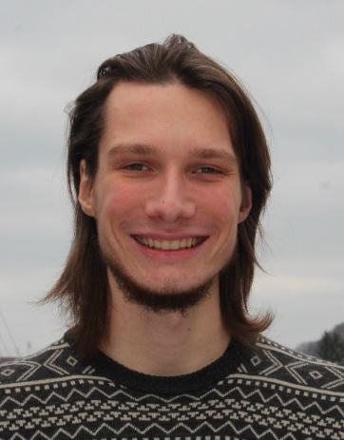
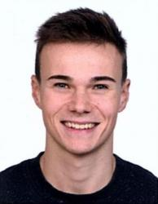
The Team
Stefanie Czischek
Linda Shen
Michael Rautenberg
Jan Philipp Klinger
Marcel Neugebauer
Sebastian Syrkowski
Adrian Breamer
Thank you!

