Slide 1




Dynamics of lattice gauge theories: reliability and out-of-equilibrium criticality
Jad C. Halimeh
Heidelberg University
Heidelberg, 23.09.2019

Slide 2
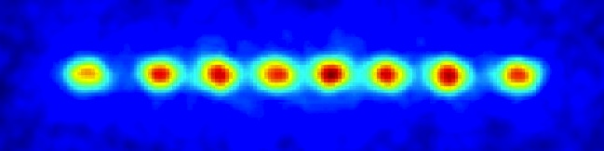




First experiments on gauge theories exist
$$e^{−}$$
$$e^{+}$$
$$e^{−}$$
$$e^{+}$$
Martinez, Muschik, Schindler, Nigg, Erhard, Heyl, Hauke, Dalmonte, Monz, Zoller, Blatt, Nature 2016
Further experiments with
explicit gauge invariance
Trapped ions
Kokail et al., Nature 2019
Ultracold atoms
Mil et al., arXiv:1909.07641
Superconducting Qubits
Klco et al., PRA 2018
Photons
Lu et al., arXiv:1810.03959
Optical lattice
Schweizer et al., arXiv:1901.07103

Slide 3
How can we certify these results?
Old question: “Can one trust quantum simulators?”
Hauke, Cucchietti, Tagliacozzo, Deutsch, Lewenstein, Rep. Prog. Phys. 2012
New results:
Trotter errors on local observables become benign at fast driving
(regular-chaos transition in periodically driven systems)
Heyl, Hauke, Zoller, Science Advances 2019
Sieberer, Olsacher, Elben, Heyl, Hauke, Haake, Zoller, arXiv:1812.05876
Even newer results: Gauge invariance
is naturally retained over a well-defined time scale
can be protected to infinite times
JCH and Philipp Hauke, in preparation

Slide 4
Breakdown of gauge invariance

Slide 5
Schwinger QLM in 1D

Slide 6
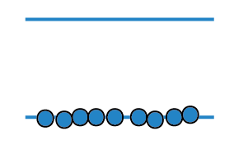
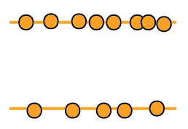



Real experiments will always break Gauss-law to some degree
⁷Li
²³Na
retains Gauss law
$$G=∇E−ρ≡0$$
$$g\left(b_{1}^{†}L_{−}b_{0}+b_{0}^{†}L_{+}b_{1}\right)$$
⁷Li
²³Na
breaks Gauss law
$$L_{−}+L_{+}\sim U+U^{†}$$
How severe are such processes?
For statics, see, e.g.,
Foerster, Nielsen, Ninomiya, „Light from Chaos“, Physics Letters 1980
Wetterich, Gauge symmetry from decoupling, Nuclear Physics B 2017

Slide 7





Real experiments will always break Gauss-law to some degree
⁷Li
²³Na
retains Gauss law
$$G=∇E−ρ≡0$$
$$g\left(b_{1}^{†}L_{−}b_{0}+b_{0}^{†}L_{+}b_{1}\right)$$
$$H=H_{0}+{λH}_{1}$$
⁷Li
²³Na
breaks Gauss law
$$L_{−}+L_{+}\sim U+U^{†}$$
$$H_{1}$$
total
Hilbert
space
Mil et al., arXiv:1909.07641
$$H_{0}$$
$$∇E−ρ=0$$

Slide 8




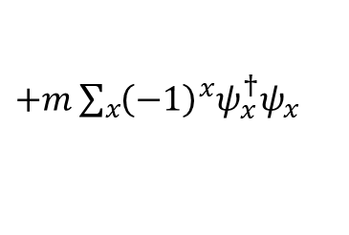


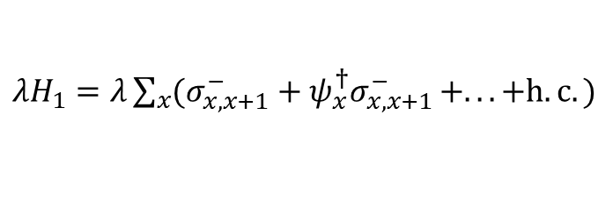
Benchmark with exact numerics
initial state
$$\hat{=}$$
$$H_{0}=−J\sum_{x}{(ψ_{x}^{†}σ_{x,x+1}^{−}ψ_{x+1}+h.c.)}$$
$+m\sum_{x}{{\left(−1\right)}^{x}ψ_{x}^{†}ψ_{x}}$
$$\hat{=}$$
$$+$$
$$−$$
$λH_{1}=λ\sum_{x}{(σ_{x,x+1}^{−}+ψ_{x}^{†}σ_{x,x+1}^{−}}+. . . +h.c.)$
$$\hat{=}$$

Slide 9
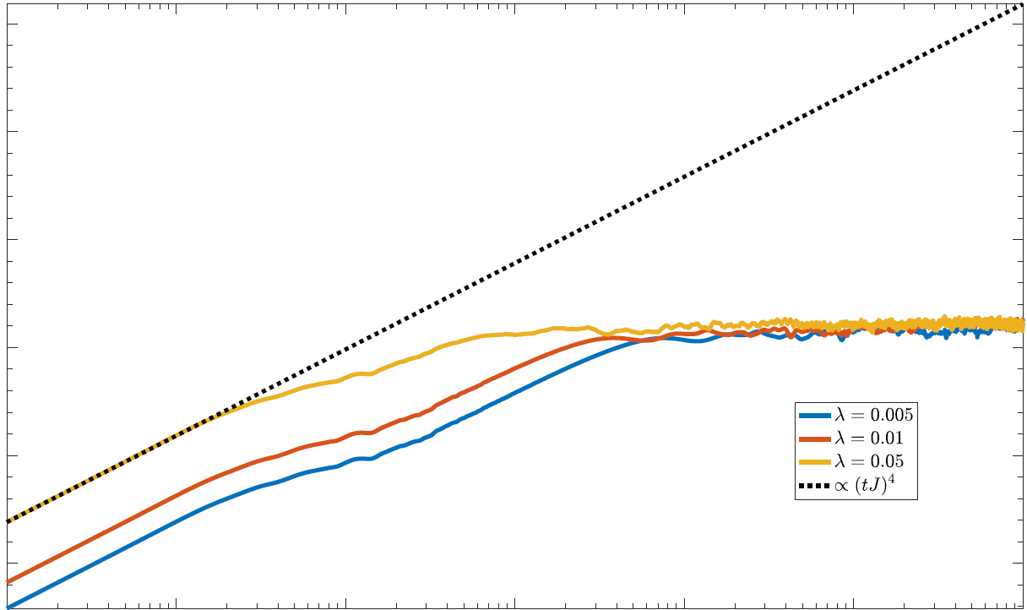
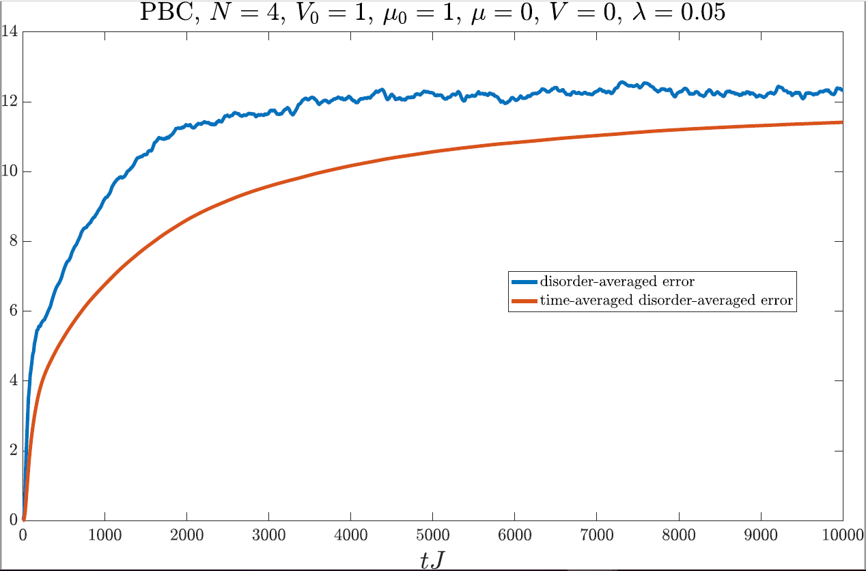







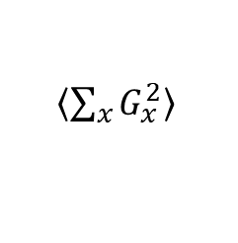



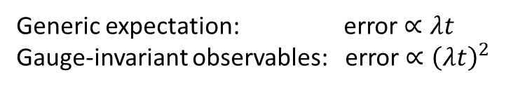


(I) Gauge-variant processes define time scale
${\left\langle \sum_{x}{G_{x}^{2}}\right\rangle }^{ }$
$${10}^{5}$$
$${∝\left(λt\right)}^{2}$$
saturation at
$G_{x}^{ }=random$
$${10}^{0}$$
$$0.05$$
$0.0$1
$$λ=0.005$$
$${10}^{−5}$$
$${10}^{−1}$$
$$tJ$$
$${10}^{5}$$
Generic expectation: error $∝λt$
Gauge-invariant observables: error $∝{\left(λt\right)}^{2}$
(from time-dependent
perturbation theory)
Intrinsic time scale over which
gauge invariance is preserved!
$⟹$
Can we do better?

Slide 10




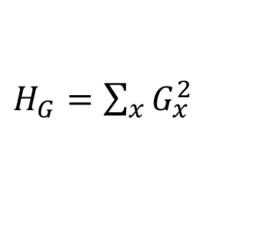
(II) Protection of gauge-invariance to large times
$$H=H_{0}+{λH}_{1}+VH_{G}$$
$H_{G}=\sum_{x}{G_{x}^{2}}$
energy protection, often used in quantum-simulation proposals to generate gauge-invariant terms perturbatively
$$H_{1}$$
$$H_{0}$$
$$∇E−ρ=0$$

Slide 11

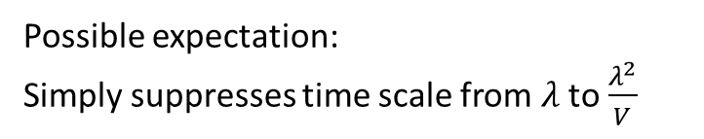

(II) Protection of gauge-invariance to large times
$$H=H_{0}+{λH}_{1}+VH_{G}$$
$H_{G}=\sum_{x}{G_{x}^{2}}$
Possible expectation:
Simply suppresses time scale from $λ$ to $\frac{λ^{2}}{V}$
$$V$$
$$H_{1}$$
$$H_{0}$$
$$∇E−ρ=0$$

Slide 12
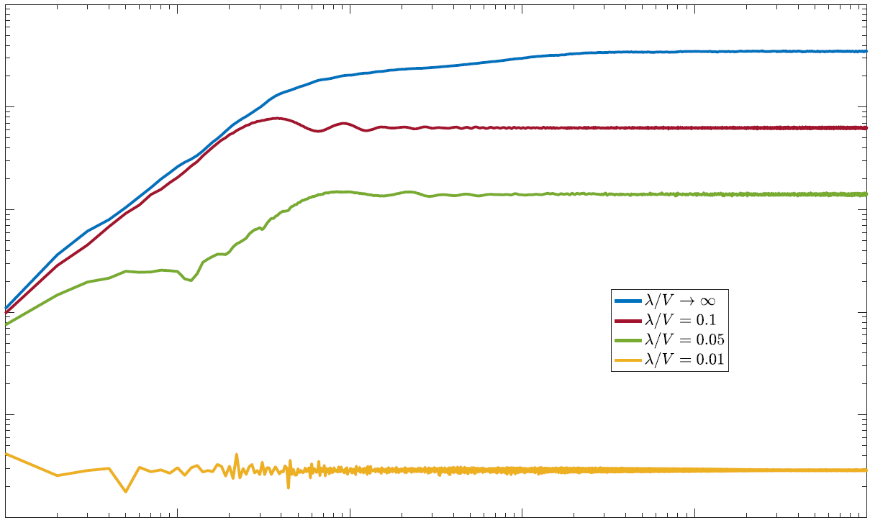
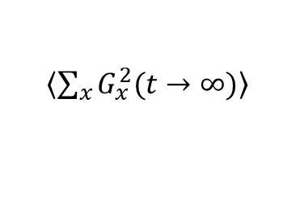









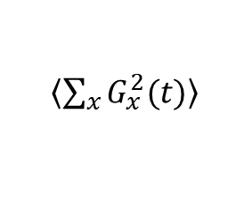



(II) Protection of gauge-invariance to large times
$$H=H_{0}+{λH}_{1}+VH_{G}$$
$H_{G}=\sum_{x}{G_{x}^{2}}$
$${10}^{1}$$
$$λ=0.05J$$
$$λ/V$$
$→∞$ ($V=0$)
${\left\langle \sum_{x}{G_{x}^{2}(t)}\right\rangle }^{ }$
$$0.1$$
$$0.05$$
${\left\langle \sum_{x}{G_{x}^{2}(t→∞)}\right\rangle }^{ }$
$${∝\left(λ/V\right)}^{2}$$
$$0.01$$
$${10}^{−4}$$
$${10}^{0}$$
$$tJ$$
$${10}^{5}$$
Surprisingly robust, even at long times!

Slide 13
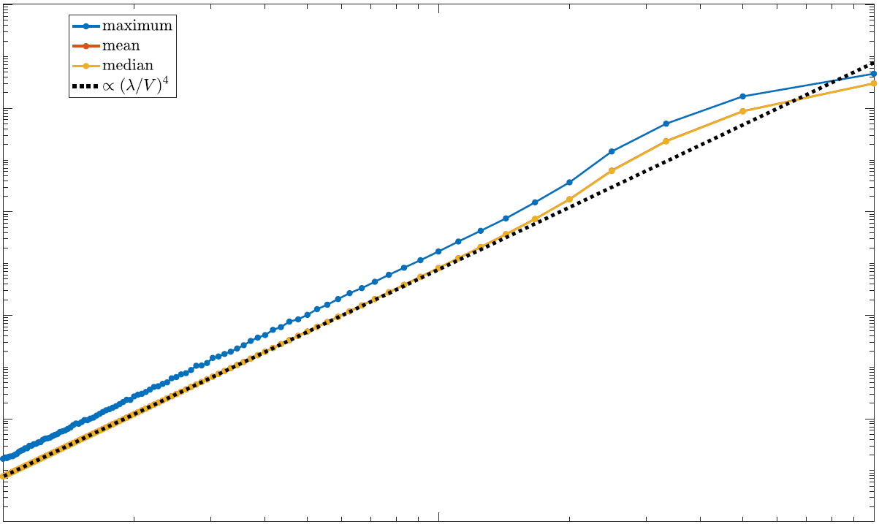

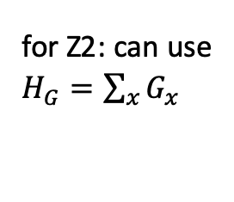






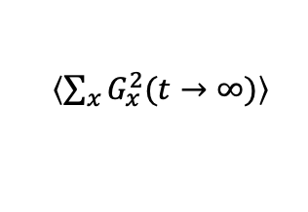

(II) Protection of gauge-invariance to large times
$H_{G}=\sum_{x}{G_{x}^{2}}$
for Z2: can use
$H_{G}=\sum_{x}{G_{x}^{}}$
$$H=H_{0}+{λH}_{1}+VH_{G}$$
${\left\langle \sum_{x}{G_{x}^{2}(t→∞)}\right\rangle }^{ }$
$${10}^{1}$$
Analytical explanations:
Degenerate perturbation theory
Emergent symmetry, perturbatively close to desired Gauss law
Chubb, Flammia, J. Math. Phys. 2017
Topological protection
Hastings, Wen, PRB 2005
maximum
$${∝\left(λ/V\right)}^{2}$$
$${10}^{−1}$$
time average
$${10}^{−3}$$
$${10}^{−2}$$
$${10}^{−1}$$
$$λ/V$$
$${10}^{0}$$

Slide 14
U(1) QLM: system-size effect

Slide 15
U(1) QLM: system-size effect

Slide 16
Z2 QLM: system-size effect

Slide 17
Z2 QLM: system-size effect

Slide 18
Dynamical quantum phase transitions
M. Heyl, A. Polkovnikov, and S. Kehrein, Phys. Rev. Lett. 110, 135704 (2013)

Slide 19
Domain-wall binding
JCH, M. Van Damme, V. Zauner-Stauber, and L. Vanderstraeten, arXiv:1810.07187

Slide 20
Z-quenches
JCH, M. Van Damme, V. Zauner-Stauber, and L. Vanderstraeten, arXiv:1810.07187

Slide 21
DQPT in lattice gauge theories

Slide 22
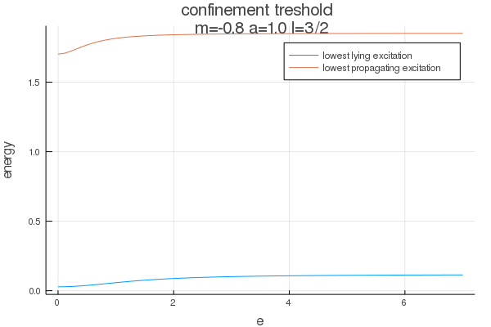
Confinement: half-integer spin
JCH, T. V. Zache, M. Van Damme, and P. Hauke, in preparation

Slide 23
Confinement: half-integer spin
JCH, T. V. Zache, M. Van Damme, and P. Hauke, in preparation

Slide 24
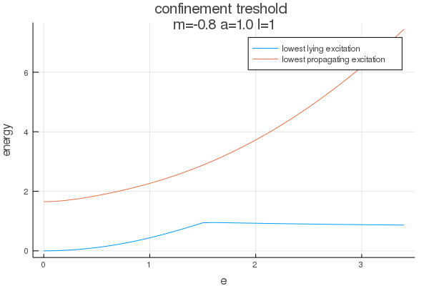
Confinement: integer spin
JCH, T. V. Zache, M. Van Damme, and P. Hauke, in preparation

Slide 25
Confinement: integer spin
JCH, T. V. Zache, M. Van Damme, and P. Hauke, in preparation

Slide 26
Confinement: integer spin
JCH, T. V. Zache, M. Van Damme, and P. Hauke, in preparation

Slide 27
Confinement: integer spin
JCH, T. V. Zache, M. Van Damme, and P. Hauke, in preparation

Slide 28
Confinement: integer spin
JCH, T. V. Zache, M. Van Damme, and P. Hauke, in preparation

Slide 29
Confinement: integer spin
JCH, T. V. Zache, M. Van Damme, and P. Hauke, in preparation

Slide 30
Confinement: integer spin
JCH, T. V. Zache, M. Van Damme, and P. Hauke, in preparation

Slide 31
Confinement: integer spin
JCH, T. V. Zache, M. Van Damme, and P. Hauke, in preparation

Slide 32
Conclusions
Protection of guage invariance robust up to long times
Emergent symmetry, perturbatively close to desired Gauss law
Rich dynamical phase diagram
Confinement leads to anomalous criticality

Slide 33



Collaborators
Philipp Hauke
Torsten Zache
Maarten Van Damme
Thank you!

