Slide 1
A fluid-dynamic approach to heavy-quark diffusion in the quark-gluon plasma
Federica Capellino
Physikalisches Institut Heidelberg
In collaboration with:
Beraudo A., Dubla A., Floerchinger S., Grossi E., Kirchner A., Masciocchi S., Pawlowski J., Selyuzhenkov I.
15.11.2022
QSEC22

Slide 2
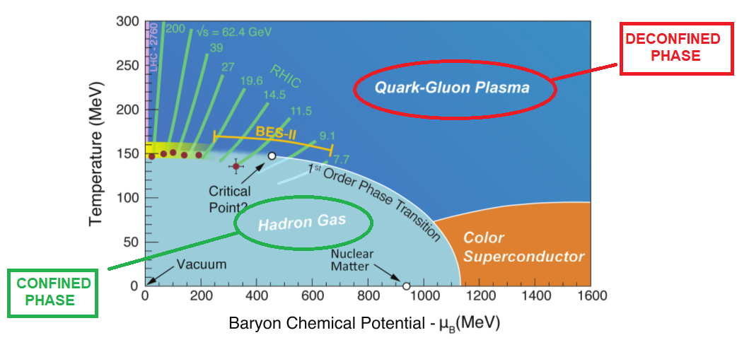
The QCD phase diagram
Heavy-ion collision experiments allow us to study the quark-gluon plasma, high-temperature deconfined phase in which the active degrees of freedom are quarks and gluons.

Slide 3
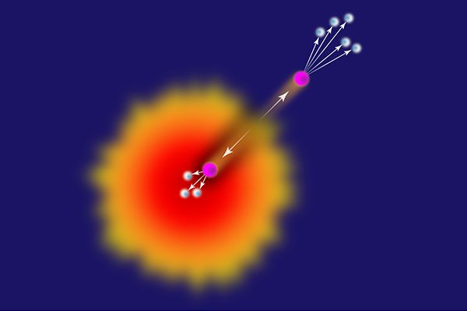
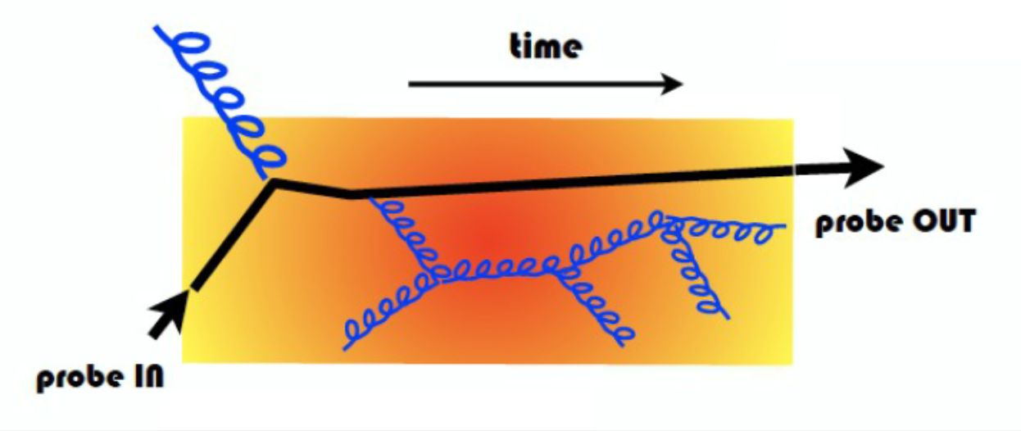
Heavy quarks as hard probes of the QGP
Heavy quarks in heavy-ion collisions
Are produced via hard scatterings at the beginning of the collision: they go through all the stages of the expanding fireball
They interact with light quarks and gluons in the QGP via elastic and radiative processes → they can lead to a better understanding of the parton-medium interaction
They help us in the characterization of the QGP
In the low pT region they provide a window to study equilibration processes

Slide 4
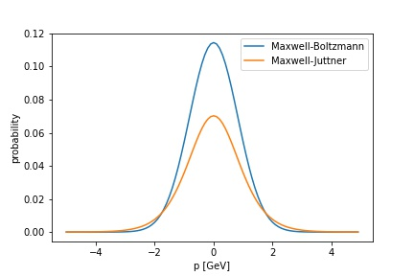
Thermalization
If particles have enough time to interact with each other they will eventually relax to (at least local) thermal equilibrium.
Chemical equilibrium:
the particle multiplicity is given by a thermal distribution at chemical potential μ = 0 For HQs: initial hard production very far from chemical equilibrium! Fugacity factor needed.
Kinetic equilibrium:
the momentum distribution of the particles approaches a Maxwell-Boltzmann (Maxwell-Juttner) distribution For HQs: possibly get quite close to local kinetic equilibrium within the lifetime of the fireball .
T = 0.45 GeV
M = 1.5 GeV

Slide 5
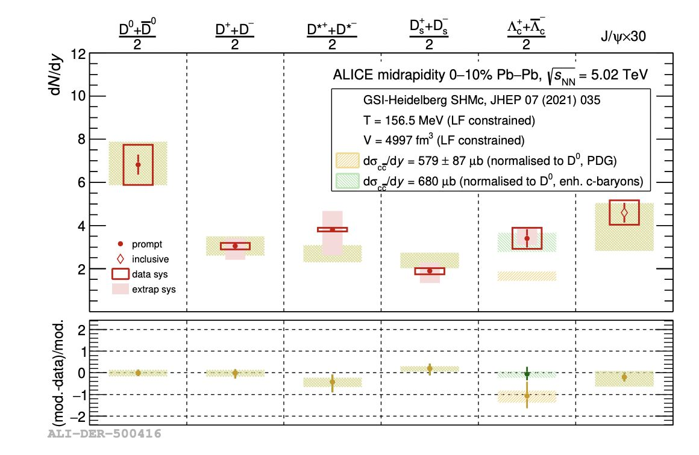
Statistical hadronization model for charm
An extension to the SHM was proposed to include charmed hadrons. The assumption of their production from a thermal source at the freeze-out temperature of the QGP reproduces well the experimental data!
Only one parameter - the fugacity factor
for charm ( 30) - is needed to reproduce
multiplicities of charmed hadrons.
First signs of full thermalization of charm quarks!
JHEP 07 (2021) 035 Andronic et al.

Slide 6
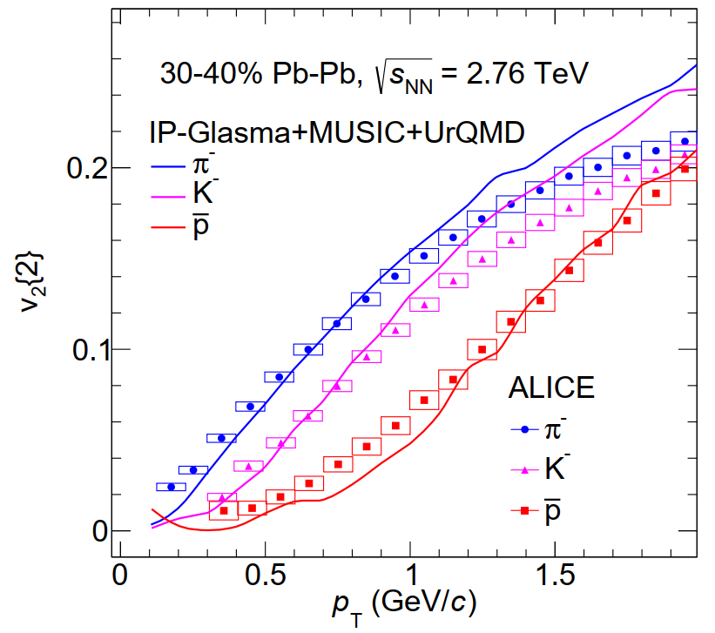
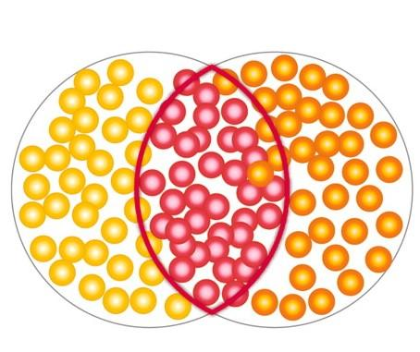
Hydrodynamics in the light sector
NPA 979 (2018) 251-264 Dubla et al.
Relativistic viscous hydrodynamics: powerful tool in order to capture
the features of the collective motion of the medium. It successfully
describes light-flavour observables such as elliptic flow of protons,
pions and kaons.
Elliptic flow v2 is an important probe of collectivity in the system created in HICs: it is a response of the dense system to the initial conditions → sensitive to the early and strongly interacting phase of the evolution.

Slide 7
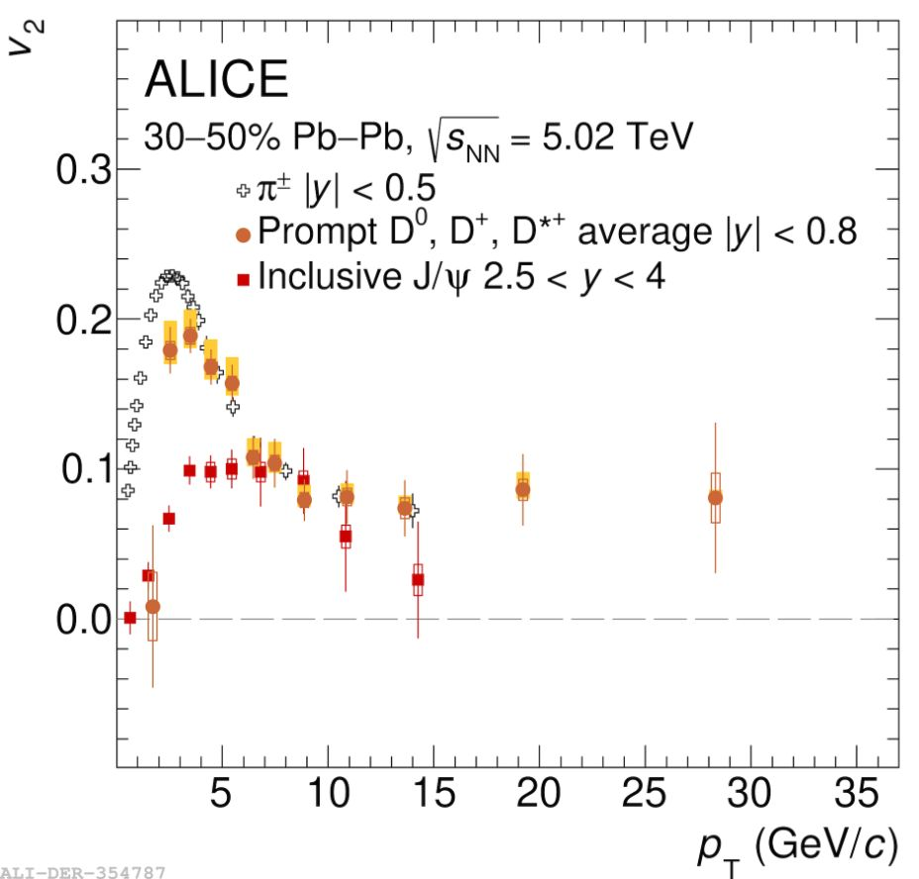
Further hints of thermalization
PLB 813 (2021) 136054 ALICE coll.
Significant measurements of J/Ψ and D mesons elliptic flow
How strong are charm quarks interacting with the partons in the QGP?
Do they interact long enough with the medium to be considered part of the medium itself?
Driven by the experimental data, we propose a new way of studying the heavy-quark dynamics in the QGP.
We assume heavy quarks interacted long enough
with the medium to approach local kinetic equilibrium
→ we treat them with a fluid-dynamic approach!

Slide 8
Heavy-quark conserved current
We write down a current associated to the conservation of QQbar pairs in the medium
HQ density
HQ diffusion current
+ equation of motion for the diffusion current
We need to determine the equation of motion for the diffusion current. We do it in a kinetic theory setup.

Slide 9
HQ distribution function
Heavy quarks are initially produced out of kinetic equilibrium: they cannot be described by a thermal Boltzmann distribution at the same temperature of the QGP

Slide 10
HQ distribution function
Heavy quarks are initially produced out of kinetic equilibrium: they cannot be described by a thermal Boltzmann distribution at the same temperature of the QGP
Fugacity: needed to match the number of QQbar pairs
Out-of-equilibrium component
The diffusion current is given by the first moment of the out-of-equilibrium distribution function and the density is given by integrating the equilibrium part, in the Landau frame.
PRD 85 (2012) 114047 Denicol et al.

Slide 11
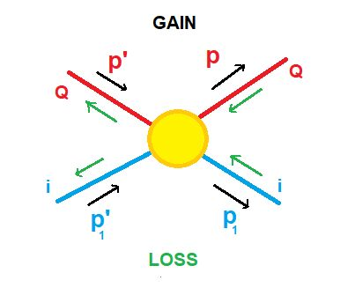
Boltzmann equation
We start with the relativistic Boltzmann equation, which studies how the distribution function of the heavy quark varies in time
where the collision integral reads
Heavy quarks
- treated like Brownian particles - asymptotically reach thermal equilibrium
Great effort was put to determine the value of the transport coefficients that encode the interaction between the heavy quark and the partons from the medium.

Slide 12
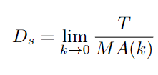
Equation of motion for the HQ diffusion current
We derive hydrodynamic equations of motion from kinetic theory (Boltzmann) in a Fokker-Planck approximation
Drag coefficient - inverse relaxation time
Momentum-diffusion coefficient
The spatial diffusion coefficient is defined as

Slide 13
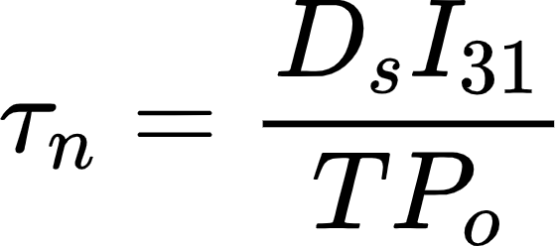
Equation of motion for the HQ diffusion current
We derive hydrodynamic equations of motion from kinetic theory (Boltzmann) in a Fokker-Planck approximation
By integrating the first moment of the equation
We obtain a relaxation-type equation for the diffusion current
HQ diffusion coefficient
Relaxation time

Slide 14
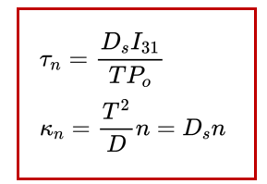
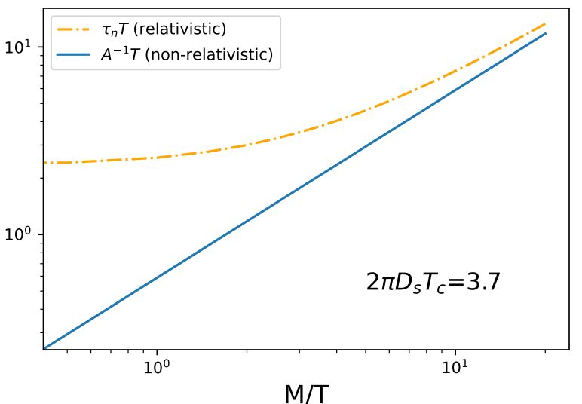
Fluid-dynamic transport coefficients
Important check: the hydrodynamic relaxation time is consistent with the
relaxation time found within the Fokker-Planck approach in the non-relativistic limit.

Slide 15
Fluid-dynamic transport coefficients
The relation between spatial diffusion coefficient and momentum-diffusion coefficient - usually found in a non-relativistic setup - arises naturally also in a relativistic framework.
This work, PRD 106 (2022) 034021

Slide 16
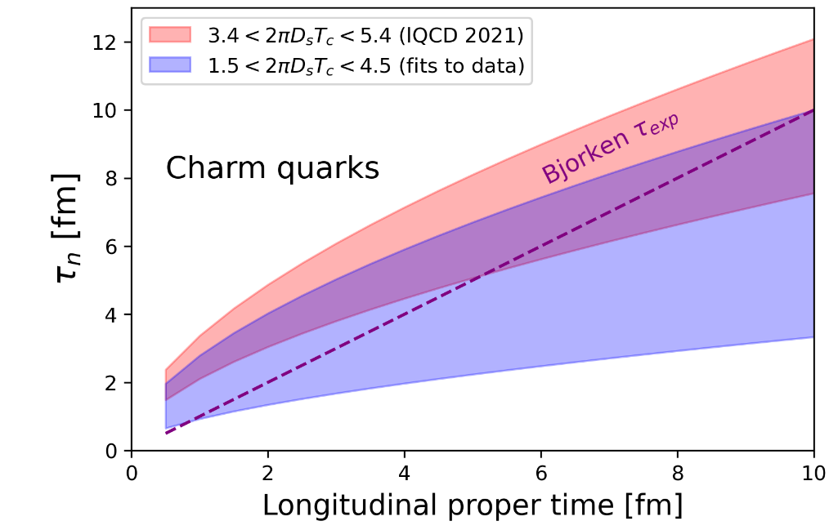
Results for charm quarks
This work, PRD 106 (2022) 034021
Bjorken flow:
We compare the typical expansion time of the QGP undergoing a Bjorken flow with the relaxation time obtained for charm.
Remarkably, the relaxation time for charm becomes much smaller than the expansion time of the fluid very quickly: a fluid-dynamic description for charm looks feasible.
lQCD 2021: PRD 103 (2021) 014511 Altenkort et al.
ALICE fits to data: JHEP 01 (2022) 174 ALICE coll.

Slide 17
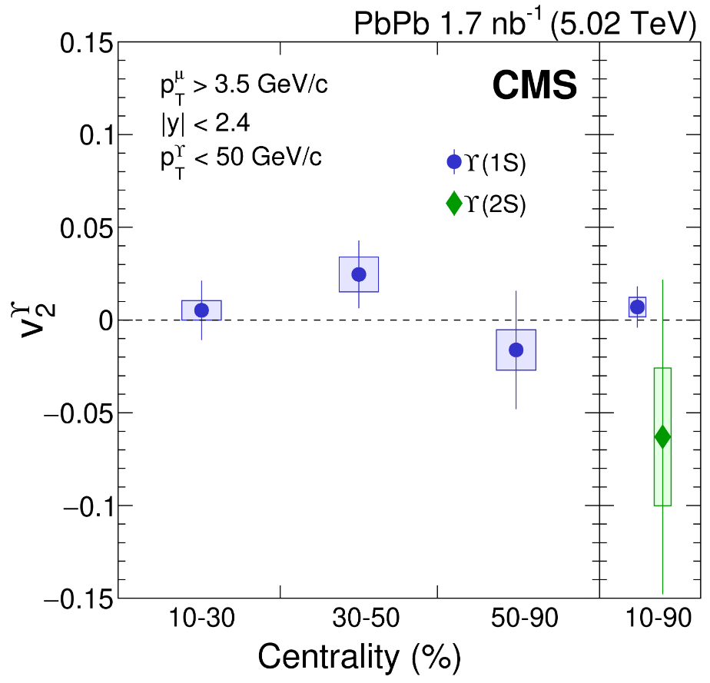
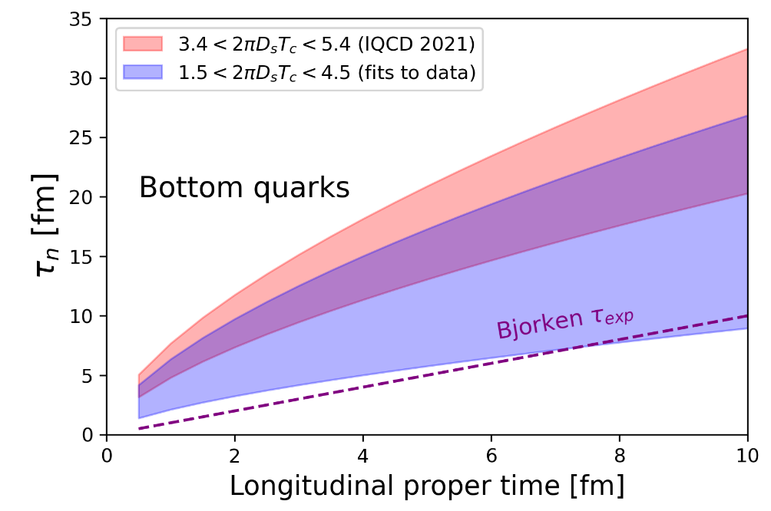
Results for bottom quarks
- From new data at low pT, can we see partial thermalization of beauty quarks in the QGP? - Can we constrain estimates for the transport coefficients by systematic comparison with data?
This work, PRD 106 (2022) 034021
PLB 819 (2021) 136385 CMS coll.

Slide 18
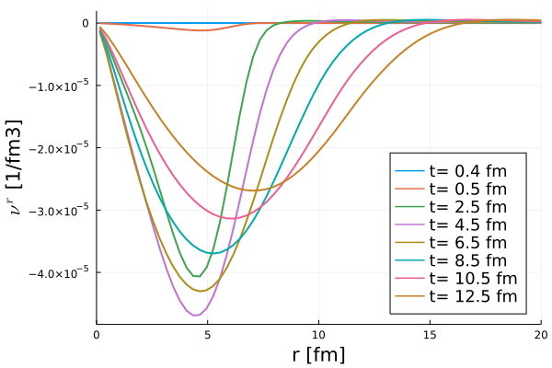
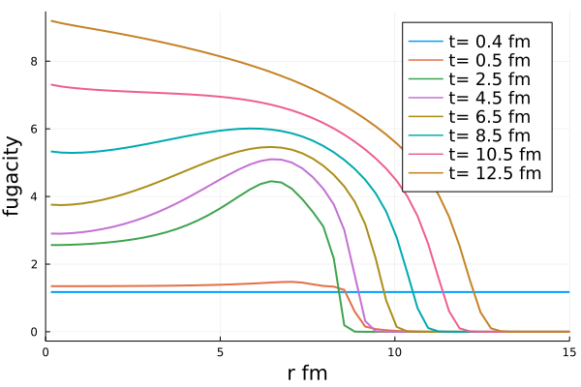
Preliminary results for charm in FluiduM
Very small diffusion current it would be interesting to study different initial conditions for it
A sizeable fugacity indicates that HQs are quite far from kinetic equilibrium (if chemical equilibrium, µ should tend to 0)
For more details on FluiduM: Luuk Vermunt‘s poster, PRC 100, 014905 (2019) Floerchinger et al., JHEP 06 (2020) 044 10.1007 Devetak et al.

Slide 19
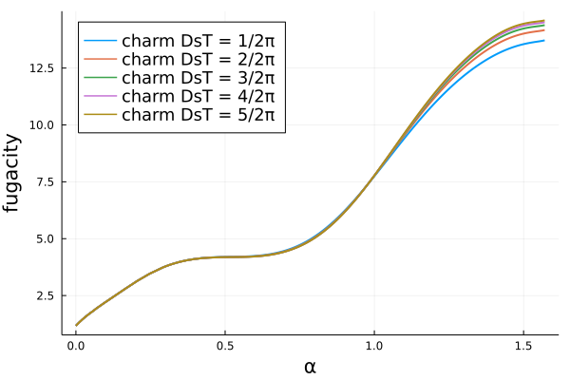
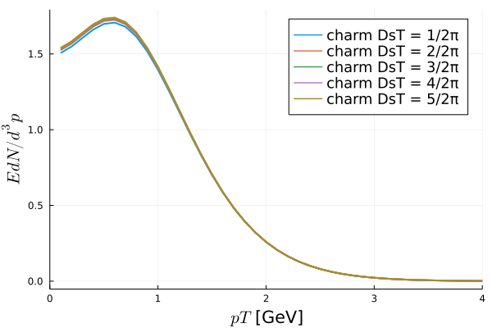
Charm quark spectra with FluiduM
We employ the Cooper-Frye prescription on the freeze-out surface at T = 156 MeV.

Slide 20
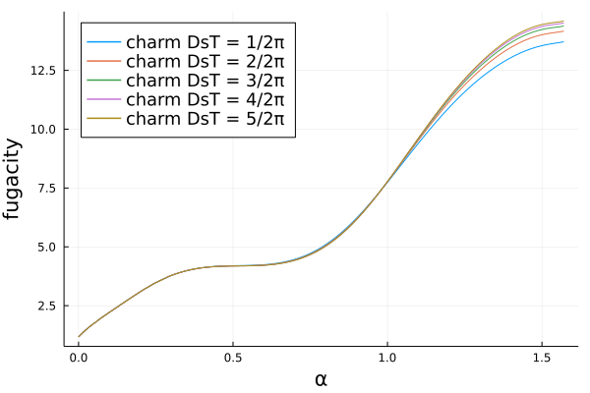
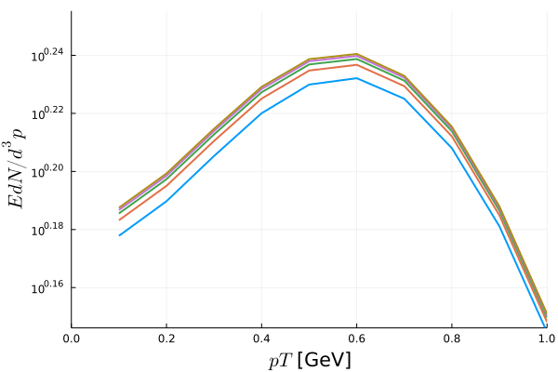
Charm quark spectra with FluiduM
We employ the Cooper-Frye prescription on the freeze-out surface at T = 156 MeV.
Little variation at low pT due do the diffusion coefficient: other observables might be more sensitive!

Slide 21
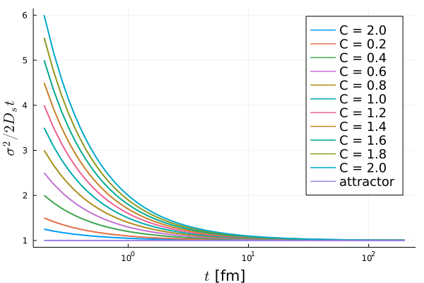
Looking for attractors
We study the variance of the HQ density as a function of dimensionless time t divided by the HQ relaxation time in 1D.
Initial condition
For late times, the variance evolves linearly with time and forgets about the initial conditions.
Does this feature survive an expanding environment?
Can we find it also in more dimensions?
Can we find attractor solutions for the HQ density?
WORK IN PROGRESS!

Slide 22
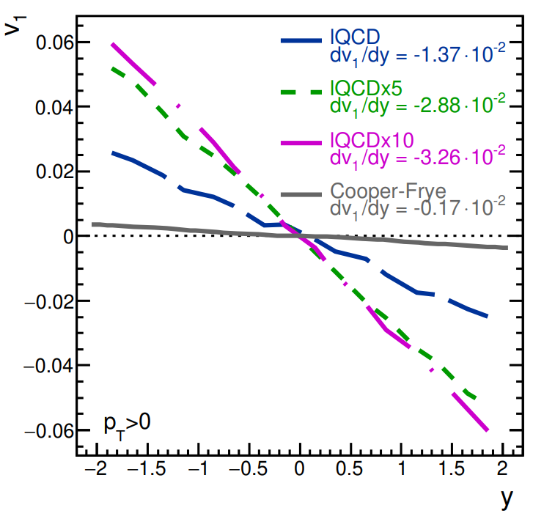
Summary
A fluid-dynamic description of heavy-quark diffusion seems feasible for charm quarks
First results for charm spectra available
Outlook
Study charmed hadron spectra and flow coefficients
with FluiduM
Study attractor behaviour under realistic hydro
simulation of the QGP
Couple HQ diffusion with magnetic fields
Study multiple conserved charges
Beraudo et al. JHEP 2021, 279 (2021)

Slide 23
Back up

Slide 24
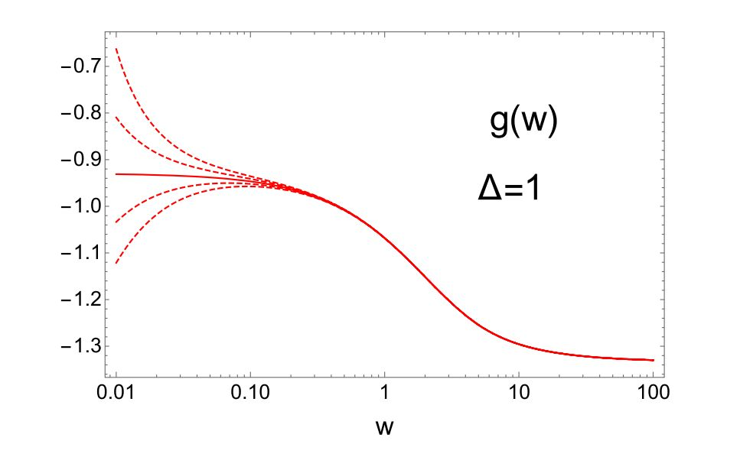
A challenging problem: initial conditions
What’s the connection between the initial spatial and momentum distribution?
Under which conditions fluid-dynamics and kinetic theory coincide for heavy quarks?
Is there an attractor solution for the hydrodynamic behaviour of HQs?
IF YES: do we lose the information on the initial state?
IF NO: can we infer something on the initial conditions? Can we observe a preferred phase-space
trajectory for heavy quarks in the QGP?
PLB 820 (2021) 136478 Blaizot et al.
Measure of pressure anisotropy under Bjorken flow for different initial conditions

Slide 25
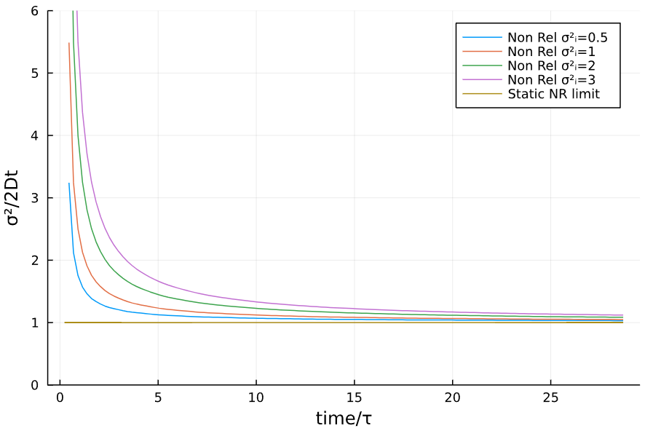
Searching for attractors: expanding QGP
Charm quarks
In the non-relativistic case, the attractor behaviour survives Bjorken flow, and it coincides with the one at static temperature.

Slide 26
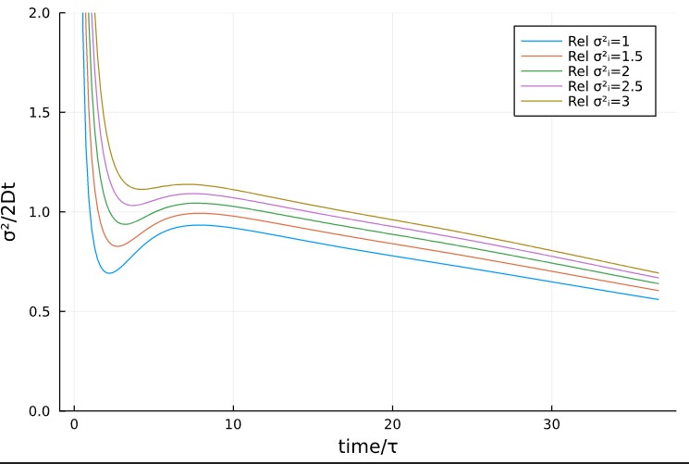
Searching for attractors: expanding QGP
Charm quarks
In the relativistic case the attractor behaviour seems to exist but it doesn’t coincide with the non-relativistic one.

Slide 27
Charm in FluiduM: causality
In order to have causal EOM for the diffusion current, the relation
must hold, where we defined
And
is the isothermal susceptibility.

Slide 28
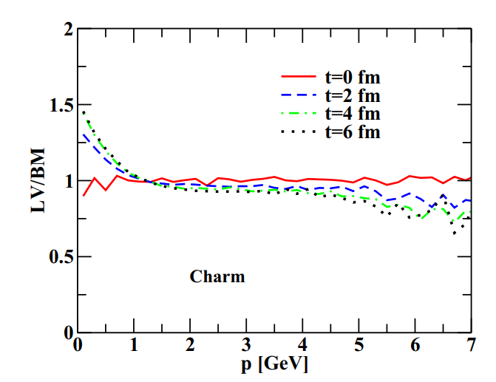
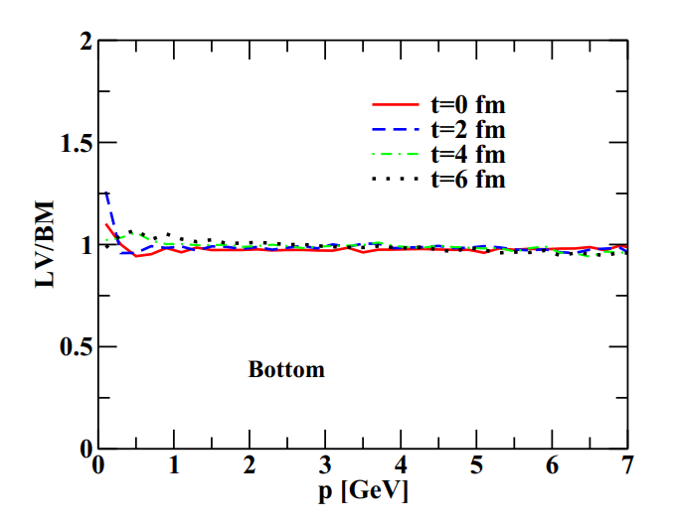
Boltzmann vs Langevin/Fokker-Planck
PRC 90 (2014) 044901 Das et al.

Slide 29
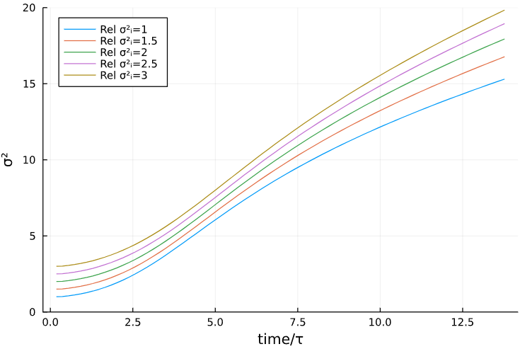
Searching for attractors: expanding QGP
Charm quarks
In the relativistic case the attractor behaviour seems to exist but it doesn’t coincide with the non-relativistic one.

Slide 30
Study the equation with Bjorken flow
To implement Bjorken flow, I write the equation in Bjorken coordinates
and then use time-dependent transport coefficients.
If this term is positive density decreases
If this term is negative density increases
Depending on the value of and I will see different behaviours at the early stages of the evolution.
E.g. in our case for charm quarks
The density will increase at the beginning of the evolution.

Slide 31
