Slide 1



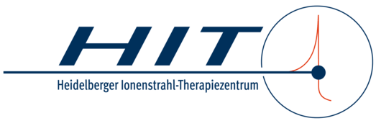
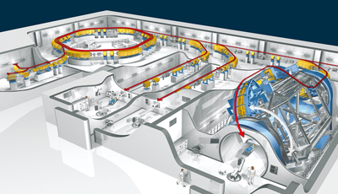
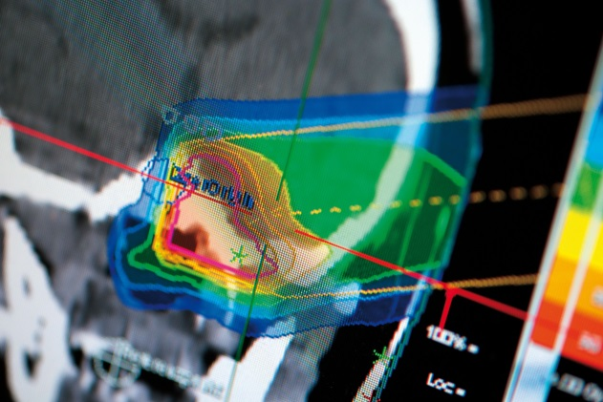

Development of a
Scintillation Fiber Transverse Profile Monitor
for Low-Intensity Ion Beams at HIT
14.07.2022, Richard Hermann

Slide 2
Agenda
Intro
Prototype
Experiments
Conclusion & Outlook

Slide 3
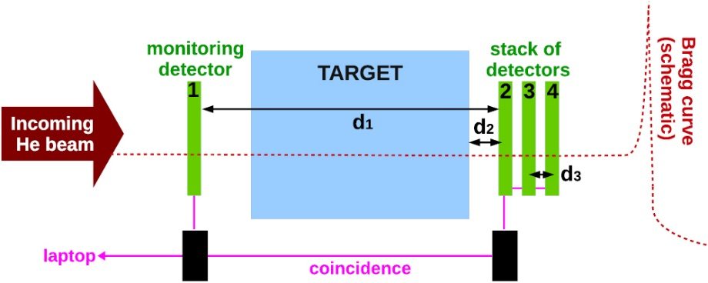
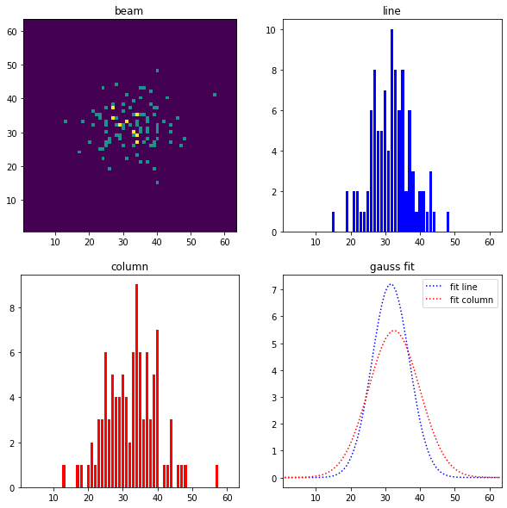
DFG Project
“Energy-painted ion radiography for precision radiotherapy“
Helium Beam Radiography
(Tim Gehrke)
  Smaller geometric uncertainties
  between CT and therapy.
  Tissue stopping power more precise.
  Smaller radiation dose.
Requirement:
Monitor for low intensity ion beams.
Beam pos. and shape not yet monitored
for ≤ 10^5 pps (feedback missing)
*
100 Ionen
*G. Aricò, T. Gehrke, J. Jakubek, R. Gallas, S. Berke, O. Jäkel, A. Mairani, A. Ferrari, M. Martišíková, Investigation of mixed ion fields in the forward direction for 220.5 MeV/u helium ion beams: comparison between water and PMMA targets, Physics in medicine and biology 62, 8003 (2017).

Slide 4
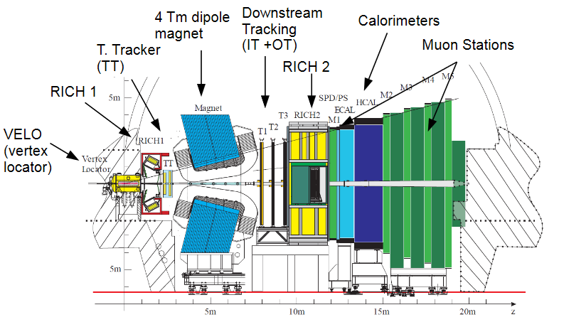
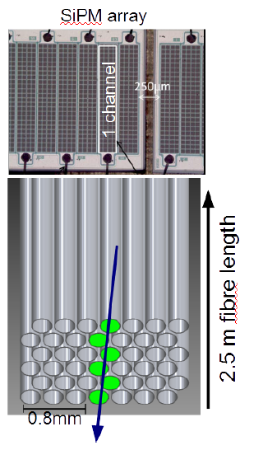

Idea from
LHCb Tracker @ Cern
LHCb fibers: 250µm x 3m, 6 layer, round
(Kuraray SCSF-78MJ)
(B. Leverington)
7.200 photons per MeV
  0,4 MeV/mm (@220 MeV/u He)
  5,4% trapping
  35% PDE* der SiPM**
  2x ~5% opt. coupling losses (air)
  (Rs = 11.55% , Rp = 1.19%)
  ≈ 45 photo electrons / He-ion
  (> 5 p.e. needed for S/N threshold)
  + 5% non-detected ions in on layer of round fibers.
*PDE: Photon Detection Efficiency **SiPM : Silicon Photomultiplier
B. Leverington „The SciFi Tracker for the LHCb Upgrade“, Vortrag 2014 in Neckarzimmern
Notes:
What?
Lhcb experiment at cern
They have small fibres, which glow when a ion is passint through – these are the szintillating fibres
Here you see that they are actually quite big.
With photomultipliers they amplify the light-signal
to get a sense of the scale we’re talking about: in my setup I get about 50 photons per Helium-Ion – and I don’t know yet how many I loose due to bad optical coupling between fibre and photomultiplier.

Slide 5
Profile monitor for low intensity ion beams
Advantages of LHCb inspired SciFi-Detector
Highly-tested, radiation hard and cheap fibers
  Low running/replacement costs: ion damage and aging only on fibers
  Expensive electronics in safe distance to beam (≠ semiconductor det.)
Clear structure of detector system
  Only a few components
  No gas or vacuum necessary
  No semiconductor creation necessary
  No cooling necessary (works at RT)
Usability
  Scalability of detector channels and electronics
  Readout electronics commercially available and comes with control software for first experiments

Slide 6
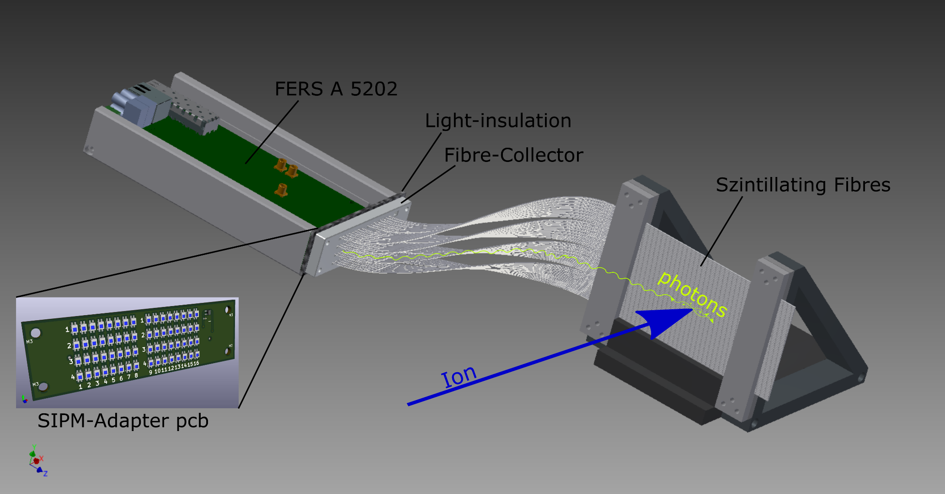
Prototype
Idea for first test setup
Readout inspired by IDEA Dual-Readout calorimeter - R. Santoro, INFN

Slide 7

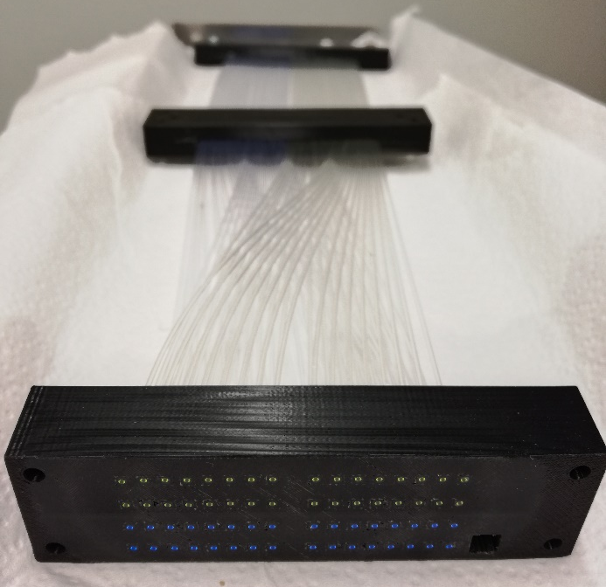
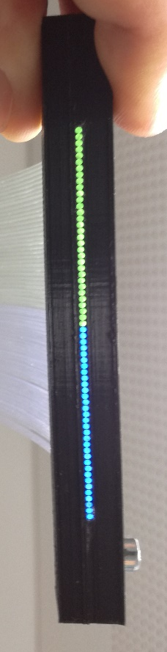
Scintillating fibers
Probes
Cutted and polished by hand
PI Heidelberg:
gluing into 3D print and milling
Kuraray SCSF-3HF multiclad
  Radiation harder
  7ns decay, 530nm
Kuraray SCSF-78 multiclad
  Same as LHCb
  2.8ns decay, 450nm
Radiation hardness:
SCSF-3HF 20% loss where SCSF-78 has 60% loss *
Kuraray 3HF multi clad
Kuraray 78 multi clad
* Preliminary radiation damage analysis for the HIT beam profile monitor; M.Dziewiecki, B.Leverington, G.Meo; Heidelberg 13.02.2018

Slide 8
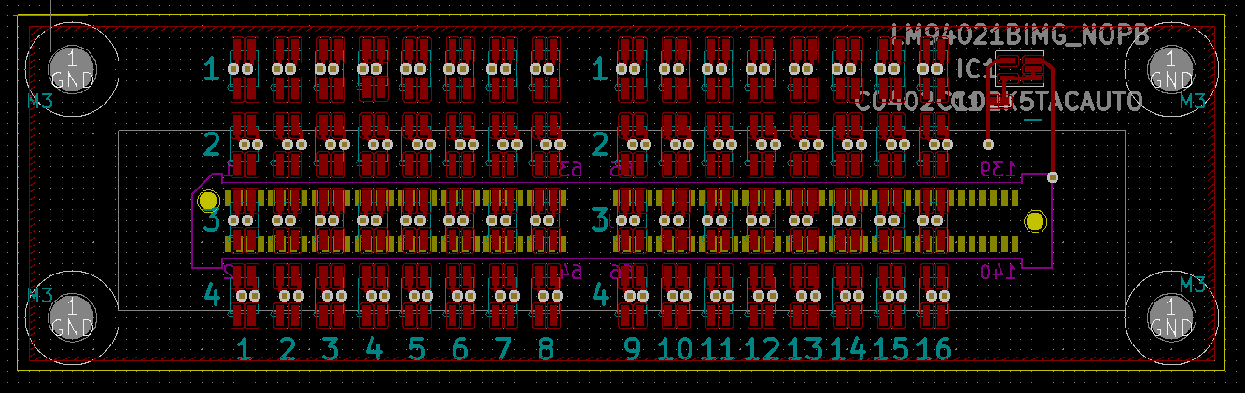
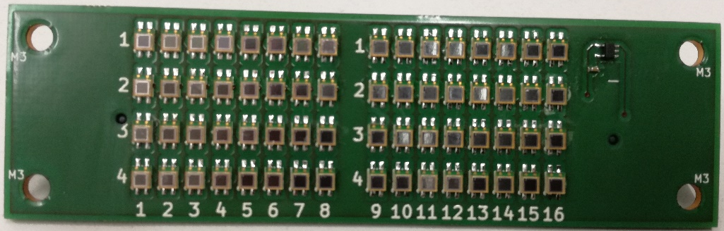
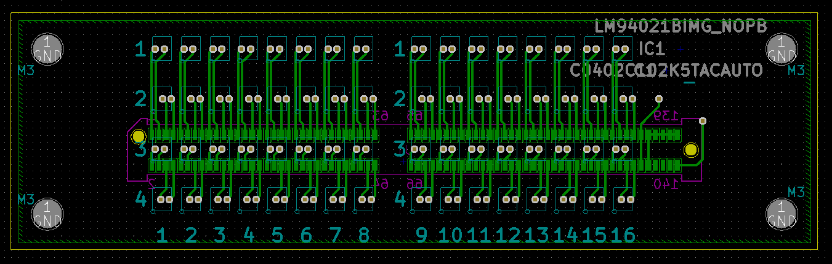
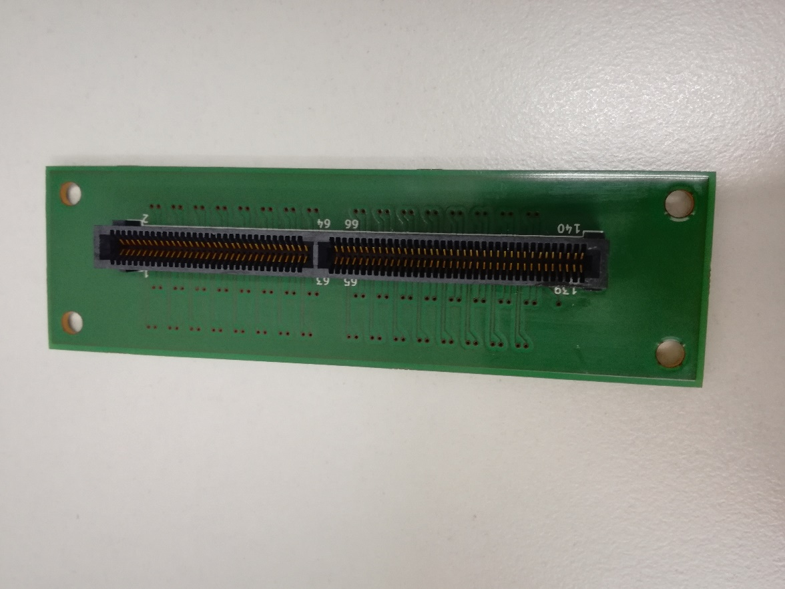
Photomultiplier
SiPMs on PCB*
MPPC** (S13360-1350PE)
  667 cells (50µm APDs)
  on 1,3x1,3mm² active area
  Peak PDE at 450nm = scintillating fiber (SCSF-78)
≈ 9 cm
*PCB: Printed Ciruit Board
**MPPC: Multi-Pixel Photon Counter (by Hamamatsu)

Slide 9
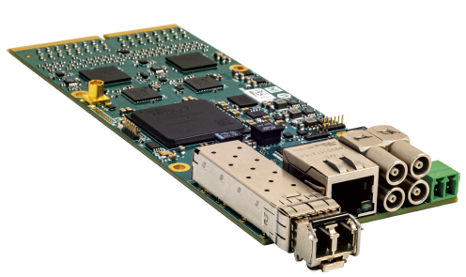
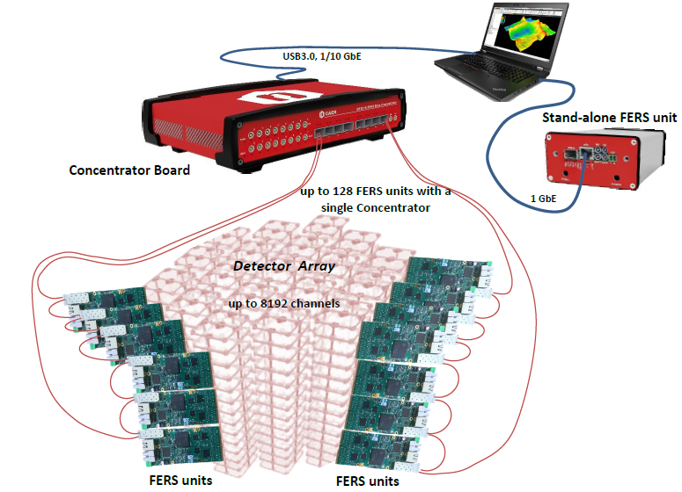
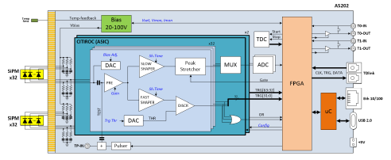
Electronics
Readout System
CAEN FERS A5202
[64 Channel CITIROC ASIC]
Future: DT5215 (CAEN)
combines several FERS boards
User Manual UM7945, A5202/DT5202; 64-Channel Citiroc-1A Unit for FERS-5200; Rev. 2 - September 9th, 2021

Slide 10
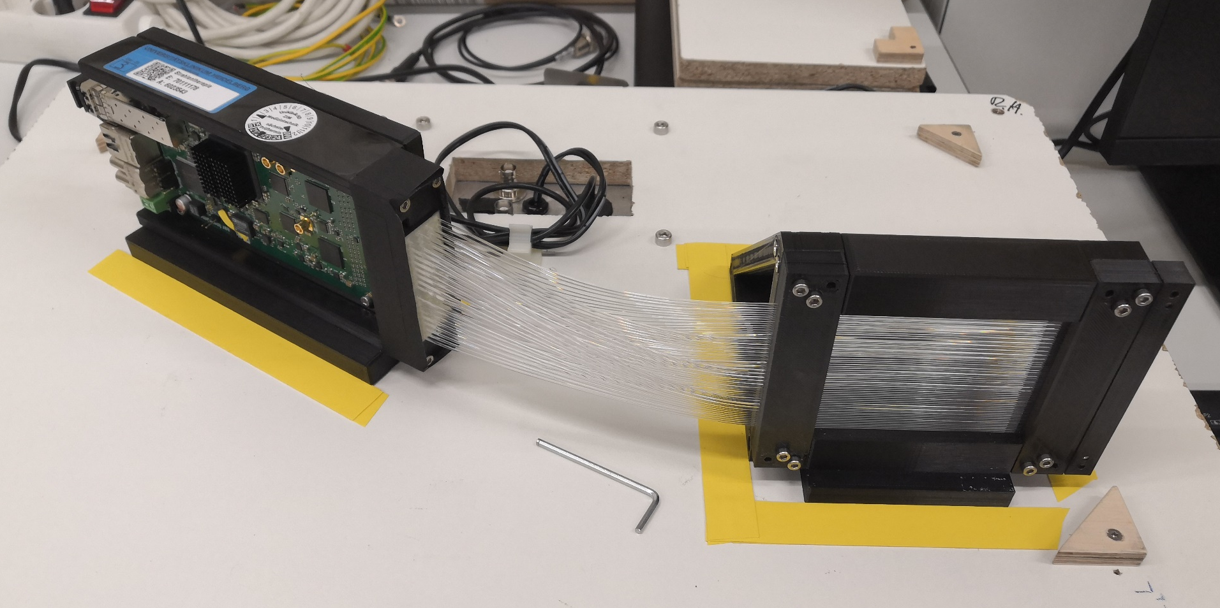
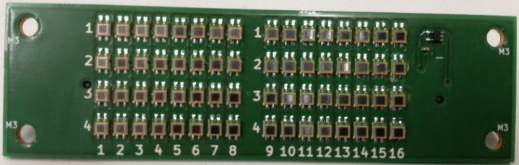
Prototype Setup
Realization
CAEN FERS A5202
Scintillating Fibres
SiPMs on PCB
Ion Beam

Slide 11
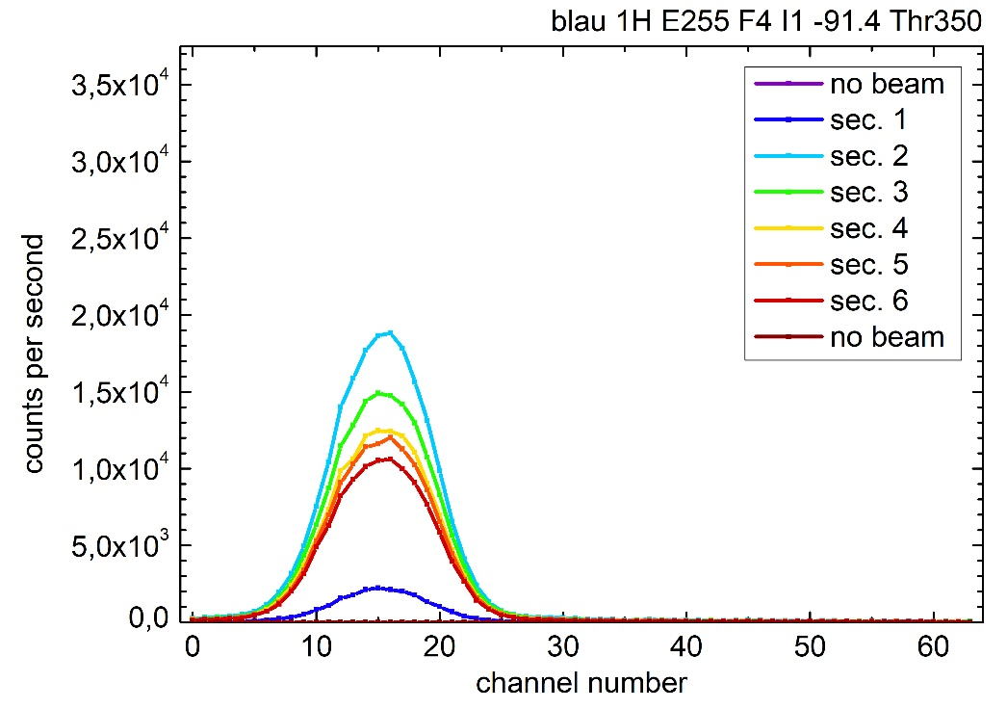
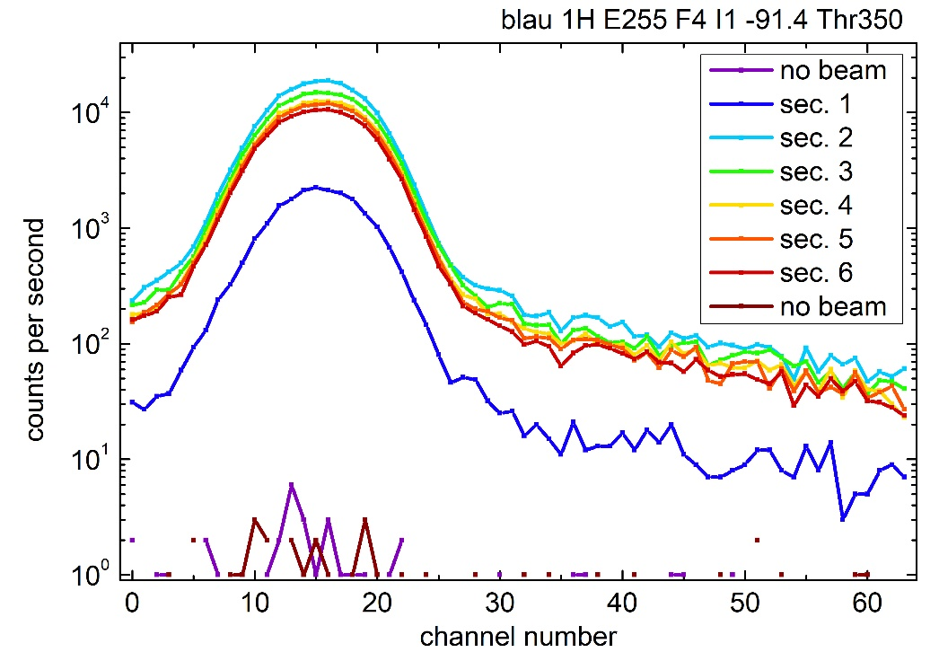
Measurements In Beam
1H, E#255, F#4, < I#1
≈ 100.000 ions/sec.
Threshold 350 (a.u.) from staircase plot
Signal to DCR: ≈ 20.000
Signal to Noise within beam: ≈ 50 - 100
logarithmic

Slide 12
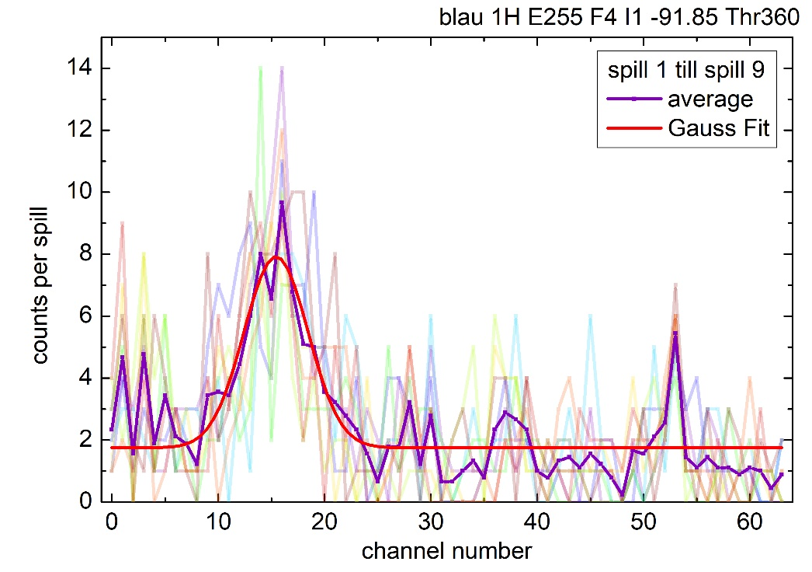
Proof of Principle: very low intensity beam
1H, E#255, F#4, << I#1
Really low intensity: ≈ 8 ions/sec.
(-> from TimePIX)
Edge of useful resolution reached.
Proof of principle
Simulation: 100 Ions
✓
Notes:
Only some of the spills have visible signal – some actually seem empty

Slide 13
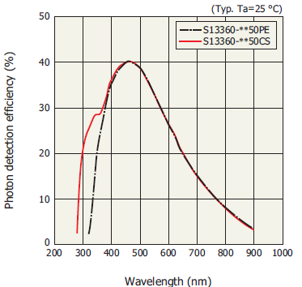

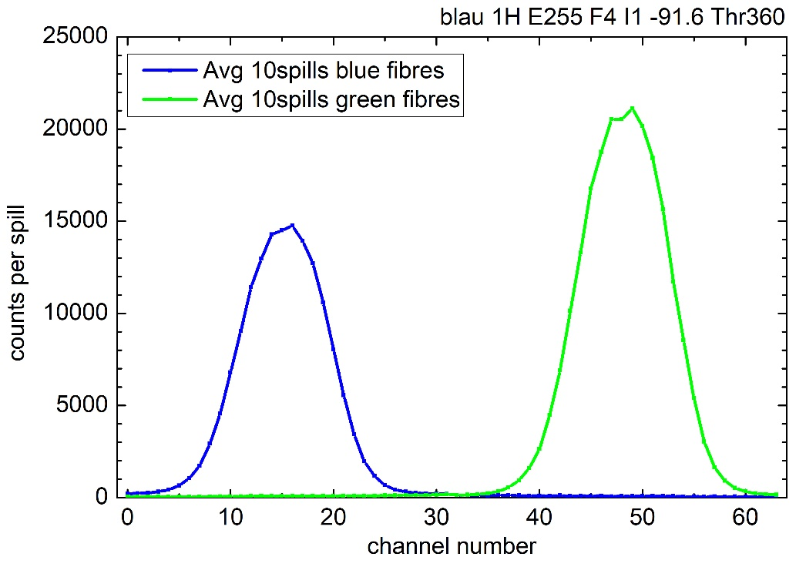
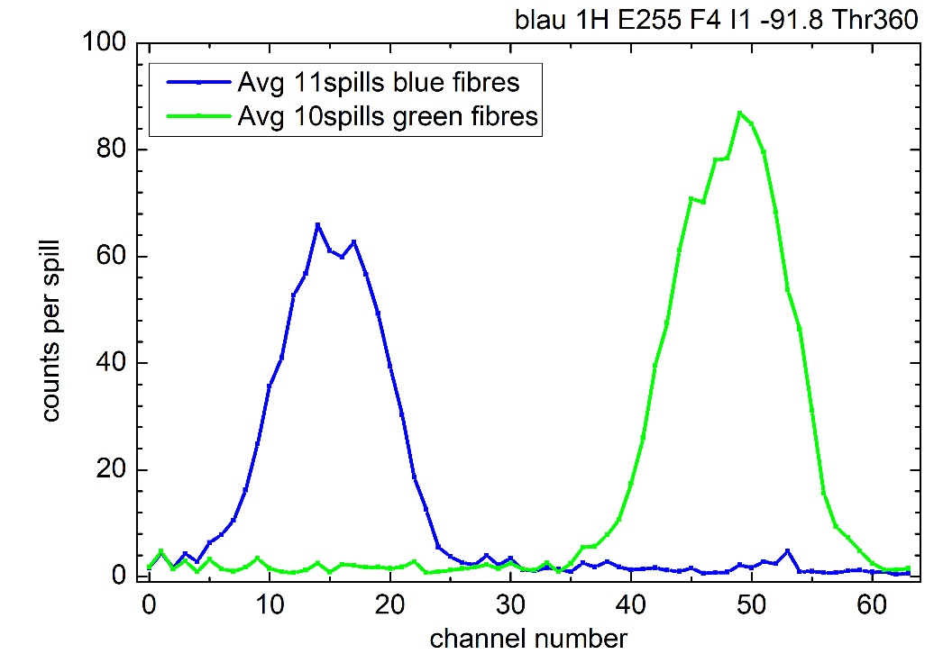
Measurements In Beam
1H, E#255, F#4, < I#1
SiPM PDE
Kuraray SCSF-78 (450nm, 8k phot./MeV*)
VS
Kuraray SCSF-3HF (530nm, 7.1k phot./MeV*)
I
Fibre-SiPM combination seem to have better S/N in this application.
≈ 30.000 ions/sec .
≈ 60 ions/sec .
* From Saint-Gobain fibre product sheet. Values for Minimum Ionizing Particles (MIP), corrected for PMT sensitivity

Slide 14
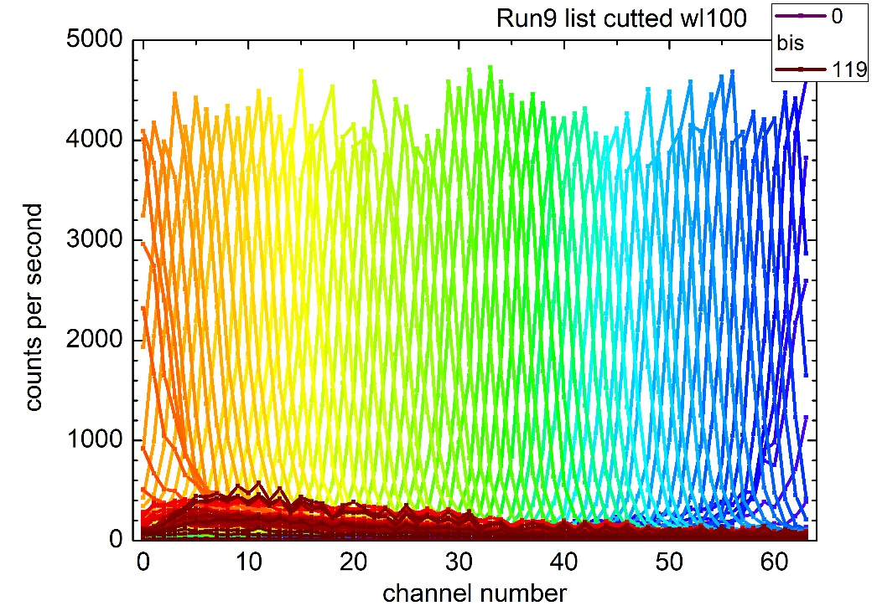
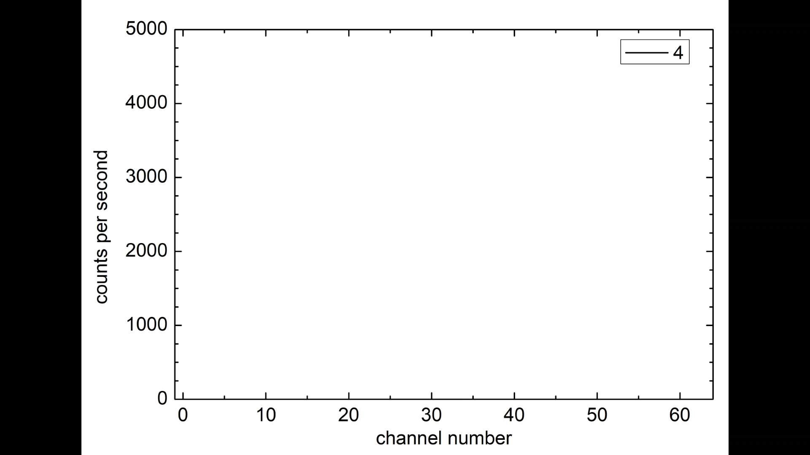
Measurements In Beam
C12 Scan, 430 MeV/u, F 3.4mm, 20k ions/mm
100 steps in 1,2 sec (from -50mm till 50mm) → 2E6 ions/sec (≙ I#1)
Position and width, movement and timing measurable.
If perfected, this can be used to define supply voltage corrections for SiPMs
10ms frames
8x slower than reality
Notes:
If not working : time is coded in colour on left side
More visual on right side

Slide 15
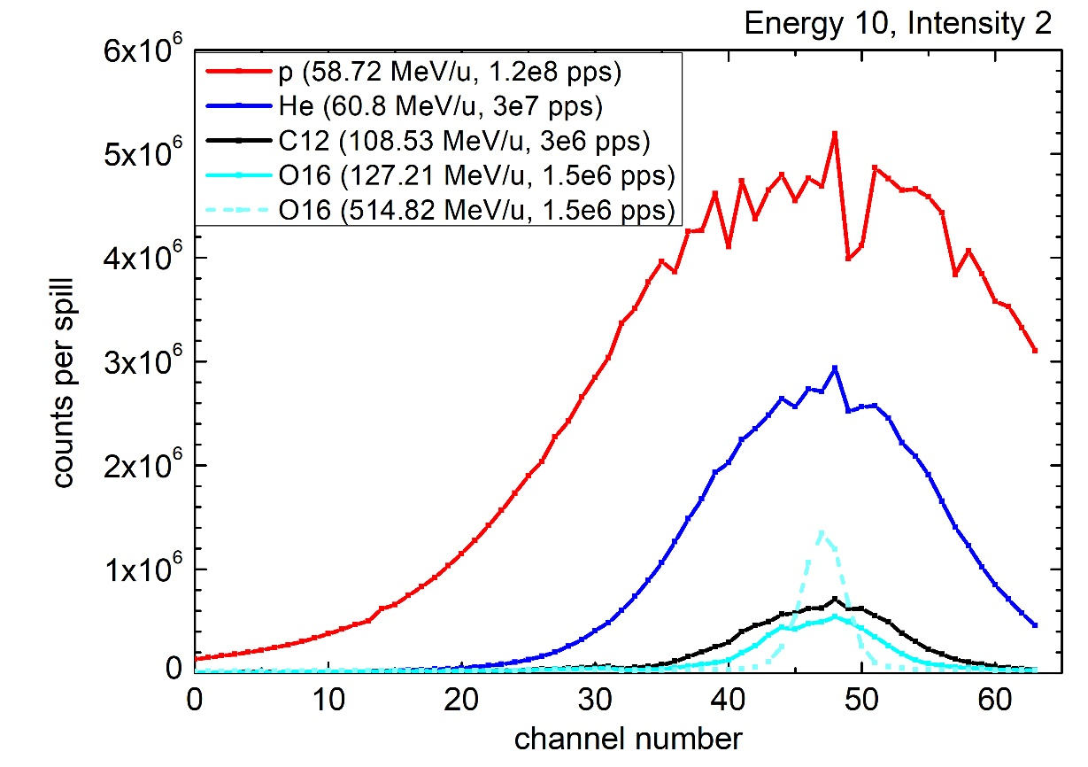
Ion Comparison
All at E#10 and I#1
I = 10mA was max.
I > 1mA looses gaussian shape
Over current only for wide (F > 1), high intensity proton beams.
Anyway, data loss through jumped time windows
Over a certain limit (roughly at 1e7 pps) SiPMs can’t fully recharge before next hit.
→ Missing counts
→ non-gaussian form

Slide 16
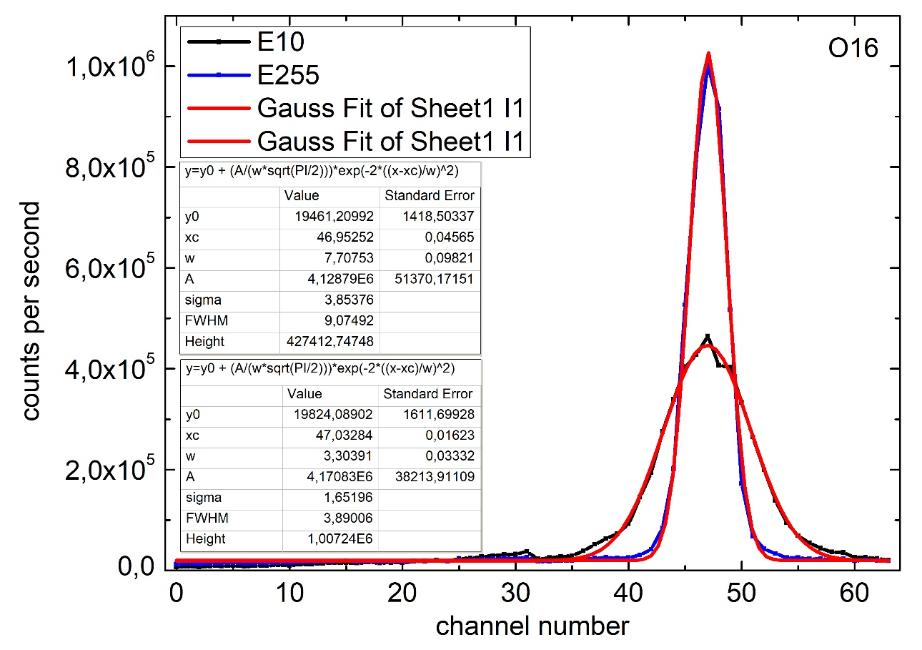
Energy comparison
Oxygen with E#10 and E#255 (1.5e6 pps)
Higher Energy (same intensity)
→ smaller spot (=FWHM)
Area A is the same
difference: 0,01%
y0 = x ± ~8%
xc = x ± ~0,1%
w = x ± ~0,13%
A = x ± ~0,12%
W, FWHM, σ: Faktor /2,34
Height: Faktor *2,34
Intensity determinable by area A of the fit.

Slide 17
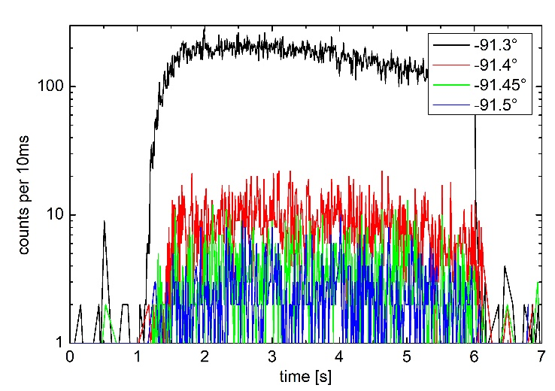
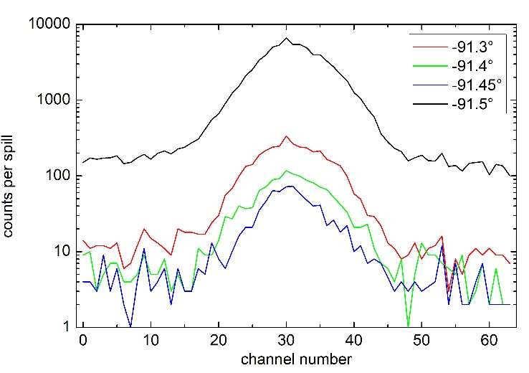
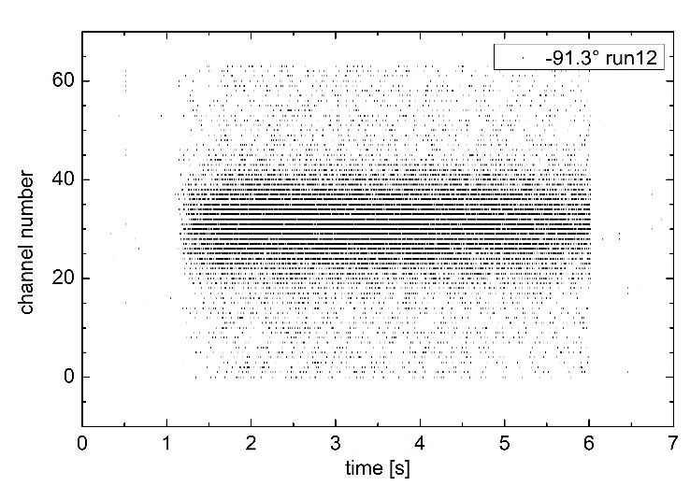
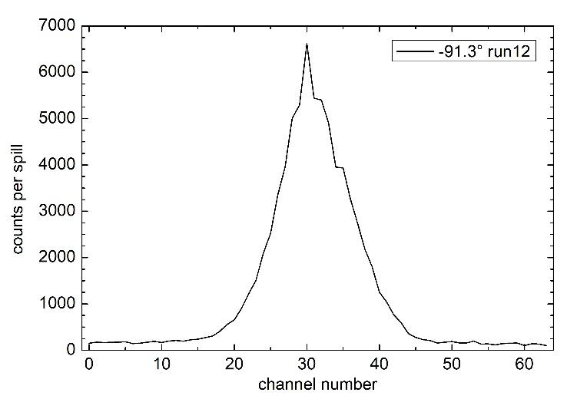
Timing Mode
Angle Comparison
C12 E255 F4 I1 -91.??°

Slide 18
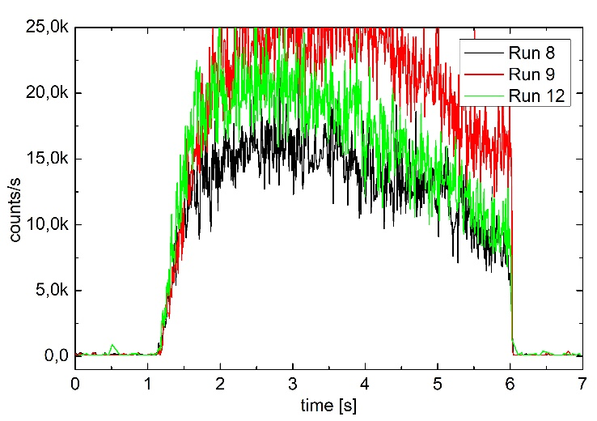
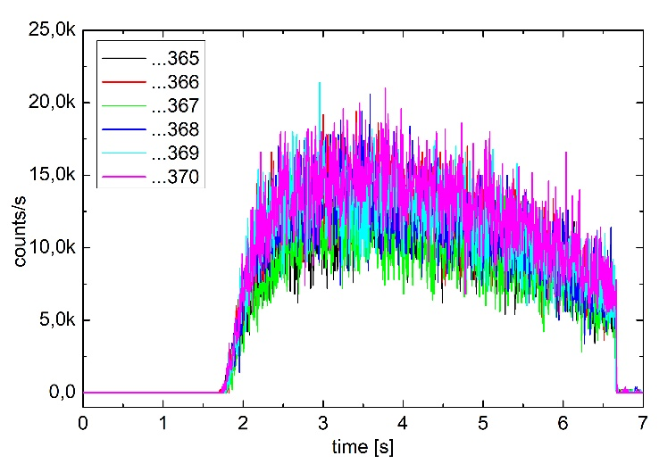
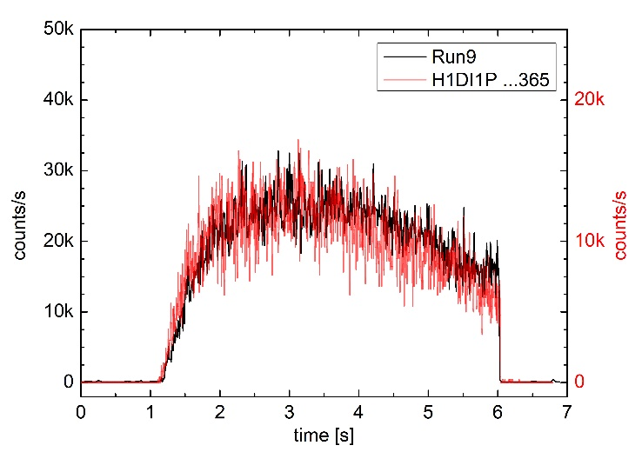
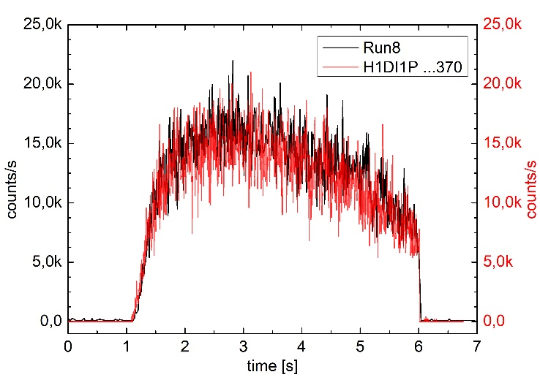
Timing Mode
Comparison with integrated scintillator
C12 E255 F4 I1 -91.3°
“Run”:
my detector
“H1DI1P…”:
integrated
scintillator
in accelerator
→ Spill form is
really good
comparable
(except intensity
fluctuations)

Slide 19
Conclusion
Prototype successfully proven to measure:
  Beam position and width
  Intensity (spill form)
  Tracking single ions (time stamp)
Limits:
  1.8 MB data throughput, due to “how data is packed and transmitted in the links“
    one full set of data takes 2776 bits (≈ 350 bytes)
  Counting: Data loss, if too short time intervals, e.g <200µs resolution.
  Data loss, if to many ions/s, e.g >10^7 ions/s.
  Timing: Data loss, if to many ions/s, e.g >5*10^4 ions/s.

Slide 20
Outlook
More and more direct comparison to BAMS (HIT), Timepix (Tim) and SciFi-monitor (PI).
Counting mode will be faster with Zero-Suppression
(Caen promised program update within weeks)
FERS A5202 & DT5215 for second detection layer are in order process and will be delivered in December & January
  Concentrator Board and TDlink will allow data throughput of 60 MB/s (~170 000 events/s possible: 200µs -> ~6 µs time windows in counting)
  Prototype extension: vertical plane & quadratic fibers.

Slide 21
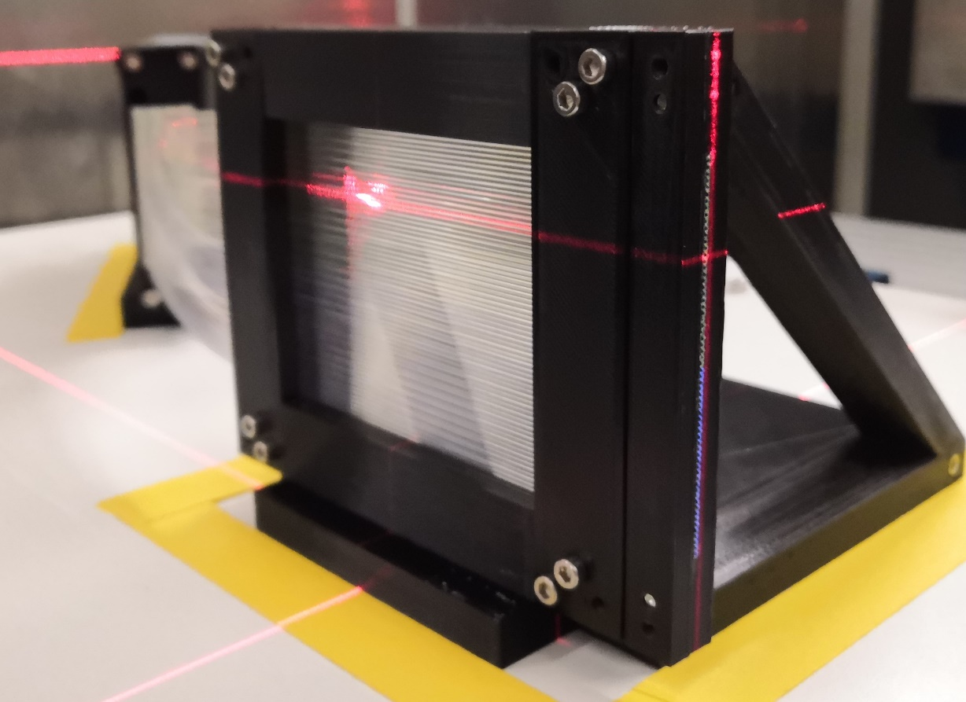
End
Questions?
With special thanks to:
HIT
Andreas Peters
Prof. Thomas Haberer (Supv.)
Michael Galonska
Christian Schömers
Eike Feldmeier
Andreas Gaffron
Stefan Brons
Rosi Vay-Meyer
DKFZ
Tim Gehrke
Maria Martisikova
Phys. Inst. HD
Blake Leverington
Sebastian Bachmann
Uni Frankfurt
Prof. Ulrich Ratzinger (Supv.)
UK HD
Prof. Oliver Jäkel
INFN
Romualdo Santoro

Slide 22
Appendix
Extra Slides

Slide 23
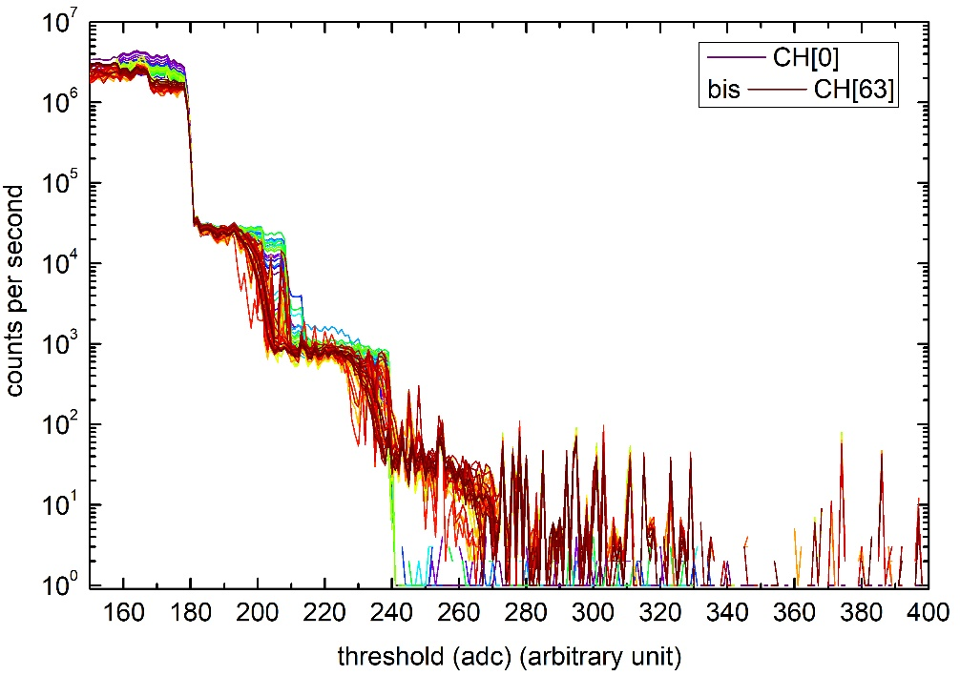
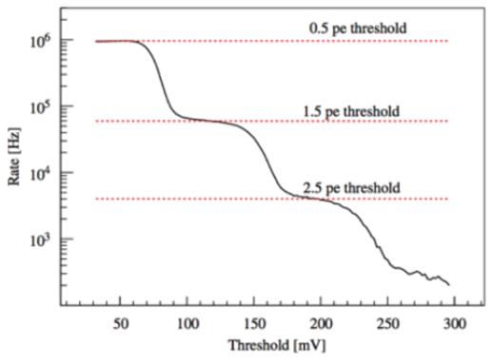
Dark Count Rate (DCR) measurement
Threshold Scan
Different Threshold-Values: 220, 300, 340, 360 (arbitrary units)
→ Threshold um 350 seems good
1 p.e. are due to dark counts
2 p.e., 3 p.e., etc. are due to crosstalk
S-curve / staircase plot
https://hub.hamamatsu.com/jp/en/technical-note/how-sipm-works/index.html
Notes:
Channels equals millimeters as I use 1mm fibres.
So 64 channels are 64 mm (with 1mm resolution) in y-direction
Counts per second means: the summed clics (fire processes) of a SiPMs – every channel is a SiPM

Slide 24
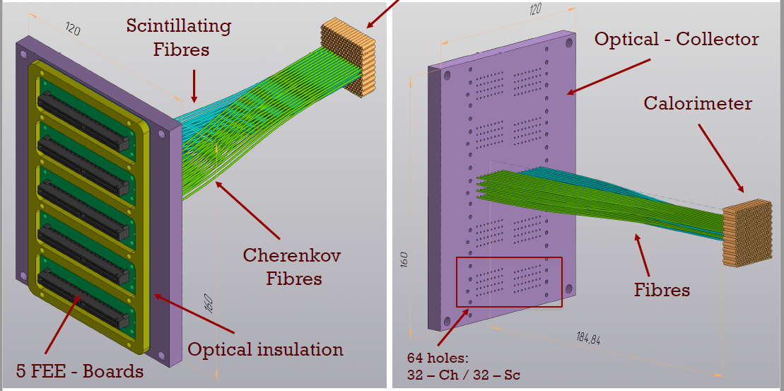
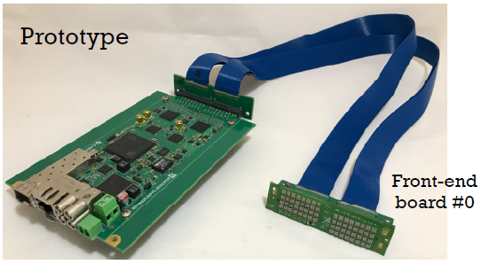
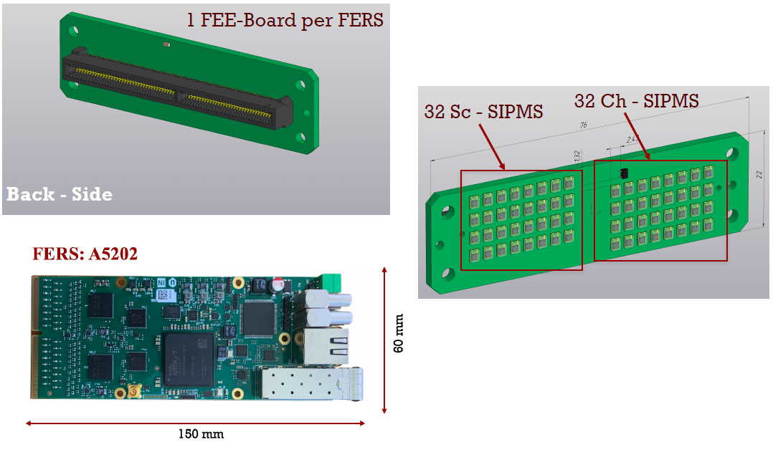
State of the Art
INFN – R.Santoro – INFN
IDEA Dual-Readout
calorimeter collaboration
- R. Santoro (INFN)
Also:
SiPM + FERS A5202
Romualdo Santoro, „IDEA DR Calorimeter: readout electronics“ , Univeristàdell’Insubria and INFN-MI, 2021

Slide 25
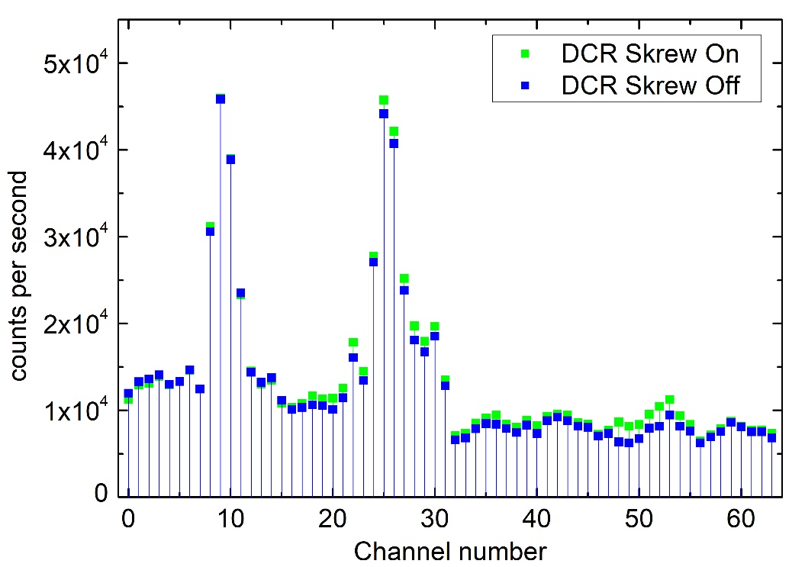
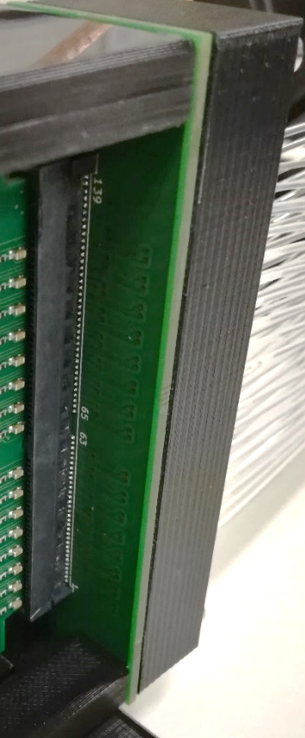
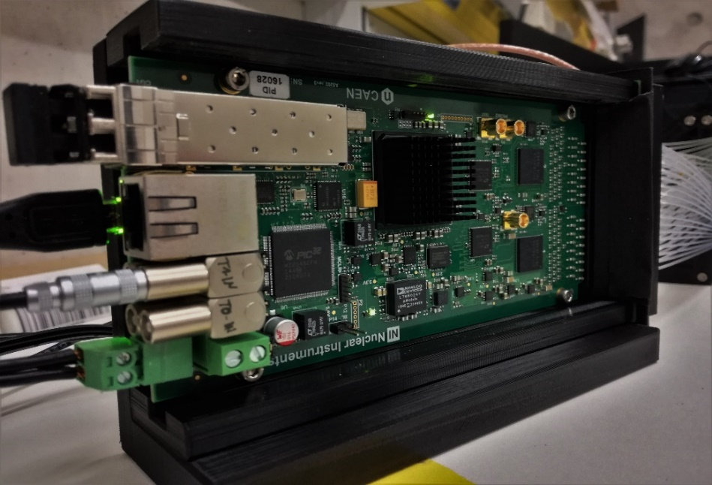
Dark Count Rate (DCR) measurement
Strange peaks
Light leaks from behind through pcb through-holes.
Status-LEDs

Slide 26
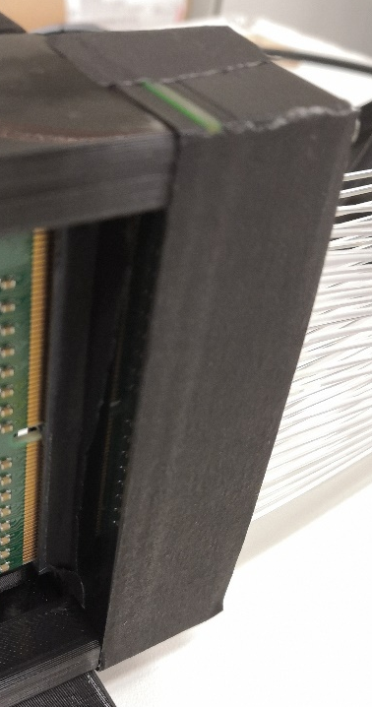
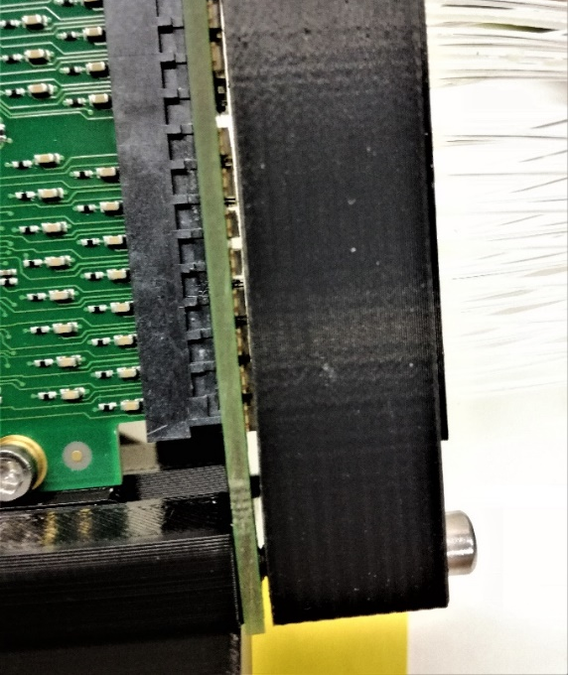
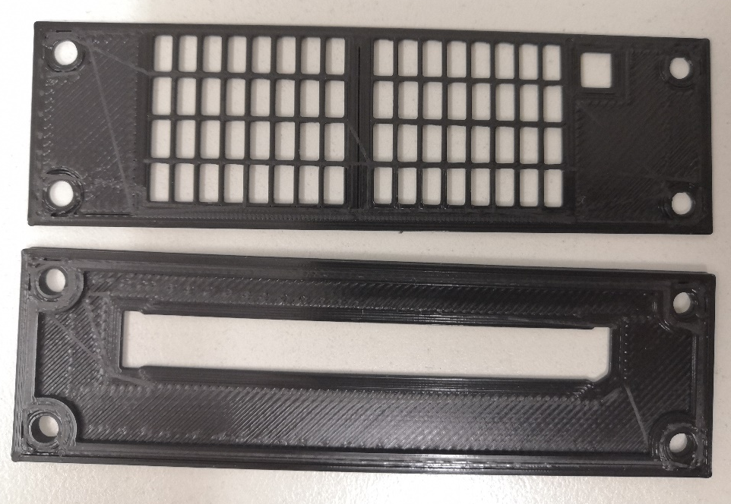
Dark Count Rate (DCR) measurement
Strange peaks
Light leak through through-holes
And: Gap on the side
  → 3D print for light protection
gap
tight

Slide 27
I
Szintillationsfasern

Slide 28
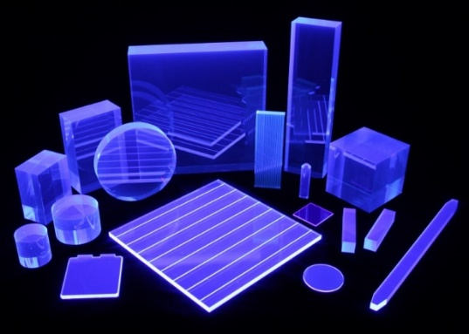


Scintillator
Organic
Scintillation:
Alternation of free valence electrons between molecular orbitals.
Typical: Benzene ring circumferential e-
Pro: Fast (ns) - intensity determinable, magnetic field insensitive, fibres enable position measurements, (+ advantages slide 6)
Contra: No energy measurement possible (non-linearity & saturation), defined radiation hardness and therefore defined lifetime – can’t be refurbished
https://scionix.nl/frame/
E. Auffray, „Scintillation Detectors“, CERN, EP-CMX technoweek School 2021
Notes:
S: Elekton energy levels (excited states) – within these levels are molecular vibration modes (fs decay)
S = Total Spin Quantum Number → Singulet: antiparallel 2*S+1= 1 / Triplett parallel spin 2*S+1=3
pi-Elektronen: nicht an ein atom gebunden, sondern nicht lokalisierbar im benzol-ring „Molekülorbital“
Transitions: allowed, forbidden, non-radiant, …
Szintillating process has something to do with light generation out of ions passing through material.
Anorganic scintillators: crystals for example used in PET scanner.
Organics one could combine with plastic, or are itself some kind of plastic.
Fast: Excitation & then Nanoseconds decay via flurescense

Slide 29

Scintillator
Plastic scintillators and fibers
Stokes-Shift:
Difference between maxima in absorption and emission.
  Carrier medium
  Primary scintillator
  Wavelength shifter
1. Primary ionization => excitation of molecules in the base polymer
2. De-excitation of the base polymer [theoretically produces scintillation photons (~ 300 nm)] => Energy transfer directly to the fluor in a very short distance.
3. Primary fluor emits at a longer wavelength (~ 340 nm),
4. Absorbed by a secondary fluor
5. Secondary fluor emits in the visible (~ 400 nm)
6. Detect by photodetector
E. Auffray, „Scintillation Detectors“, CERN, EP-CMX technoweek School 2021
Notes:
- mechanism of energy absorption: energy is first absorbed by the solvent, then passed onto the scintillation solute (the details of the transfer are not clearly understood)
- Emission has longer wavelength (lower energy)

Slide 30
Scintillating fibers
Radiation hardness
Kuraray SCSF-3HF multiclad
  3-hydroxyflavone
  Smaller radiation damage than other fibers *
  Lifetime & attenuation length also dependent on bending and on temperature of the fiber. *
  annealing effect in days/weeks/months, total and none at all **
  20% loss where Kuraray SCSF-78 multiclad has 60% loss ***
Kuraray 3HF multi clad
Kuraray 78 multi clad
*Radiation damage in scintillating fibers -Preliminary literature study- ; Michael Moll, CERN, 15.10.2003
** A fiber detector radiation hardness test, J Bähr et al., Nuclear Instruments and Methods in Physics Research Vol 449, 11.08.2000
*** Preliminary radiation damage analysis for the HIT beam profile monitor; M.Dziewiecki, B.Leverington, G.Meo; Heidelberg 13.02.2018

Slide 31

Scintillating fibers
Cladding
E.g. Kuraray
“polystyrene core (inner side) with a fluorescent agent and a methacrylate cladding (outer side)”
https://www.kuraray.com/products/psf
Notes:
Deshalb trapping recht schlecht

Slide 32
II
SiPM

Slide 33





Photomultiplier
Silicon Photomultiplier (SiPMs)
APDs: 50 x 50 µm²
Avalanche-Photodiode:
Semiconductor equivalent
of a photomultiplier.
SiPM:
50µm APDs on 1,3x1,3mm² active area
= 667 pixels
Pro: Fast (ns) - intensity determinable,
magnetic field insensitive; (+ advantages slide 6)
Contra: No energy measurement possible (Geiger-Mode), radiation damage – aging
*
**
*Von Kirnehkrib - Eigenes Werk, CC BY-SA 3.0, https://commons.wikimedia.org/w/index.php?curid=17725203
**Hamamatsu, MPPC Technical Note
Cat. No. KAPD9008E01 Apr. 2021 DN
Notes:
SiPMs consist of …

Slide 34


Detector principal
SiPM (Silicon-Photomultiplier)
The primary waveforms (1 p.e.) are due to dark counts; whereas, 2 p.e., 3 p.e., etc. are due to crosstalk
https://hub.hamamatsu.com/jp/en/technical-note/how-sipm-works/index.html

Slide 35
III
FERS

Slide 36
Electronics
The CAEN FERS
Measurement Modes:
  Counting Mode
  no dead time (except saturation), max. 20Mcps/channel
  Timing Mode
  TOA (25-bit), dynamic range ~16,78ms (2^25 *0.5ns)
  Time Stamped Spectroscopy:
  TOA (16-bit) + TOT (9-bit), dynamic range ~32,77µs
  Spectroscopy Mode
  Amplitude conversion by 13-bit ADC (~10µs dead time)
Data Throughput: 1.8 MB/s (due to data packaging → 200µs time windows)
User Manual UM7945, A5202/DT5202; 64-Channel Citiroc-1A Unit for FERS-5200; Rev. 2 - September 9th, 2021

Slide 37

Readout
FERS A5202 (CAEN)
User Manual UM7945, A5202/DT5202; 64-Channel Citiroc-1A Unit for FERS-5200; Rev. 2 - September 9th, 2021

Slide 38

Readout
FERS A5202 (CAEN)
User Manual UM7945, A5202/DT5202; 64-Channel Citiroc-1A Unit for FERS-5200; Rev. 2 - September 9th, 2021

Slide 39

Readout
FERS A5202 (CAEN)
User Manual UM7945, A5202/DT5202; 64-Channel Citiroc-1A Unit for FERS-5200; Rev. 2 - September 9th, 2021

Slide 40
IV
Simulation

Slide 41





Sideproject – Simulation Geant4
LHCb-tracker Simulation adapted
Only first adaptions: size, material, readout cells
6x250µm fiber mat 1x1mm fiber mat
BUT Output file/-plots not yet useable (e.g. pixels not correctly assigned)
Kein Signal
Crosstalk

