Slide 1
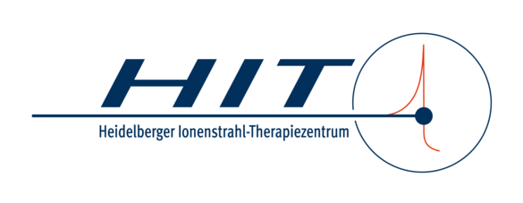
Quantitative helium-beam radiography _{(αRad)} with high-energy beams
T. Gehrke^{1,2,3}
M. Metzner^{2,3}, Yanting Xu^{2,3}, F. Kehrein^{2,3}, R. Hermann^{1,4,5}, C. Schömers⁴, S. Scheloske⁴, S. Brons⁴, A. Peters⁴, O. Jäkel^{2,3,4}, M. Martisikova^{2,3}
¹ Department of Radiation Oncology, Heidelberg University Hospital, Im Neuenheimer Feld 400, Heidelberg, Germany
² Department of Medical Physics in Radiation Oncology, German Cancer Research Center (DKFZ), Im Neuenheimer Feld 280, Heidelberg, Germany
³ Heidelberg Institute for Radiation Oncology (HIRO), National Center for Radiation Research in Oncology (NCRO), Im Neuenheimer Feld 280, Heidelberg, Germany
⁴ Heidelberg Ion-Beam Therapy Centre (HIT), Im Neuenheimer Feld 450, Heidelberg, Germany
⁵ Goethe University Frankfurt, Institute of Applied Physics, Frankfurt, Germany

Slide 2
Helium-beam radiography (αRad) – Application in Ion-beam therapy
Important to detect any uncertainty on the treatment day
like anatomical changes or
uncertainties on relative stopping power (RSP)
based on x-ray CT
Verification of WET-map
from planning CT in treatment position!
Low-dose αRad @ day of treatment
Direct information on $WET=\int_{entr.}^{exit}{RSP\left(z\right) dz}$:
avoiding conversion
from photon-imaging
to physics of ions.
⁴He
@ high energy
?
WET_{meas} = WET_{CT}
Simultaneous patient-positioning is feasible
Low-dose ion imaging:
Collins-Fekete et al., 2021; PMB 66(105009)
Proton radiography for QA:
Schneider et al., 2004; MedPhys 22(4) &
?
WET_{meas} = WET_{CT}
⁴He
@ high energy

Slide 3
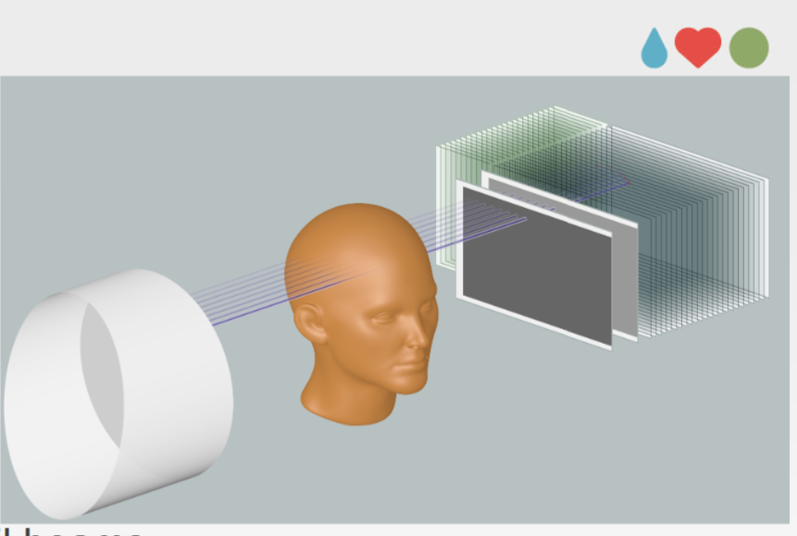
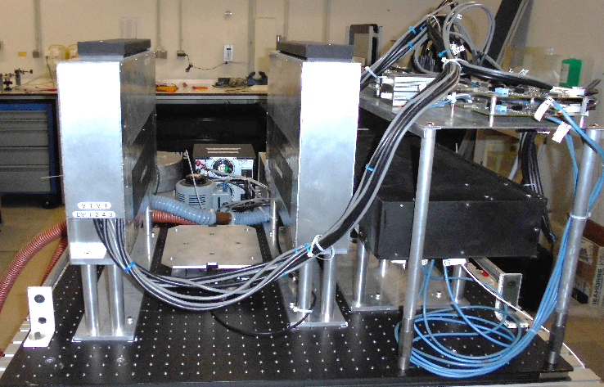
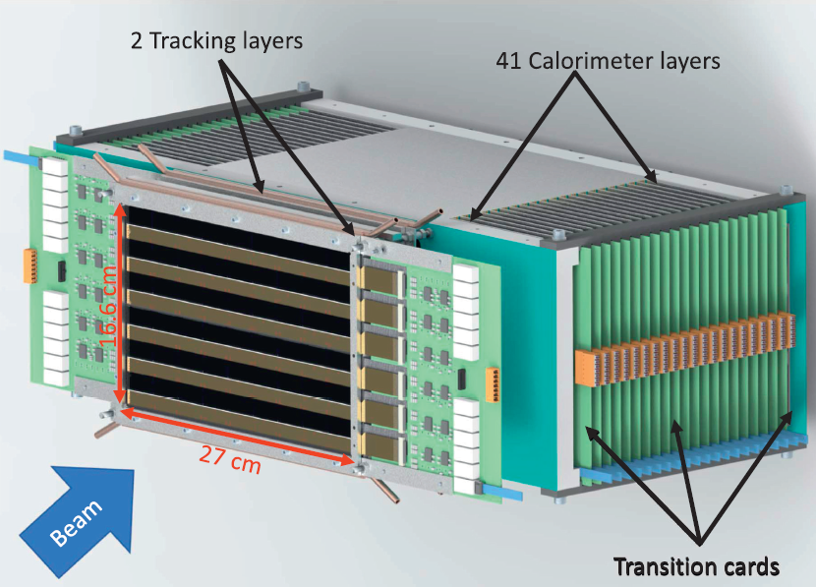
Ion imaging – Detection systems worldwide
US pCT group:
2002 – 2016
built phase I & II detection systems
considered to be gold standard system
Bergen pCT group:
2017 – 2021
building single-sided detection systems
Incredible amount of 4644 MAPS chips
CAD model (Alme et al 2020, Front. Phys.)
E/Range detector (scintillator & PMTs)
Front & rear trackers (silicon strip detectors)
Even more groups: OPTima @ The Christie (UK); ProtonVDA company @ Chicago Proton Center (US)
?
WET_{meas} = WET_{CT}
⁴He
@ high energy

Slide 4
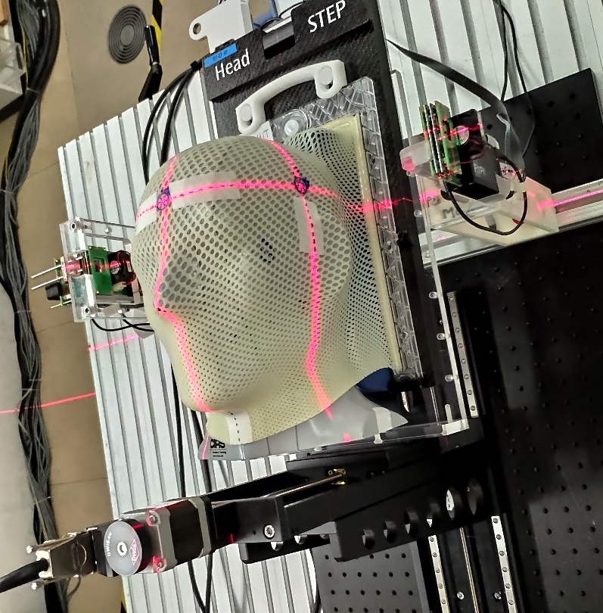
Ion imaging – Our current detection system
αRad at HIT/DKFZ/UKHD
2016 – now
Compact and very thin
US pCT group:
E/Range detector (scintillator & PMTs)
Front & rear trackers (silicon strip detectors)
?
WET_{meas} = WET_{CT}
⁴He
@ high energy

Slide 5
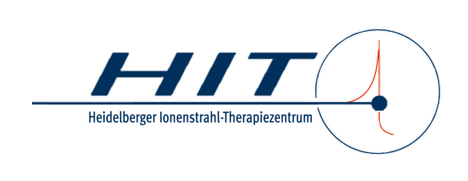
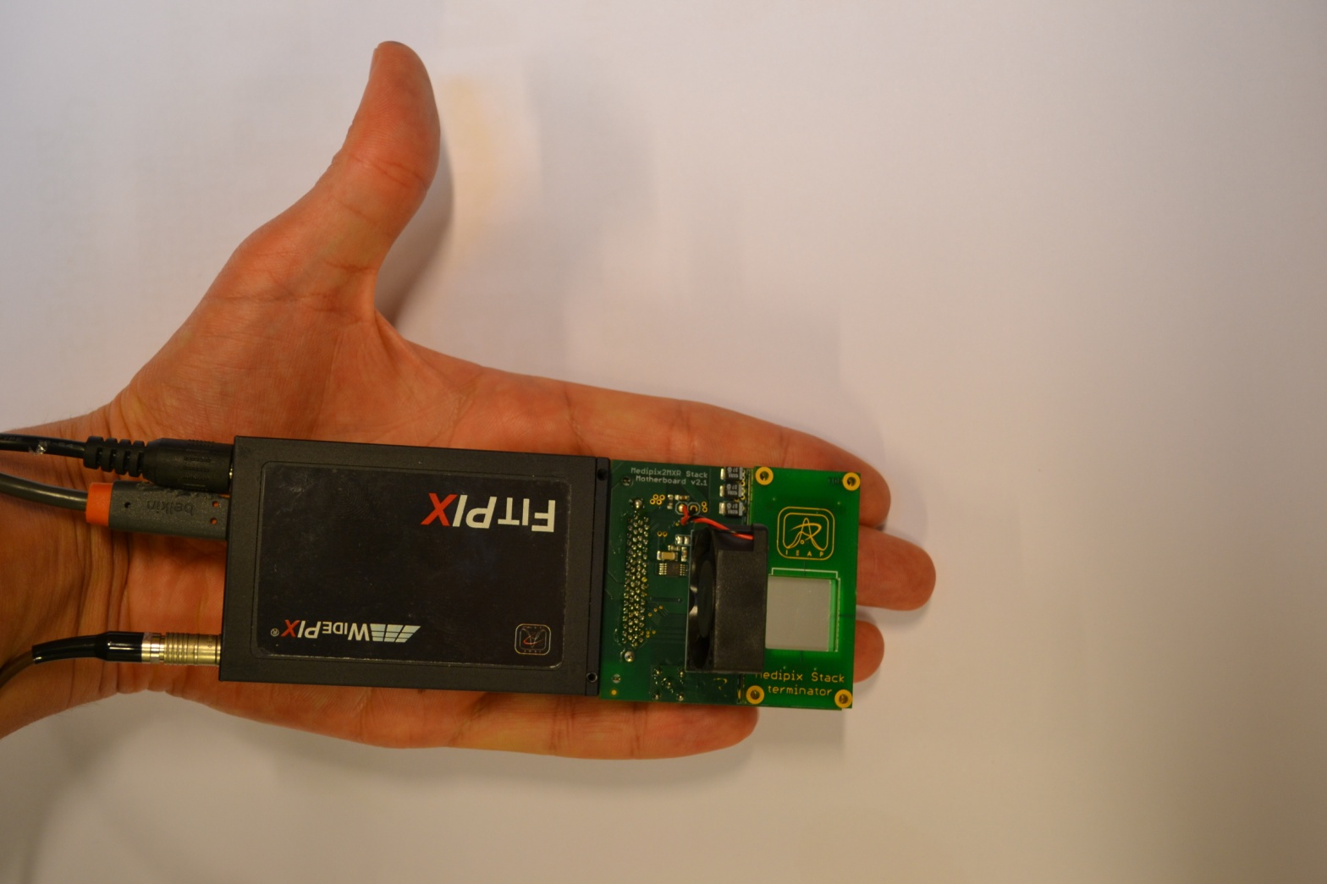
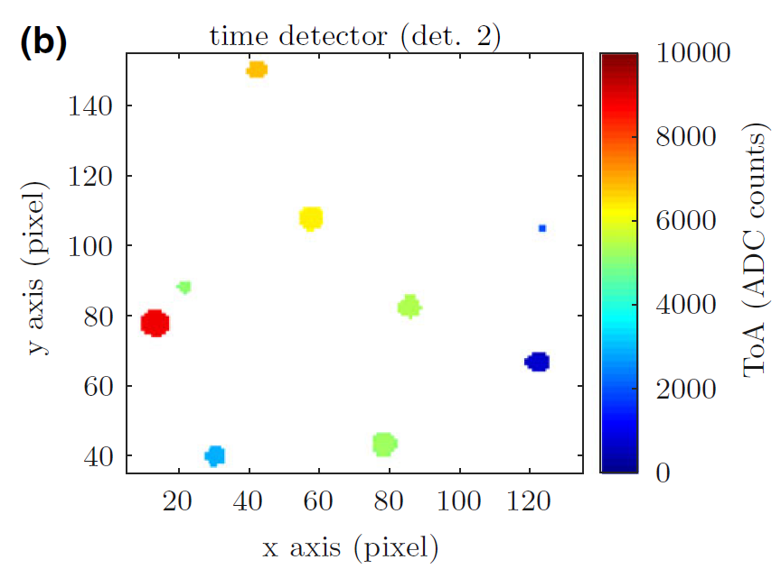
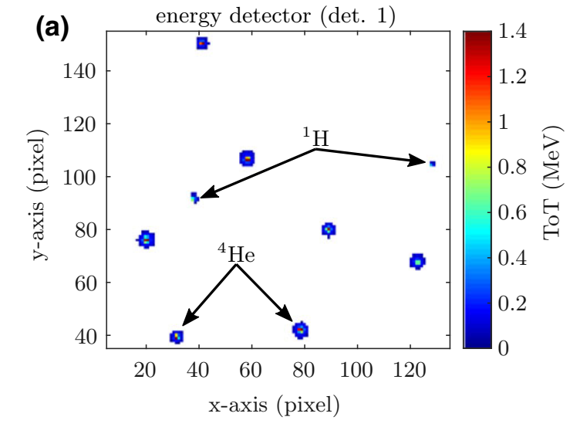
Detection system – based on silicon pixel detectors
sensitive
Si-layer+
TPX chip
operating
principle
read-out interface
Position + time
Position + dE + ion ID
MLP:Schulte et al., 2008, Med.Phys. 35(11)
Collins-Fekete et al., 2015, PMB 60(13)
Timepix: Llopart et al., 2007, NIM A 581(1-2)
Detection system: Gehrke et al., 2018, PMB 63 035037; Amato et al., 2020, MedPhys 47(5)
MLP:Schulte et al., 2008, Med.Phys. 35(11)
Collins-Fekete et al., 2015, PMB 60(13)

Slide 6
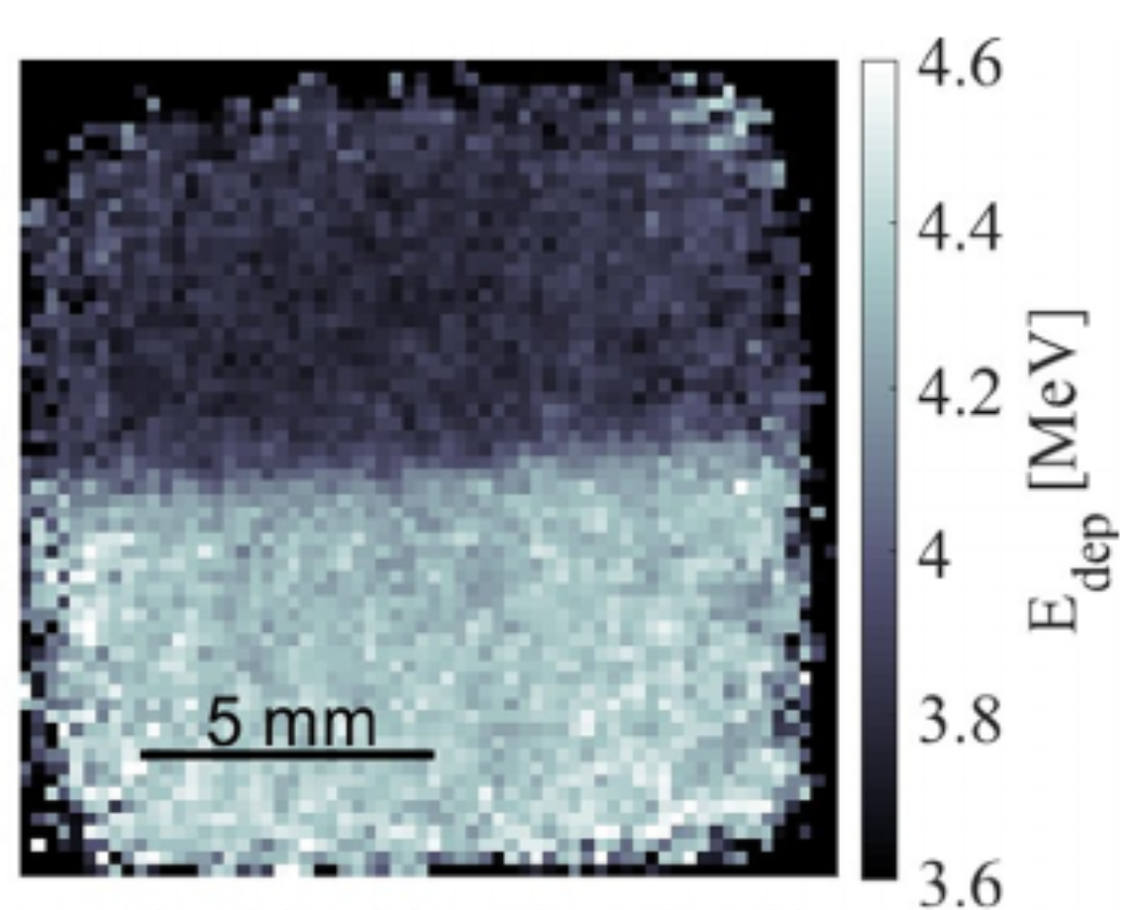
Previous results & current research questions
…for head-sized objects:
Spatial resolution (SR) MTF_{10%}=0.6 lp/mm
Can we perform quantitative αRad, i.e. obtain WET maps?
Can we image the pelvis/abdomen region (WETs up to 320 mm) with sufficient image quality?
WET resolution 0.6 % @ 350 µGy, 0.22 mm pixel pitch
(object’s WET =190 mm)
Spatial & WET resolution: Gehrke et al., 2018, PMB 63 035037;
Amato et al., 2020, MedPhys 47(5)

Slide 7
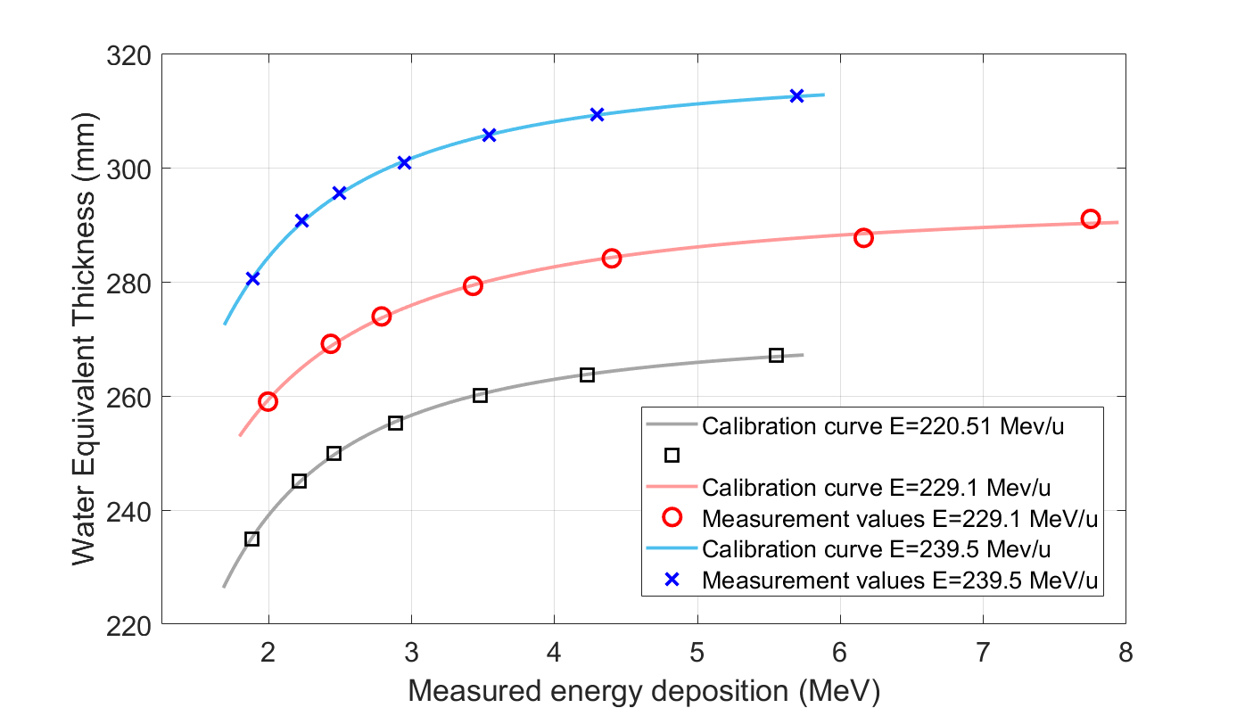
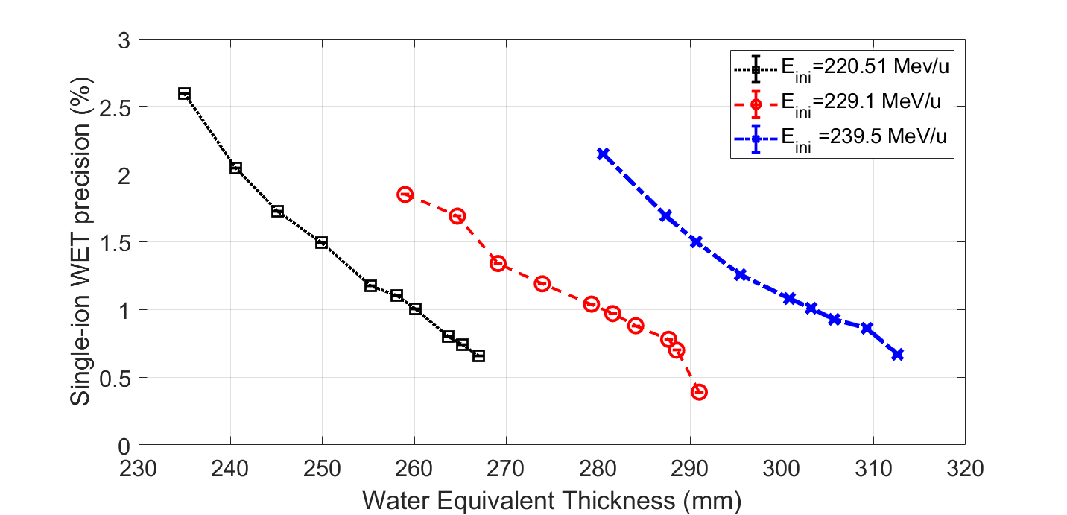
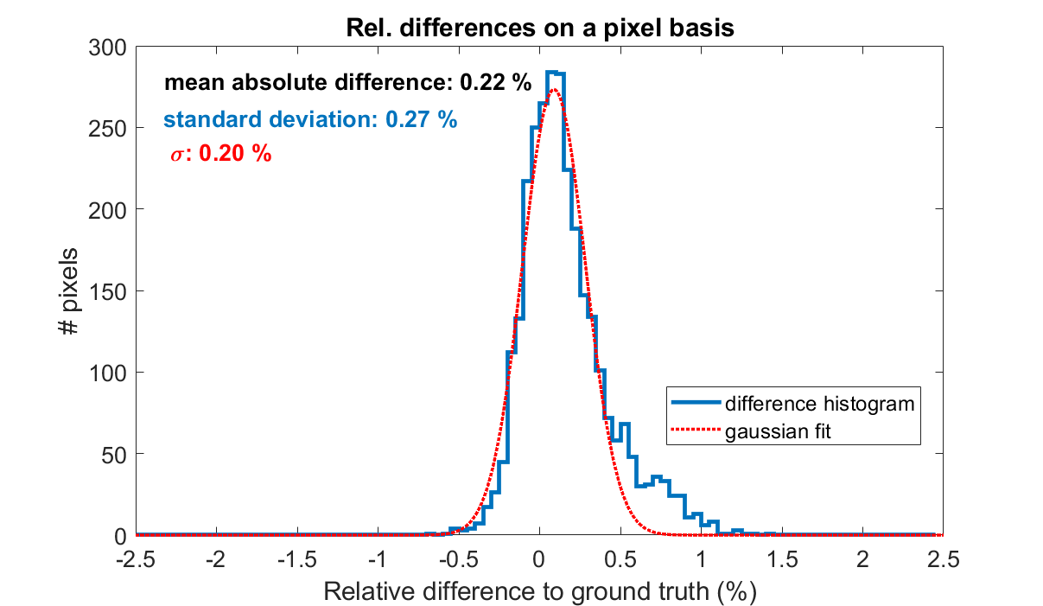
Quantitative αRads @ high initial energies → WET maps
Newly established ⁴He beams at HIT: up to 330 MeV/u → 600 mm range
Quality assessment of WET maps
I Single-ion WET precision (σ_{WET})
preliminary
0.7% ≤ σ_{WET} ≤ 1.6% for WET range [250 mm, 313 mm]
Calibration function:
Comparison to US pCT prototype II: 0.8% ≤ σ_{WET} ≤ 1.6%, WET range [180 mm, 240 mm]
$$WET=R_{0} − {\left(p∙α^{1/p}∙\left(dE\right)\right)}^{p/(1−p)}$$
dE/dx – WET:
Bortfeld, 1997, MedPhys 24(12)
WET precision, US pCT phase II:
Bashkirov et al., 2016, MedPhys 43(2)

Slide 8
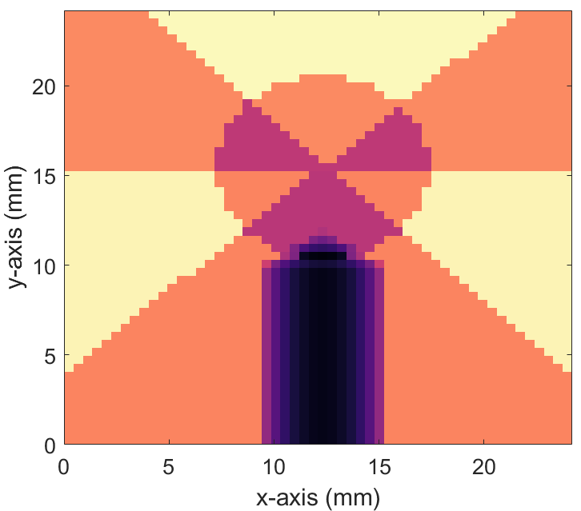
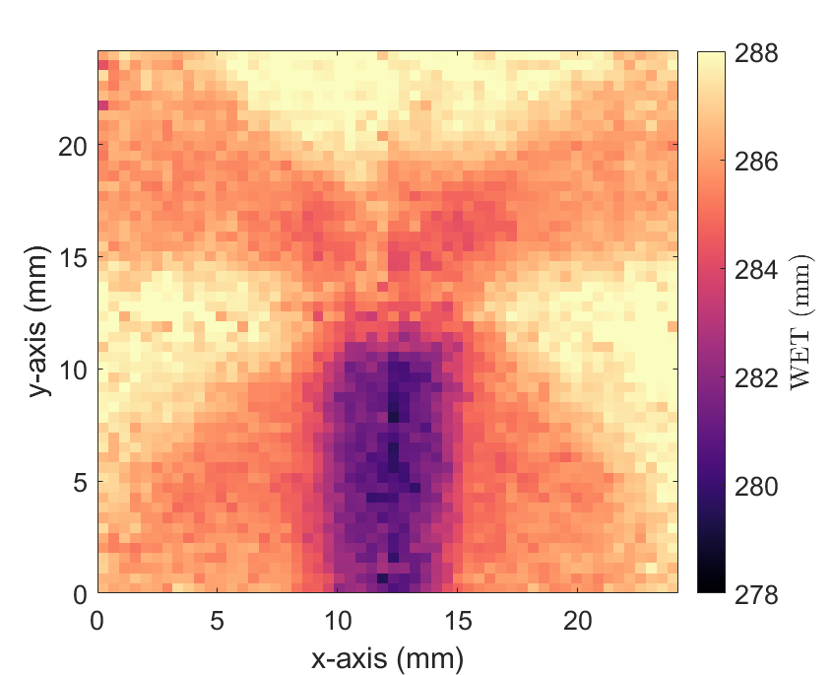
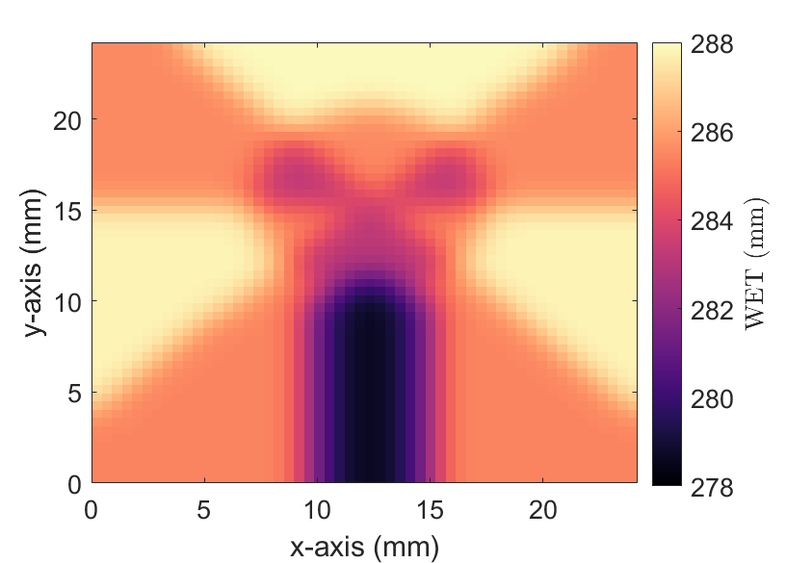
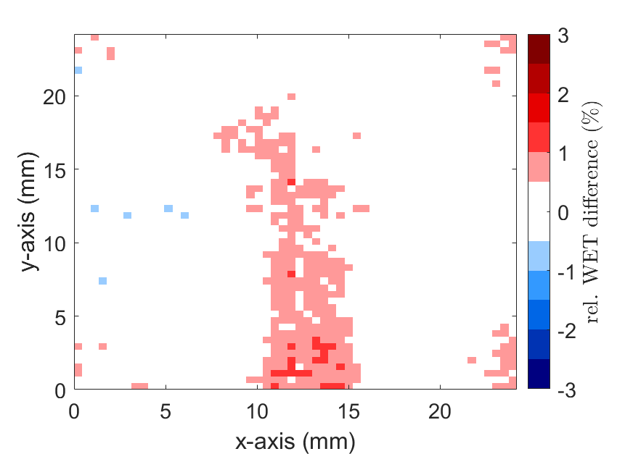
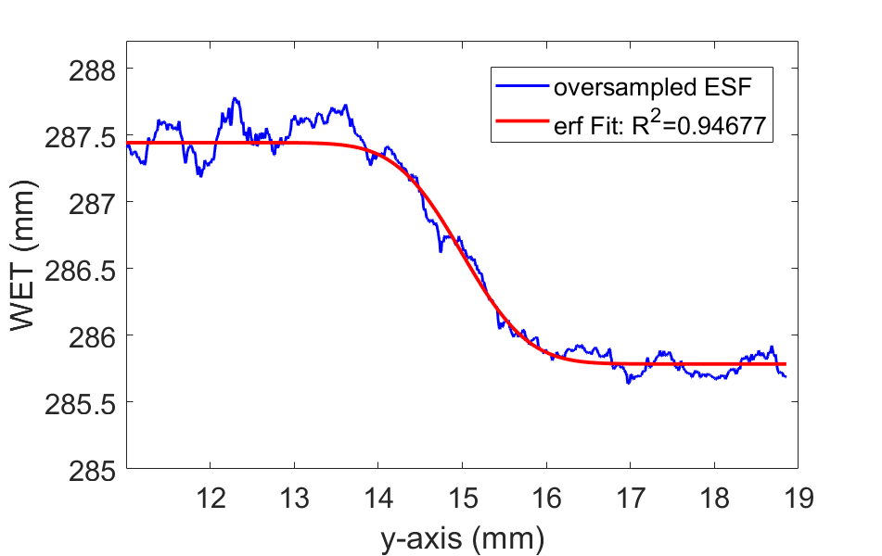
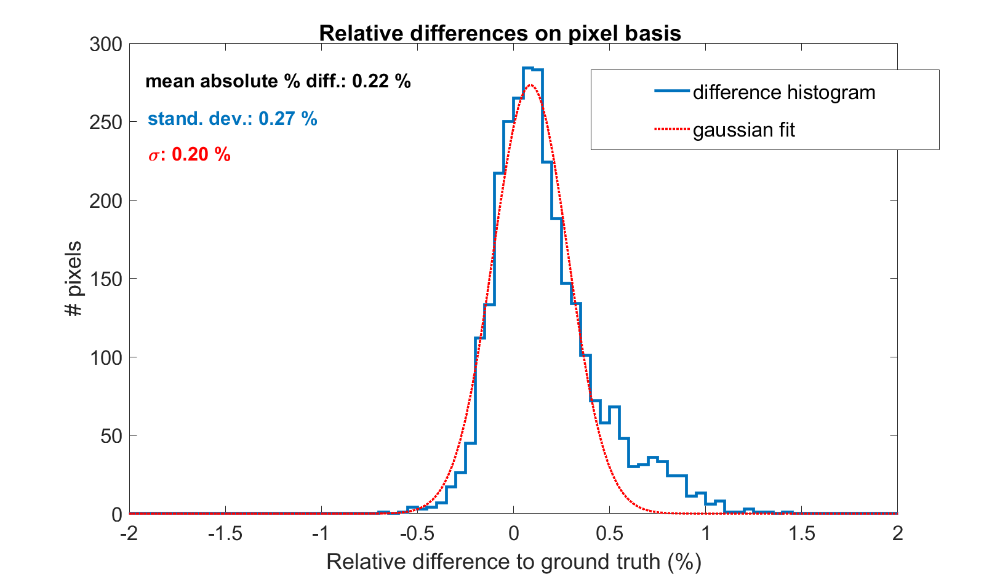
Quality assessment of WET maps
II Spatial resolution (SR)
III WET accuracy
Ground truth (GT)
αRad
GT ∗ GaussKernel
Rel. difference map
MTF_{10%}= 0.46 lp/mm @ WET_{obj} = 286 mm!
Comparison to HeRad with US pCT prototype II: MTF_{10%}= 0.61 lp/mm @ WET_{obj} = 100 mm
MAPD=0.22 %
preliminary
HeRad with US pCT II - SR:
Volz et al., 2017, CDBME 3(2)

Slide 9
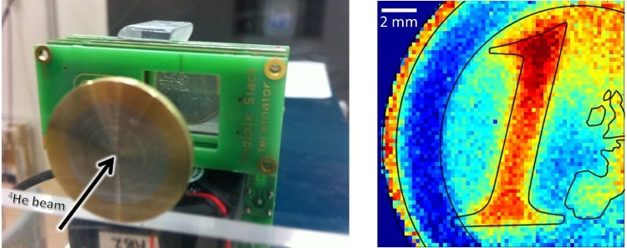
Conclusion
The presented method provides helium-beam radiographs with high image quality even for thick objects (~300 mm WET):
Single-ion WET precision: < 1.6 %
WET accuracy: MAPD=0.22 %
Spatial resolution: MTF_{10%}=0.46 lp/mm
1.5 σ, 10 ions per pixel => 0.8 % vs. 2.4 % of CT
vs. 0.33 lp/mm of CT_{1.5 mm slice thickness}
Visual indication that imaging of thin & head-sized objects works:
DECT
αRad

